Slide 1
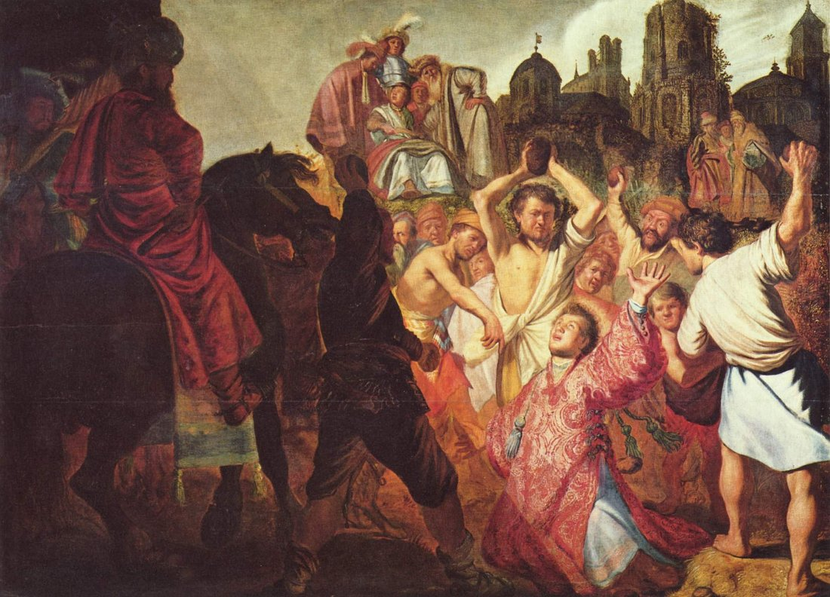
Martyrs: God’s Witnesses

Slide 2
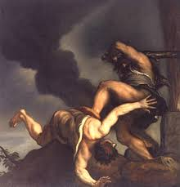
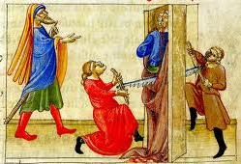
A Jewish Precedent
The OT Response to God’s Servants:
Matt. 23:34f –
Abel to Zechariah
Genesis to 2 Chronicles
Heb. 11:35b-38 –
Ultimate Faith
Mark 12:1-12 –
Rejection and Murder

Slide 3
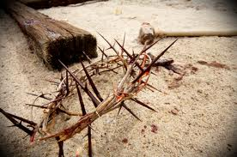
Same Old Story in the New Testament
The Martyrdom of Jesus
Illegal Trial
Illegal Condemnation
Illegal Capital Punishment
All for No Cause
Jesus Ensures the Same Response to His Disciples
The Nature of It? Matt. 10:28-34
The Reason? John 15:18-16:4

Slide 4
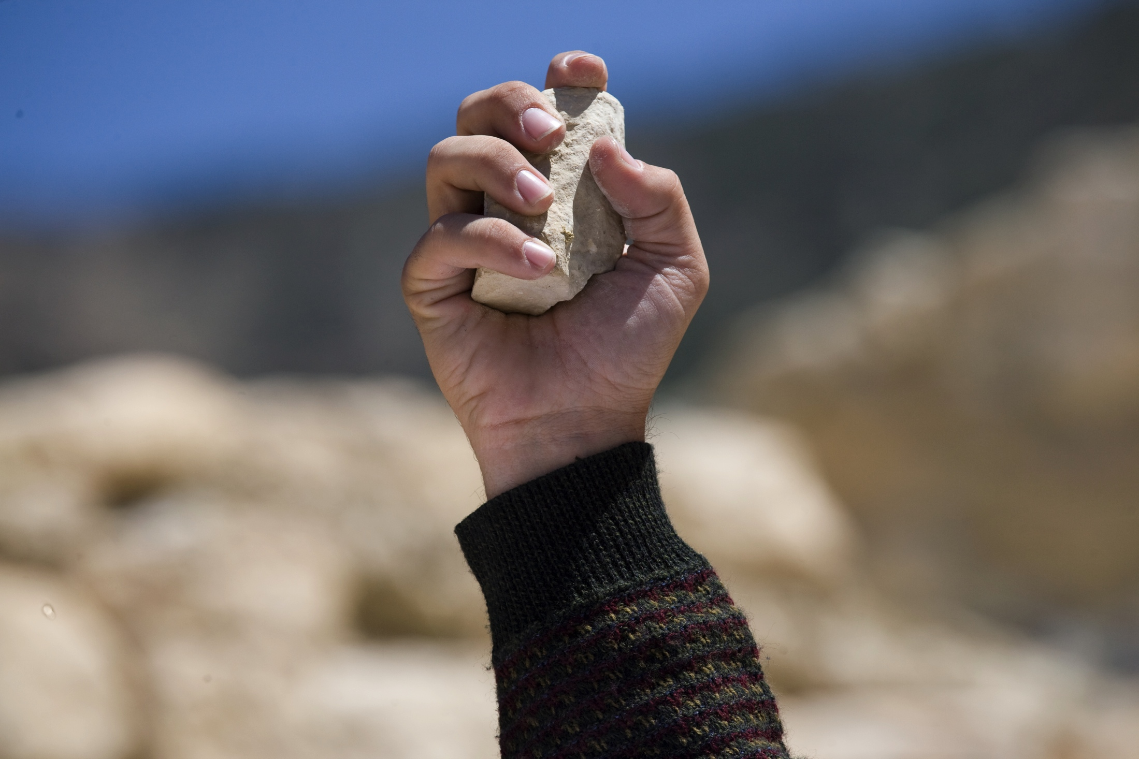
New Testament Martyrdom
John the Baptist (Mt. 14:3-12)
The Book of Acts
Stephen (7:52, 54-60)
After Stephen (8:1-3; 9:1)
James, the Apostle (12:1-3)
The Book of Revelation
Antipas (2:12f)
The Souls Under the Altar of God (chapters 6, 17, 20)

Slide 5
Fox’s Book of Martyrs
Peter – Crucified Upside Down
Jude (Thaddeus) – Crucified
Bartholomew – Filleted Alive and then Crucified
Simon the Zealot – Crucified
Andrew – Crucified on an x-shaped cross
Thomas – By a Spear
Matthew – By a Halberd
Matthias – Stoned and then Beheaded
Philip – Crucified
Paul – Beheaded
Luke – Hanged
James, Jesus’ Brother – thrown off the Temple, stoned, and clubbed
Mark – Dragged through the city for two days

Slide 6
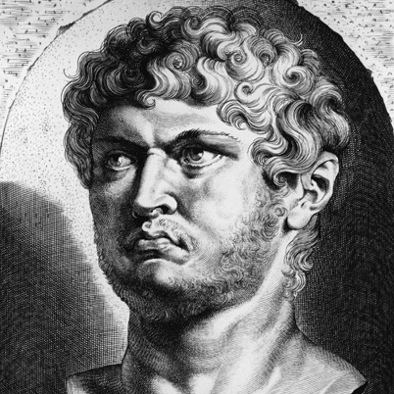
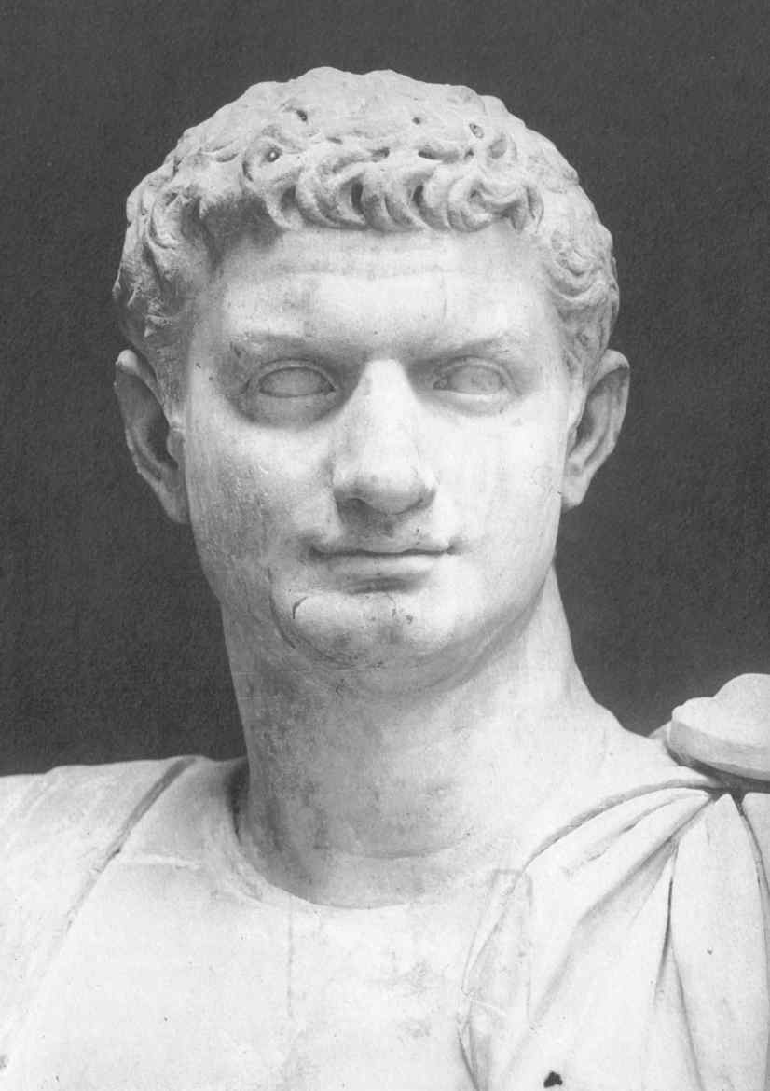
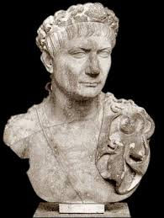
“Faithful Until Death”
Tacitus on the Persecution Under Nero
The Martyrdom of Polycarp
Ignatius
“The seed of the church is built on the blood of the martyrs.”
Justin Martyr – “You can kill us, but you cannot hurt us!”

Slide 7
Practical Applications for Us
Persecution Will Come So Be Prepared
This will involve various forms of mistreatment, some small, some not so small
We cannot allow this to separate us from God
Toil is temporary, has a goal, and brings a blessing

