Slide 1
Pain

Slide 2
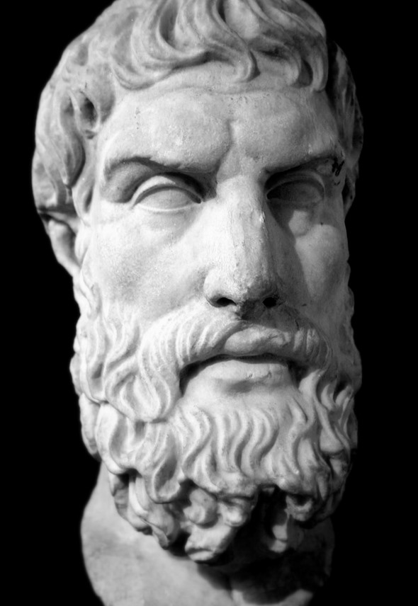
God vs. Pain
Is God willing to prevent evil, but not able? Then he is not omnipotent.
Is he able, but not willing? Then he is malevolent.
Is he both able and willing? Then whence cometh evil?
Is he neither able nor willing? Then why call him God?
Epicurus, 341-270 B.C.

Slide 3
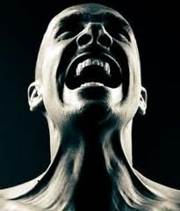
Is God To Blame?
Objective Standards
“The problem of reconciling human suffering with the existence of God who loves is only insoluble so long as we attach a trivial meaning to the word ‘love,’ and limit His wisdom by what seems to us to be wise.” (C.S. Lewis)
Pain is Sin’s Fruit!

Slide 4
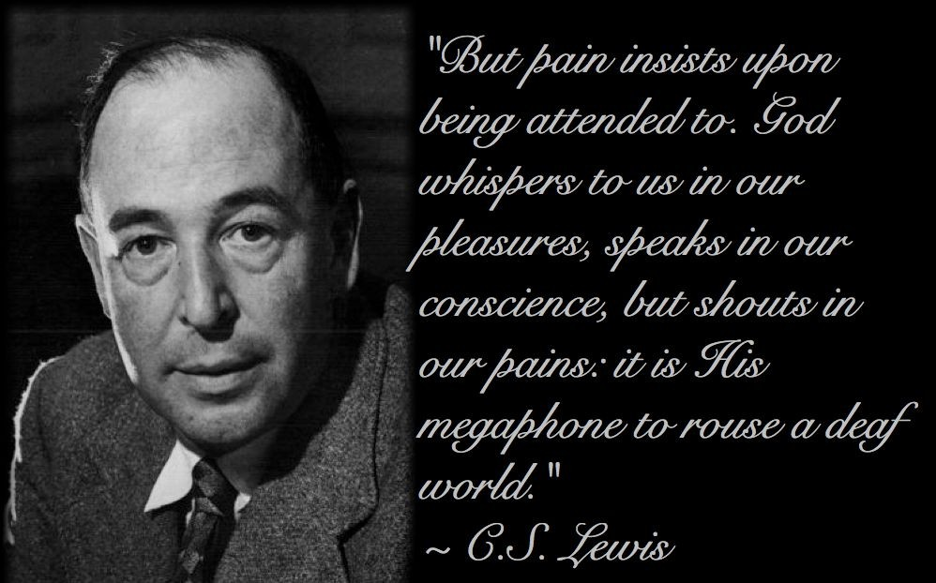
What God Has Done with Pain:
1. Pain Is God’s Megaphone

Slide 5
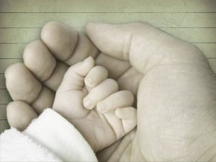
What God Has Done with Pain:
2. Pain Teaches Dependence

Slide 6
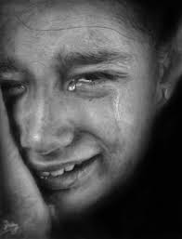
What God Has Done with Pain:
3. Pain Gives Perspective
“It’s much harder to believe that the world is here just so I can party when a third of its people go to bed starving each night. It’s much harder to believe the purpose of life is to feel good when I see teenagers smashed on the freeway. If I try to escape the idea and merely enjoy life, suffering is there, haunting me, reminding me of how hollow life would be if this world were all I’ll ever know.” (Philip Yancey, Where Is God When It Hurts?)

Slide 7
Pain Can Only Be Beneficial If…
Response is IMMEDIATE
APPROPRIATE Aid is Given
EFFORT is Made to Heal
TIME is Given to Recover

