Slide 1
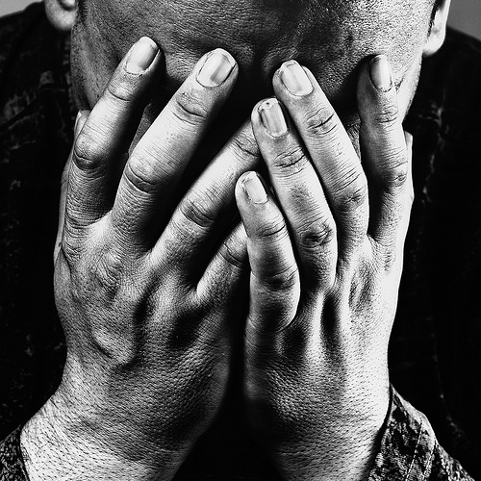
The Book of Lamentations

Slide 2
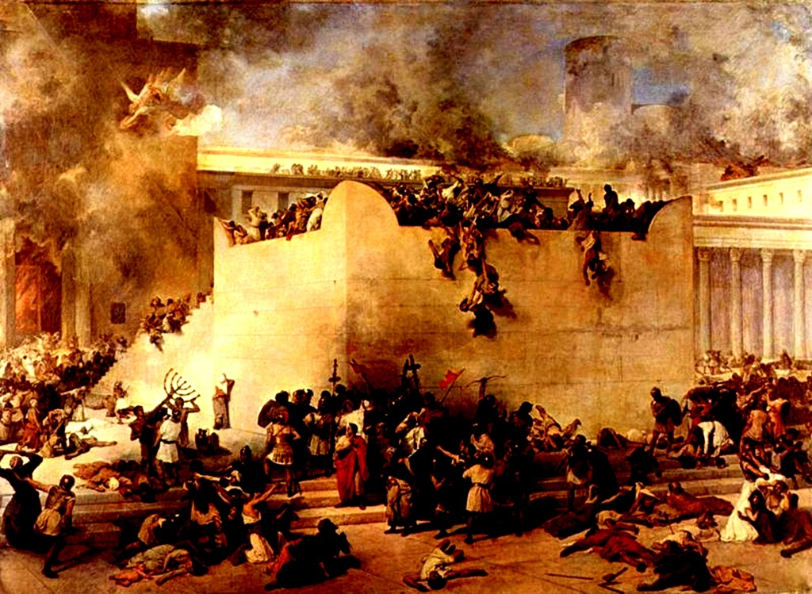
Chapter 1
1st person pronouns used 44x in 22 verses!
Description of Judgment (vv. 11-16)
Reasons for judgment (vv. 17ff)
Guilt of religious leaders (v. 19)
God is faithful (v. 18)

Slide 3
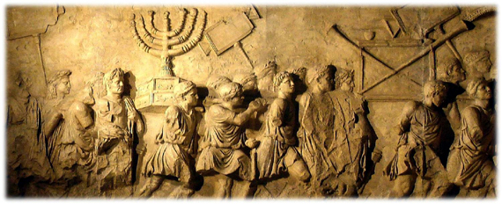
Chapter 2
The Wrath of God
Sin’s Consequence
Who could stand?! (v. 2)
Famine (vv. 11f, 19f, 21)
Upper class brought low (vv. 9f)
False Hope Exposed (Jer. 7:4, 5-7; Lam. 2:6f)
God remains faithful to the covenant (v. 17)

Slide 4
Chapter 3
Transition from hopelessness to hope (vv. 18, 21, 24)
1st person pronouns abound (70x in 66 vv.)
Sympathy for the People (vv. 1-7, 15f, 48f)
Sin’s Effect on Prayer (vv. 8f, 44; contrast vv. 54-57)
Jeremiah’s Call to Repentance (vv. 38f)

Slide 5
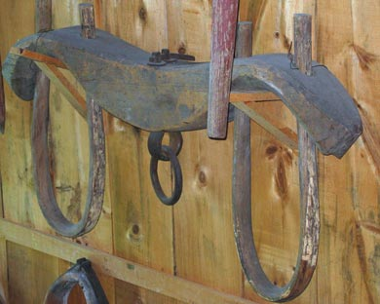
Chapter 4
Hideousness of Sin (vv. 4, 9f)
Could anyone hide? (vv. 5, 13-15)
Unfaithfulness Brought Punishment (v. 16)
“After recounting the horrors of the siege and laying the blame for the depraved spirituality of the nation at the door of the priests and prophets, the poem looks towards the restoration of community life and the punishment of hereditary enemies, including the Edomites.” - R.K. Harrison, Lamentations, TOTC

Slide 6
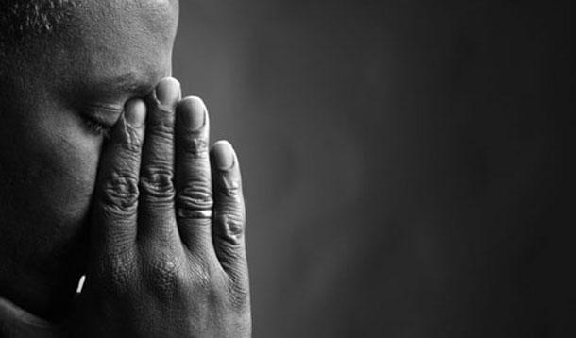
Chapter 5
Intercessory Prayer
Ruin (vv. 1, 2-9, 10-14)
Preventable (Jer. 8:20-22)
God’s Faithfulness (vv. 19ff)

Slide 7
Personal & Corporate Accountability
Sympathy + Compassion = Action
Knowledge + Opportunity = Responsibility
Add to Judgment or Aid in Prevention
God is faithful; Are we?

