Slide 1
Enslaving Yourself for Christ
Mastering the Desires of the Flesh

Slide 2
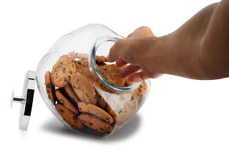
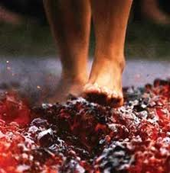
What is Self-Control?
The Power to Eat Only One Cookie
Steadfastness Under Pressure
The Spiritual War Within (Galatians 5:16-24)
Some go about it in the wrong way (Colossians 2)

Slide 3
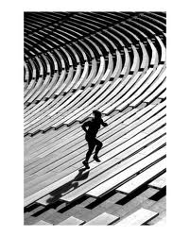
Areas of Self Control
In Body
In Speech
In Heart

Slide 4
How Do We Develop It?
Discipline!
Training!
Teammates!
Looking to the Goal!

Slide 5
“I have been crucified with Christ; and it is no longer I who live, but Christ lives in me; and the life which I now live in the flesh I live by faith in the Son of God, who loved me and gave Himself up for me.”

