Slide 1
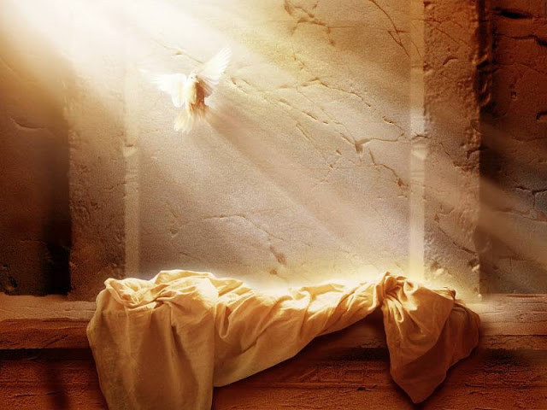
The Resurrection:
A Historically Minimal Approach

Slide 2
The Historically Minimal Approach
Resurrection is Key!
(1Cor. 15:3-7)
The Burden of Proof
(1Pet. 3:15)
Five Points
“[the historically minimal] approach considers the data that are so strongly attested historically that they are granted by nearly every scholar who studies the subject, even the rather skeptical ones.”
Gary Habermas, Michael Licona

Slide 3
The Capital Punishment of Jesus
“that [Jesus] was crucified is as sure as anything historical can ever be, since both Josephus, and Tacitus…agree with the Christian accounts on at least that basic fact.” -Jean Dominic Crossan
Lucian, Mara-bar Serapion, & the Bab. Talmud
Did it lead to death? Alternative Explanations…
- Problems: Defies Logic and Has No Evidence

Slide 4
Josephus “Ant. of the Jews” 18.64
“And when Pilate, at the suggestion of the principal men among us, had condemned him to the cross, those that loved him at the first did not forsake him; for he appeared to them alive again the third day, as the divine prophets had foretold these and ten thousand other wonderful things concerning him. And the tribe of Christians, so named from him, are not extinct at this day.”

Slide 5
Cornelius Tacitus Annals 15.44
“Nero fastened the guilt [of the burning of Rome] and inflicted the most exquisite tortures on a class hated for their abominations, called Christians by the populace. Christus, from who the name had its origin, suffered the extreme penalty during the reign of Tiberias, at the hands of one of our procurators, Pontius Pilate.”

Slide 6
The Disciples’ Claim
Stated Incorrugibly: The disciples claimed to have seen Jesus alive after His death.
Sources:
Paul, Oral, Written
Undisputed Epistles
Romans, 1 & 2 Corinthians, Galatians, Philippians, 1 Thessalonians, and Philemon
Extra-biblical Sources:
Clement of Rome, Polycarp, Ignatius, Dionysius of Corinth, Tertullian, & Origen

Slide 7
Origen Contra Celsum 4:454
“But a clear and unmistakable proof of the fact I hold to be the undertaking of His disciples, who devoted themselves to the teaching of a doctrine which was attended with danger to human life—a doctrine which they would not have taught with such courage had they invented the resurrection of Jesus from the dead, but were themselves the first to manifest their disregard for its terrors.”

Slide 8
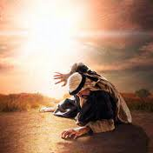
Saul’s Conversion
His Zeal for Judaism
His Reason for Change
Acts Threefold Record
Sources:
Paul himself
Luke
Clement of Rome
Polycarp
Tertullian
Dionysius of Corinth
Origen

Slide 9
Tertullian Scorpiace 15
“That Paul is beheaded has been written in their own blood. And if a heretic wishes his confidence to rest upon a public record, the archives of the empire will speak, as would the stones of Jerusalem. We read the lives of the Caesars: At Rome Nero was the first who stained with blood the rising faith. Then is Peter girt by another, when he is made fast to the cross. Then does Paul obtain a birth suited to Roman citizenship, when in Rome he springs to life again ennobled by martyrdom.”

Slide 10
James’ Conversion
More difficult than Paul’s to Substantiate
Pre-Resurrection Reaction to Jesus’ Teaching
(Mark 3:21, 31; 6:3-4; John 7:5)
The Reason and Nature of James’ Change
(1Cor. 15; Acts 15:12-21; Gal 1:19)
Outside Sources of James’ Zeal:
Josephus, Hegesippus, and Clement of Alexandria

Slide 11
Josephus Ant. Of the Jews 20:9
“Festus was now dead, and Albinus was but upon the road; so he assembled the Sanhedrin of judges, and brought before them the brother of Jesus, who was called Christ, whose name was James, and some others, [or, some of his companions]; and when he had formed an accusation against them as breakers of the law, he delivered them to be stoned…”

Slide 12
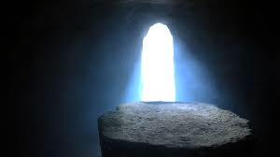
The Empty Tomb
The 1st Explanation
Who Found the Tomb
The Tomb Was New
The Disciples Watched the Body
Secured by Roman Soldiers
If stolen by the Jews, why not present the body?

Slide 13
The Logical Conclusion
Historians’ Requirements & the Bible’s Account
Who Has Power Over Death?
What Does that Mean to Man?
Man’s Duty to Jesus Christ
“God has made Him both Lord and Christ, this Jesus whom you crucified…He is the firstfruits of the resurrection of all believers”

