Slide 1
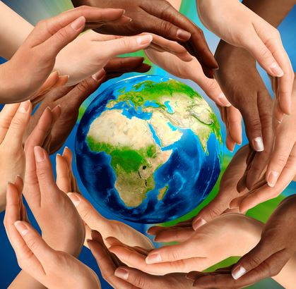
Unity of the Spirit in the Bond of Peace

Slide 2
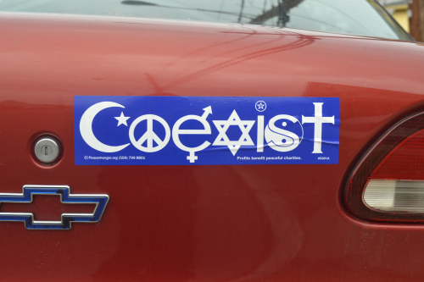
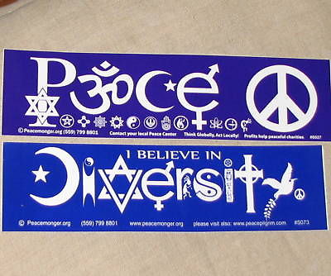
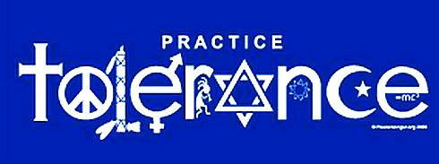

Slide 3
Peace and Unity Are Conditional
“There is no peace for the wicked”
– God
“They heal the brokenness of the daughter of My people superficially, saying ‘Peace, peace,’ but there is no peace.”
- God
Christians maintain peace through security, unity, and amity of the Holy Spirit.

Slide 4
Definitions:
Unity
Spirit
Bond of Peace
“There is neither Jew nor Greek, there is neither slave nor free man, there is neither male nor female; for you are all one in Christ Jesus. And if you belong to Christ, then you are Abraham’s descendants, heirs according to promise.”

Slide 5
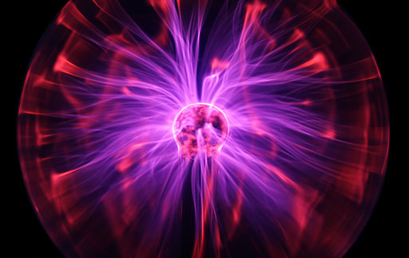
True Unity’s Origin
Exemplified in the Trinity – one God, one Lord, one Spirit
Demonstrated in Doctrine – one faith, one baptism, one hope, one body

Slide 6
Practical Applications
We choose to walk worthily or unworthily
We have been given the calling of unity and peace, but those are on God’s terms.
In order to fulfill this calling, diligent effort is mandated.

