Slide 1
Heartbreak For A Man After God’s Own Heart
Psalm 51

Slide 2
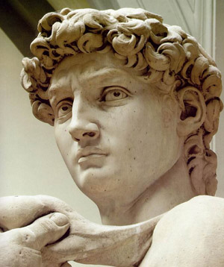
Psalm 51: The Background
David, One of the Few
David’s Chief Desire
1Sam. 13:14; Acts 13:22
David’s Catastrophe
2Sam. 11
The Valley of the Shadow of Death

Slide 3
Psalm 51: The Importance
Ash and Miller in the Living Word Commentary (p. 180) give an apt description of the psalm:
“This is the zenith of the penitential psalms (6, 32, 38, 102, 130, 143). There may be no more impassioned or beautiful prayer for forgiveness and renewal in the Bible than here. The poet’s wrongdoing has overwhelmed him. His remorse and his plea are intense. There are multiplied uses of the imperative, as well as tremendous stress on the personal relation to God which he wished fully restored. The honesty of the psalm is at times painful.”

Slide 4
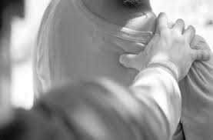
Psalm 51: The Superscription
“For the choir director. A Psalm of David, when Nathan the prophet came to him, after he had gone in to Bathsheba.”

Slide 5
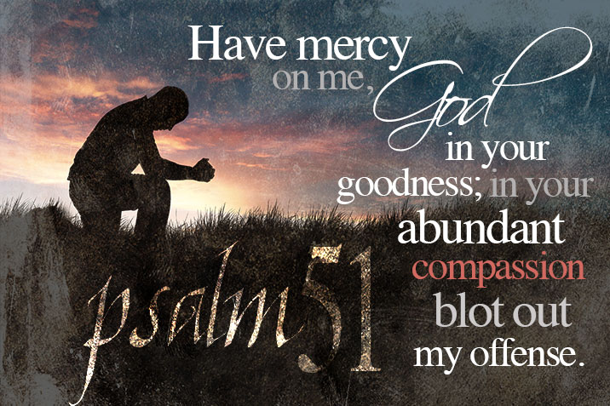
Strophe I: Verses 1-4
“the blackest of scars”
Response (2Sam. 12)
Strong Parallelism
Not His Initial Reaction
“His conscience unceasingly accuses him, and we sense his agony.”
It is easy to float in the demonic doldrums of doubt, guilt, & depression. It is the recognition & appreciation of divine grace that billows our sails. Remember Him!

Slide 6
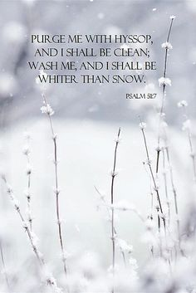
Strophe II: Verses 5-9
v. 5 – Self-Abnegation
v. 6 – Praise in Comfort
v. 7 – Truest Cleansing
vv. 8-9 – Divine Burden
Spiritual Depression
Pricked Conscience

Slide 7
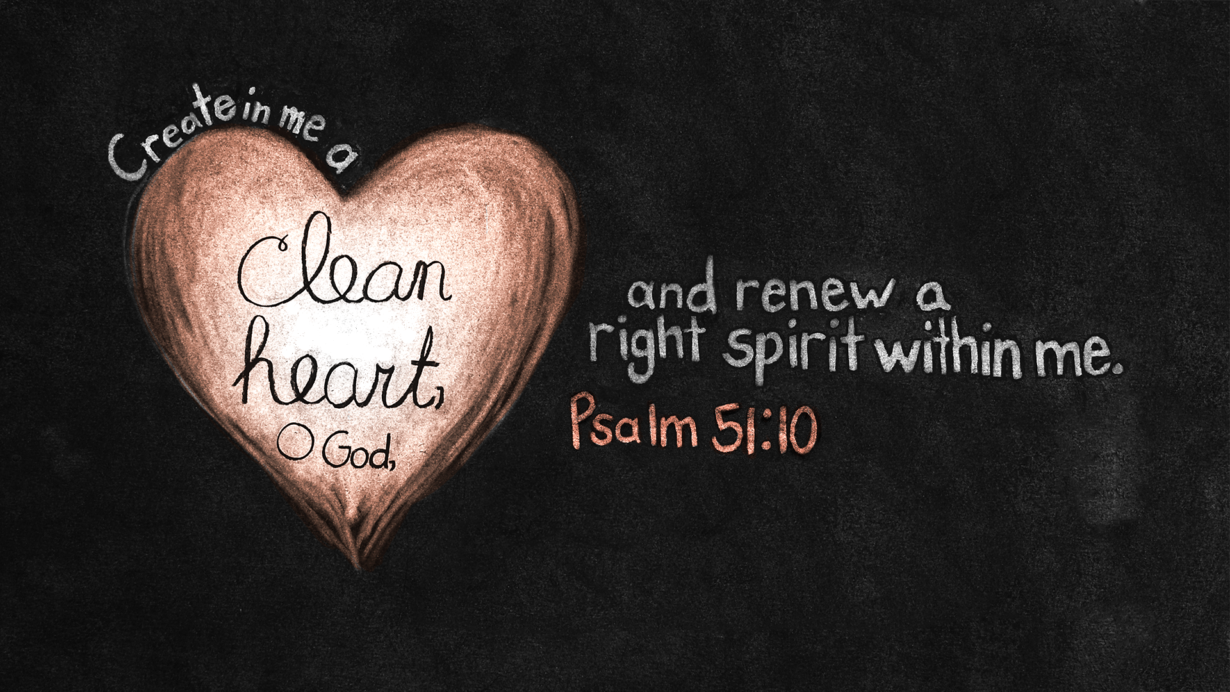
Strophe III: Verses 10-13
vv. 11-12 – 4 petitions: 2 negative pairs, 2 positive pairs
Prayer for restoration; A believer’s petition
God is Deliverer
Threefold Spiritual Focus in vv. 10-13
V. 13 – Vow of Service

Slide 8
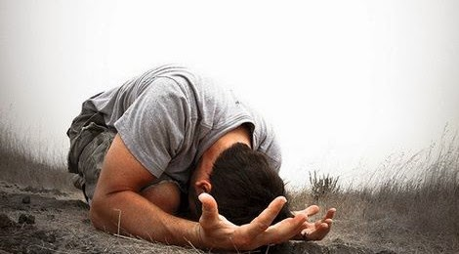
Strophe IV: Verses 14-17
David Anticipated Jesus!
Do we appreciate grace?
“Nothing in my hand I bring, Simply to Thy cross I cling.” (Augustus M. Toplady)
The Result of a Broken Heart (v. 17; cf. 32:3-4)

Slide 9
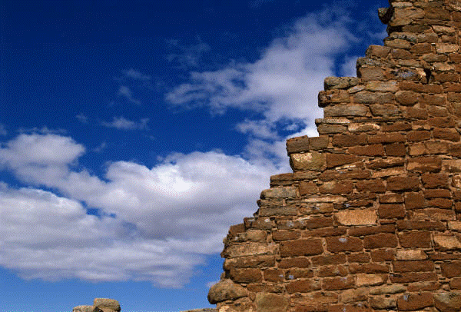
Strophe V: Verses 18-19
Out of Place?
Interrelationship
God’s Forgiveness Enables Service
God is big enough to lift us from the pits of Hades; He is powerful enough to forgive our sins (w/e they may be); and He is merciful enough to always desire a relationship with us; He is wise enough to allow our experiences, spiritual disasters, and restorations to lead others to His forgiveness.

Slide 10
Your Opportunity Is Now…

