Slide 1
The Big Picture: Second Corinthians

Slide 2
1.
Paul’s Vindication
Chapters 1-7

Slide 3
Paul’s Vindication
Personal Vindication of His Veracity
“Therefore, I was not vacillating when I intended to do this, was I? Or what I purpose, do I purpose according to the flesh, so that with me there will be yes, yes and no, no at the same time?” (1:17)
“For we are not like many, peddling the word of God, but as from sincerity, but as from God, we speak in Christ in the sight of God.” (2:17)

Slide 4
Paul’s Vindication
Personal Vindication of His Veracity
Addresses Erring Brother
“Sufficient for such a one is this punishment which was inflicted by the majority, so that on the contrary you should rather forgive and comfort him, otherwise such a one might be overwhelmed by excessive sorrow.” (2:6-7)

Slide 5
Paul’s Vindication
Personal Vindication of His Veracity
Addresses Erring Brother
New Covenant v. Old Covenant (Judaizers)
I Belong to Jesus, not to the Law!
“You are our letter, written in our hearts, known and read by all men; being manifested that you are a letter of Christ, cared for by us, written not with ink but with the Spirit of the living God, not on tablets of stone but on tablets of human hearts.“ (3:2-3)

Slide 6
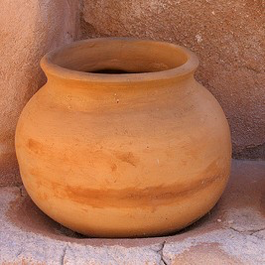
Paul’s Vindication
Personal Vindication of His Veracity
Addresses Erring Brother
New Covenant v. Old Covenant (Judaizers)
Paul’s Ministry was Conscientious
“but we have renounced the things hidden because of shame, not walking in craftiness or adulterating the word of God, but by the manifestation of truth commending ourselves to every man’s conscience in the sight of God.” (4:2)

Slide 7
Paul’s Vindication
Personal Vindication of His Veracity
Addresses Erring Brother
New Covenant v. Old Covenant (Judaizers)
Paul’s Ministry was Conscientious
Paul’s Results Are Clear
“Therefore, knowing the fear of the Lord, we persuade men…” (5:11a)

Slide 8
Paul’s Vindication
Personal Vindication of His Veracity
Addresses Erring Brother
New Covenant v. Old Covenant (Judaizers)
Paul’s Ministry Was Conscientious
Paul’s Results Are Clear
Addresses Practical Demands of the Gospel
“Come out from their midst and be separate” (6:17)

Slide 9
2.
Collection for Poor Saints
Chapters 8-9

Slide 10
Collection for Poor Saints
Background:
“Now concerning the collection for the saints…On the first day of every week each one of you is to put aside and save, as he may prosper, so that no collections be made when I come…”
1 Corinthians 16:1-3
Encouragement:
“…he who sows sparingly will also reap sparingly, and he who sows bountifully will also reap bountifully. Each one must do just as he has purposed in his heart, not grudgingly or under compulsion, for God loves a cheerful giver.”
2 Corinthians 9:6-7
Would They Give?
“diversity of socioeconomic levels and religious and ethnic backgrounds among Corinthian Christians” may have been “an underlying cause of several of the issues and problems that Paul addresses in 1 and 2 Corinthians”
Ben Witherington, 28-29

Slide 11
3.
Defense of Apostleship
Chapters 10-13

Slide 12
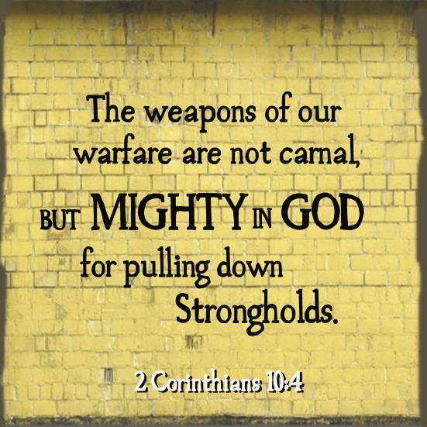
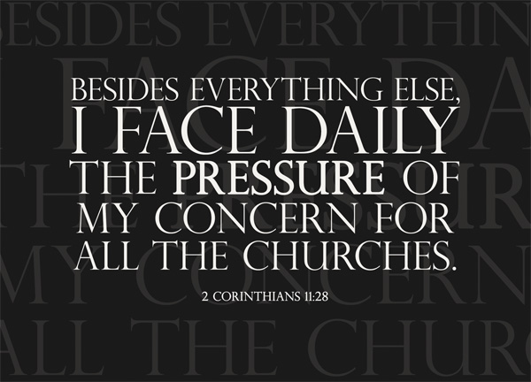
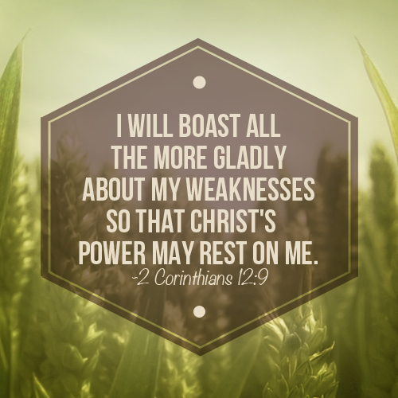
Defense of Apostleship
His Means of Overcoming Adversaries of the Gospel (10:8-11)
His Authority Equal to Any Apostle (11:5-6; cf. 1Cor. 2:1-5)
His Method Was Not To Glory (12:2-6, 7-10)

Slide 13
“For you know the grace of our Lord Jesus Christ, that though He was rich, yet for your sake He became poor, so that you through His poverty might become rich…thanks be to God for His indescribable gift!” (8:9; 9:15)

