Slide 1
The (Penitent) Thief on the Cross

Slide 2
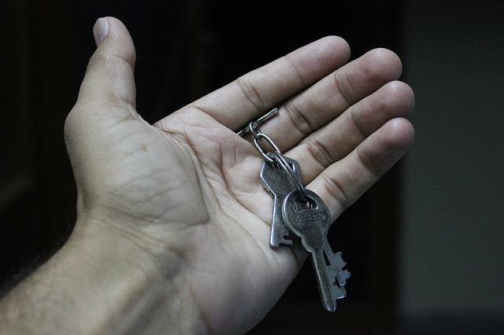
The Bible, A Book of Faith
The Necessity Of Faith
And without faith it is impossible to please Him, for he who comes to God must believe that He is and that He is a rewarder of those who seek Him. (Hebrews 11:6)
“…unless you believe that I am He, you will die in your sins.” (John 8:24)
…if you confess with your mouth Jesus as Lord, and believe in your heart that God raised Him from the dead, you will be saved (Romans 10:9)

Slide 3
The Bible, A Book of Faith
A Compendium of Faith (e.g. Hebrews 11:4-12)
The Thief Is Another Example of Faith
Little Visual Difference Between the Three Crosses
He Was A Sinner – “And we indeed are suffering justly, for we are receiving what we deserve for our deeds; but this man has done nothing wrong.” (Luke 23:41; contrast 2 Corinthians 5:14)

Slide 4
A Closer Look At The Penitent Man
He Was A Thief!
“lestes” not “kleptes”
What Did He Know?
His Petition:
“Remember Me”
Better Than Many Of Us!

Slide 5
A Closer Look At The Penitent Man
“The grace of Christ is exquisitely seen in this response to the thief. There is no mention of this man’s past transgressions. He is evidence that even the vilest sinners having turned to Christ can be present with the Lord eternally. Jesus had both the will and the right to grant this man spiritual fellowship with Himself; thus providing him with the joys God offers beyond the sufferings of this life.” (C.G. Caldwell, “Luke”, Truth, 1309)

Slide 6
A Closer Look At The Penitent Man
…He is a Rewarder of those who diligently seek Him.
(Hebrews 11:6)
“Not everyone who says to Me, ‘Lord, Lord,’ will enter the kingdom of heaven, but he who does the will of My Father who is in heaven will enter.” (Matthew 7:21)
“Do not let your heart be troubled; believe in God, believe also in Me….for I go to prepare a place for you.” (John 14:1-2)

Slide 7
Can We Be Saved In The Same Way?
Is Baptism Not Really Required?
For all of you who were baptized
into Christ have clothed yourselves
with Christ. (Galatians 3:27)
Corresponding to that, baptism
now saves you— not the removal
of dirt from the flesh, but an
appeal to God for a good conscience—through the resurrection of Jesus Christ (1 Peter 3:21)
Now why do you delay? Get up and be baptized, and wash away your sins, calling on His name. (Acts 22:16)

Slide 8
Can We Be Saved In The Same Way?
The Death of Christ Was A Climax In History!
…having canceled out the certificate of debt consisting of decrees against us, which was hostile to us; and He has taken it out of the way, having nailed it to the cross. (Colossians 2:14)
For this reason He is the mediator of a new covenant, so that, since a death has taken place for the redemption of the transgressions that were committed under the first covenant, those who have been called may receive the promise of the eternal inheritance. For where a covenant is, there must of necessity be the death of the one who made it. (Hebrews 9:15-16)

Slide 9
Can We Be Saved In The Same Way?
A Truly Unique Event:
“…the thief was granted to be in paradise by a direct and personal disposition before the death of Jesus and the effectual beginning of the universally applied gospel of Christ. We are not in that circumstance!” (C.G. Caldwell, “Luke”, Truth, 1310)
Water Baptism Is Most Definitely Required!
Go therefore and make disciples of all the nations, baptizing them in the name of the Father and the Son and the Holy Spirit… (Matthew 28:19)
Peter said to them, “Repent, and each of you be baptized in the name of Jesus Christ for the forgiveness of your sins; and you will receive the gift of the Holy Spirit.” (Acts 2:38)

Slide 10
Two men died with Jesus. One was saved because he believed and turned to the Lord. One was lost and died in his sins. Which cross will you carry?

