Slide 1
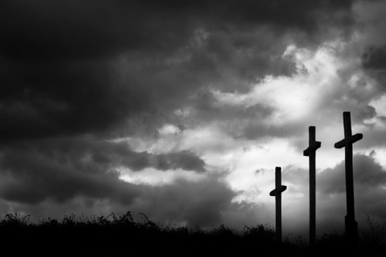
Three Crosses on Golgotha

Slide 2
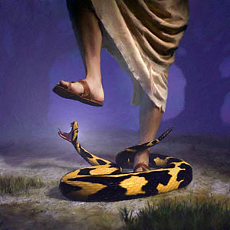
One Died FOR Sin
Now the chief priests and the whole Council kept trying to obtain testimony against Jesus …and they were not finding any. For many were giving false testimony against Him, but their testimony was not consistent. Some stood up and began to give false testimony against Him… Not even in this respect was their testimony consistent.
(Mark 14:55-59; compare Luke 23:13-14)

Slide 3
One Died FOR Sin
But He was pierced through for our transgressions, He was crushed for our iniquities; The chastening for our well-being fell upon Him, And by His scourging we are healed.
(Isaiah 53:5; compare Romans 5:8)
Therefore, since the children share in flesh and blood, He Himself likewise also partook of the same, that through death He might render powerless him who had the power of death, that is, the devil… (Hebrews 2:14)

Slide 4
One Died FOR Sin
“And I, if I am lifted up from the earth, will draw all men to Myself.” (John 12:32)
but we preach Christ crucified, to Jews a stumbling block and to Gentiles foolishness, (1 Corinthians 1:23)
…and He Himself is the propitiation for our sins; and not for ours only, but also for those of the whole world. (1 John 2:2)
“For God so loved the world…” (John 3:16)

Slide 5
One Died FOR Sin
And not only this, but we also exult in God through our Lord Jesus Christ, through whom we have now received the reconciliation. (Romans 5:11)
In Him we have redemption through His blood, the forgiveness of our trespasses, according to the riches of His grace (Ephesians 1:7)
For you are all sons of God through faith in Christ Jesus. For all of you who were baptized into Christ have clothed yourselves with Christ. (Galatians 3:26-27)

Slide 6
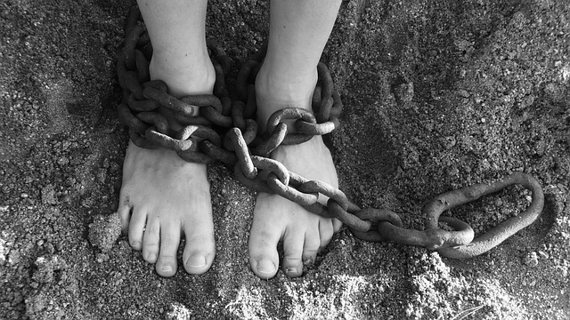
One Died IN Sin (Luke 23:39)
At that time two robbers were crucified with Him, one on the right and one on the left. (Matthew 27:38)
And the people stood by, looking on. And even the rulers were sneering at Him, saying, “He saved others; let Him save Himself if this is the Christ of God, His Chosen One.” (Luke 23:35)

Slide 7
One Died IN Sin (Luke 23:39)
“Do you not even fear God, since you are under the same sentence of condemnation? And we indeed are suffering justly, for we are receiving what we deserve for our deeds; but this man has done nothing wrong.” (Luke 23:40-41)
For we must all appear before the judgment seat of Christ, so that each one may be recompensed for his deeds in the body…
(2 Corinthians 5:10)

Slide 8
One Died IN Sin (Luke 23:39)
And there is salvation in no one else… (Acts 4:12)
For I am not ashamed of the gospel, for it is the power of God for salvation to everyone who believes… (Romans 1:16)
Therefore I said to you that you will die in your sins; for unless you believe that I am He, you will die in your sins.” (John 8:24)

Slide 9
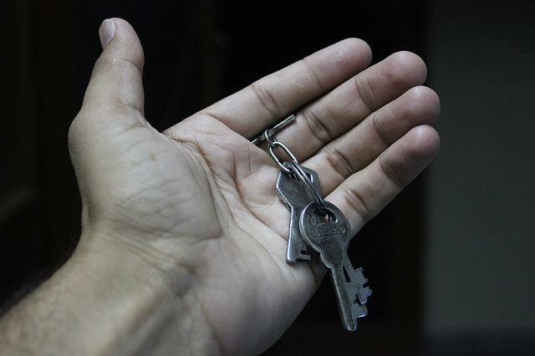
One Died TO His Sins
The robbers who had been crucified with Him were also insulting Him with the same words. (Matthew 27:44)
Let this Christ, the King of Israel, now come down from the cross, so that we may see and believe!” Those who were crucified with Him were also insulting Him. (Mark 15:32)

Slide 10
One Died TO His Sins
“…when there was no other earthly tribunal to which he could appeal, he had suddenly discovered that there was another Throne, higher than the throne of the Caesars, another realm where there was a Father, who could extend mercy. He saw in Jesus, the One Who had the right of appeal to that Throne, to that Father, and he flung himself out into that wider area, into that higher reach of being.” (G. Campbell Morgan, Luke, 272).

Slide 11
Three men shared death upon a hill, But only one man died; The other two— A thief and God Himself— Made rendezvous. Three crosses still Are borne on Calvary’s Hill, Where Sin still lifts them high; Upon the one, sag broken men Who cursing, die; Another holds the praying thief, Or those who, penitent as he, Still find the Christ Beside them on the tree.

