Slide 1
The Role & Function of the Holy Spirit

Slide 2
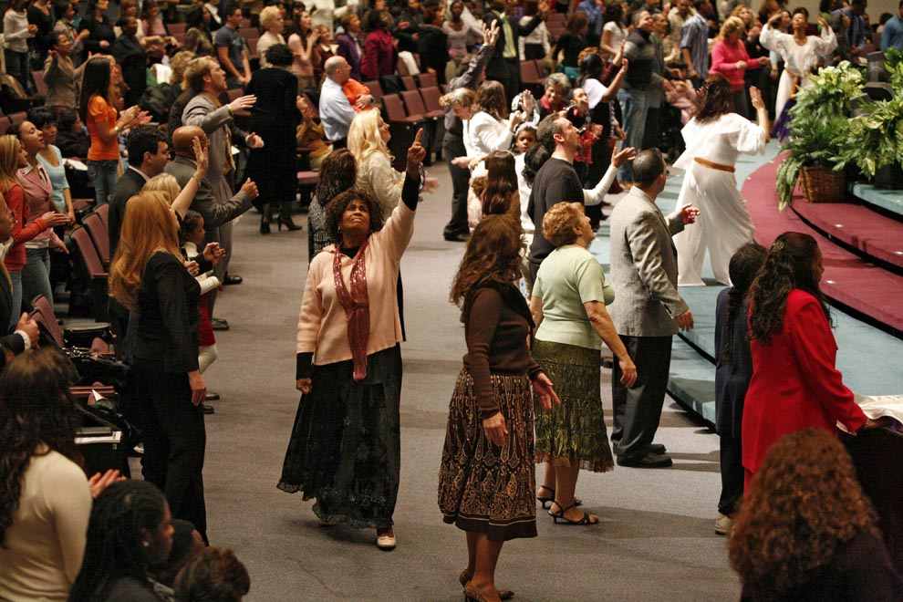
Misunderstood

Slide 3
Person/Member of Godhead
As much a person in godhead as the Father and Son
Like any other person, He wants to be understood, not misunderstood
We gain understanding of Him through His words and actions (these are revealed in the Scriptures)
Since He is divine, He possesses the same fundamental attributes and purposes as the Father and Son.

Slide 4
Function In The Godhead
Creation
Human History
Jesus’ Ministry
Conveyance of Father’s Will
The Holy Spirit is involved in :
Revealing, Equipping, Facilitating, Signifying, Blessing

Slide 5
Work of the Holy Spirit for Christians
Salvation:
Other Roles:
Facilitating The Means For, Announced
Grants Access, Gives ID
Prompts Renewal, Obedience
Rebirths
Comforter
Mediator
Warner

Slide 6
More Difficult Roles
Gift – Peter said to them, “Repent, and each of you be baptized in the name of Jesus Christ for the forgiveness of your sins; and you will receive the gift of the Holy Spirit. (Acts 2:38)
Indwelling – However, you are not in the flesh but in the Spirit, if indeed the Spirit of God dwells in you. But if anyone does not have the Spirit of Christ, he does not belong to Him. (Rom. 8:9)
Sealing – Now He who establishes us with you in Christ and anointed us is God, who also sealed us and gave us the Spirit in our hearts as a pledge. (2Cor. 1:21-22)

Slide 7
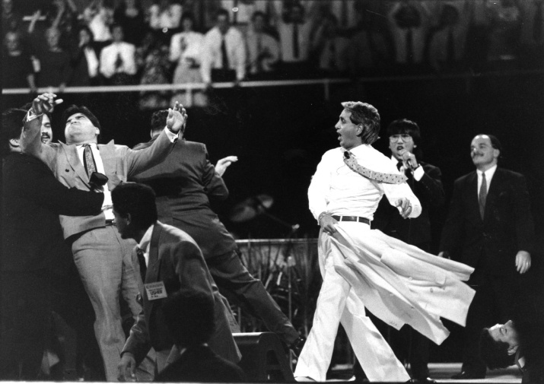
What The Holy Spirit Does Not Do
Override A Person’s Free Will
Override A Person’s Faculties

Slide 8
The Christian’s Responsibility To The Holy Spirit
To Please Him:
Forsake The Flesh (Gal. 5:16-26)
Walk By Him (Rom. 8:4, 14; 2Cor. 3:18)
Produce His Fruit (Gal. 5:22f)
Live As His Witnesses (2Cor. 3:1-3)
Avoid:
Blasphemy (Matt. 12:31f)
Quenching (1Thess. 5:19)
Grieving (Eph. 4:30; Heb. 10:26-29)

Slide 9
Do YOU want the gift of the Holy Spirit?

