Slide 1
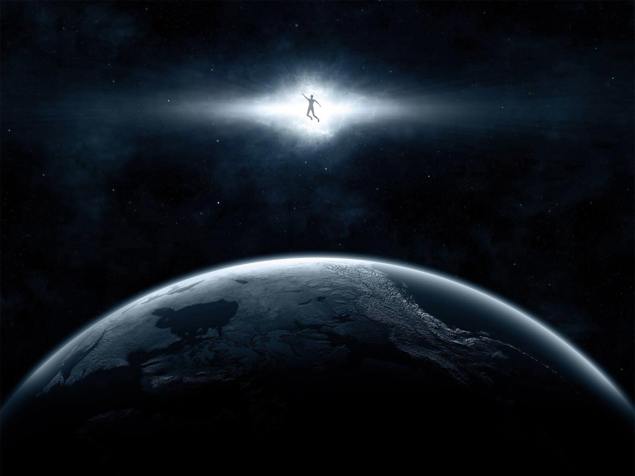
What is it?
Everyone has one
Impacts every significant question
God
Reality
Knowledge
Morality
Humanity

Slide 2
Choosing
Testing
Reason
Experience
Practice
A Biblical Worldview

Slide 3
Reaching for something higher
Who is the Biblical God?
God has reached out to us
On the edge?

