Slide 1
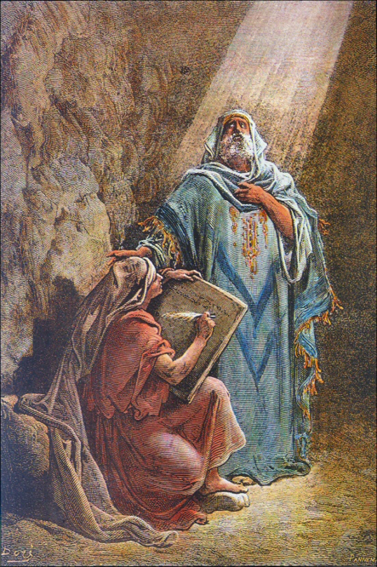
Christ In Jeremiah

Slide 2
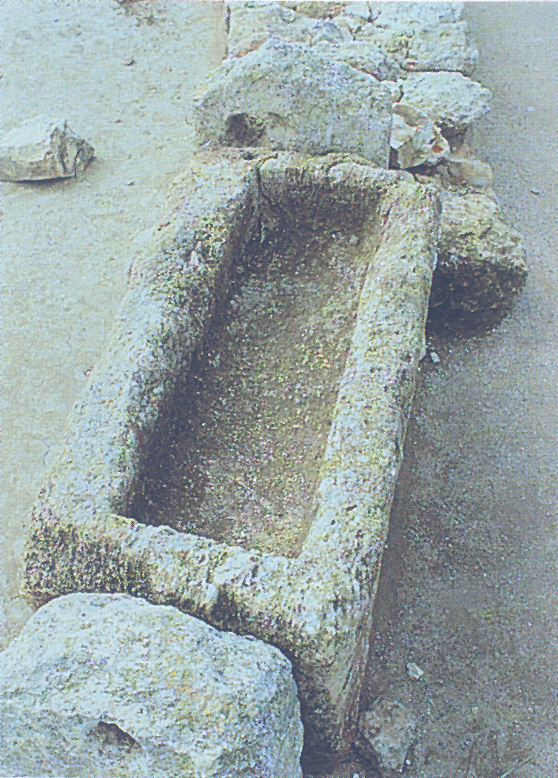
Jeremiah’s Prophecies: Messiah’s Coming
He would come in "the latter days" (30:24; 48:47; 49:6, 39).
As ruler, He would come from the stock of Israel (30:21).
There would be great weeping at His birth (31:15).

Slide 3
NT Fulfillment: Messiah’s Coming
He would come in "the latter days" (Acts 2:16f; Heb. 1:1f).
As ruler, He would come from the stock of Israel (Matt. 2:6).
There would be great weeping at His birth (Matt. 2:17).

Slide 4
Jeremiah’s Prophecies: Messiah’s Purpose
He would serve another king of kings named David (23:5-8; 30:9; 33:14-16).
He would be a perpetual priest and king (33:17f).
He would seal a new covenant (31:31-34; 50:5).
He would prohibit Jerusalem from falling (31:38-40).

Slide 5
New Testament Fulfillment: Messiah’s Purpose
He would serve another king of kings named David (Luke 1:31-33; Acts 2:30-36).
He would be a perpetual priest and king (Heb. 7:25-28; 8:1; 9:11f; 10:10-14).
He would seal a new covenant (Heb. 8:8-11; 10:16f).
He would prohibit Jerusalem from falling (Heb. 12:22-28).

Slide 6
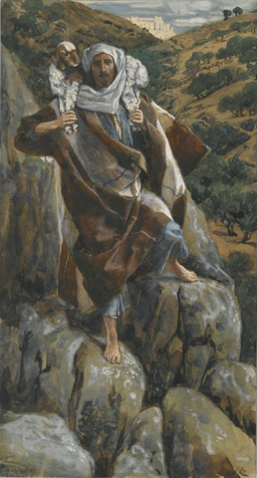
Jeremiah’s Prophecies: Messiah’s Effect
His coming would bring about a new attitude (31:29f).
He would lead the people of Israel back to Zion (3:14-18; 31:6; 32:36-44).
He would provide ceaseless descendants of Israel (31:35-37).
He would save a remnant (31:7).
The people of earth would be His (30:22; 31:1, 7, 14, 33; 32:38; 33:24).

Slide 7
New Testament Fulfillment: Messiah’s Effect
His coming would bring about a new attitude (Rom. 2:6-11; 14:12; Gal. 6:5-8).
He would lead the people of Israel back to Zion (Heb. 12:22f).
He would provide ceaseless descendants of Israel (Rom. 9:7f; Gal. 3:26-29; 6:16).
He would save a remnant (Rom. 9:27f; 11:5).
The people of earth would be His (2Cor. 6:14-18).

Slide 8
How did Jeremiah know all of these things about the king of kings? How was he right in every detail? How could he have known?
Only with divine insight could the NT writers have so clearly and eloquently recorded the fulfillment of Jeremiah’s prophecies.
Well, the answer is simple: God told Jeremiah about these truths and He commanded him to write them down so that people would know beforehand.
These fulfilled prophecies provide evidence to substantiate our faith and convict us that Jesus is the Christ, the Son of God. Let us obey!

