Slide 1
Churches Of The Past:
Antioch

Slide 2
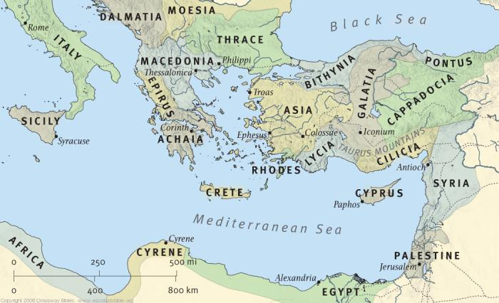
A Brief History
The Christian Dispersion (Acts 8:1-4; 11:19)
Barnabas (Acts 11:22)
Saul (Acts 11:25-26)

Slide 3
Character: A Unique Church
The first church we know of to be composed generally of both Jews and Gentiles. Jews established it, but Gentiles were soon plentiful
and they sent this letter by them, “The apostles and the brethren who are elders, to the brethren in Antioch and Syria and Cilicia who are from the Gentiles, greetings. (Acts 15:23)
The name “Christians” was first given there
and when Barnabas had found Paul, he brought him to Antioch. And for an entire year they met with the church and taught considerable numbers; and the disciples were first called Christians in Antioch. (Acts 11:26)

Slide 4
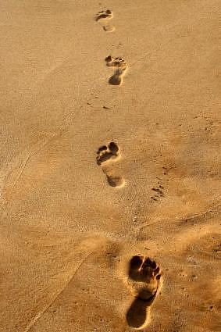
Character: A Church To Copy
Zealous in teaching and preaching (Acts 11:25f)
But Paul and Barnabas stayed in Antioch, teaching and preaching with many others also, the word of the Lord. (Acts 15:35).
Antioch was well supplied with teachers (13:1).

Slide 5
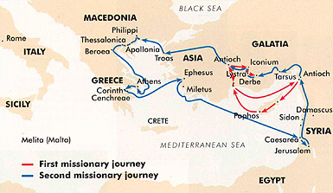
Character: A Sending Church
It was most prominent in this work. It became the base of Paul’s preaching tours.
1st journey began/ended in Antioch (13:1-3; 14:26-28).
2nd journey also started at Antioch and Paul returned there (15:35-41; 18:21-22).

Slide 6
Character: A Benevolent Church
They must have been liberal in their giving.
They sent relief according to ability to Judea (11:29f). This is the first record we have of one church sending money to another church. Learn what it was for!
It was a benevolent need in Judea greater than could be handled by the receiving churches. Antioch recognized the local churches as medium through which to work as they sent it to the elders.
Benevolence

Slide 7
Character: A Church That Respected Divine Authority
Church Autonomy
Apostolic Authority
Autonomy and Local Oversight (Acts 11:30)
Each congregation should work and pray toward the appointment of elders. No church should be satisfied to do without elders.
There should be a determined effort to train men to be elders.
The Final Authority (Acts 15:1-2)
When a problem or controversy arises in the church, we should go to the Apostles.
What the Bible teaches is the work of the Spirit through the apostles (1Pet. 1:2).
CENI

Slide 8
Character: A Growing Church
Faithfulness Incites Growth
Studying God’s Word Incites Growth
They grew because they were all the things we have studied so far.
When we practice the teaching of the NT, we do not have to worry about growth. It will come as a result of God’s law (1Cor. 3:6).
Why they were strong (Acts 11:16; 15:35)
People must desire to be taught before you can teach them anything (Matt. 6:33; 5:6).
We must always be willing to accept what the Bible says even if it is contrary to what we have always believed.

Slide 9
