Slide 1
Sacred Principles of Marriage

Slide 2
A Serious Situation
Marriage is a lifetime proposition
Romans 7:2-3
It is now a social disaster. Is there a cure?

Slide 3
What Is Marriage?
God’s Definition
God Ordained (Gen. 2; Prov. 18:22; Mt. 19)
Qualifications
Intent to Unite (Mt. 19:4-5, 11-12; Eph. 5:31)
Authorization/Right (Rom. 7:2-3; 1 Cor. 7:39)
Legalities of the Land (Rom. 13:1-2)
Intimacy ≠ Marriage
Undefiled (Heb. 13:4; 1 Cor. 7:2-5; Gal. 5:19-21)

Slide 4
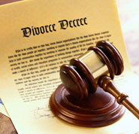
Why Marriages Are Failing
Faulty Expectations
Incorrect Views
Not Taken Seriously
True Love Is Lacking
Lack of Preparation

Slide 5
If one wants a happy, meaningful, and glorious marriage it will take the right attitude with sincere and continued effort. God joined you and if you follow His will, He will keep you together.

