Slide 1
“Take Heart, I Have Overcome”
A Message of victory for the defeated

Slide 2
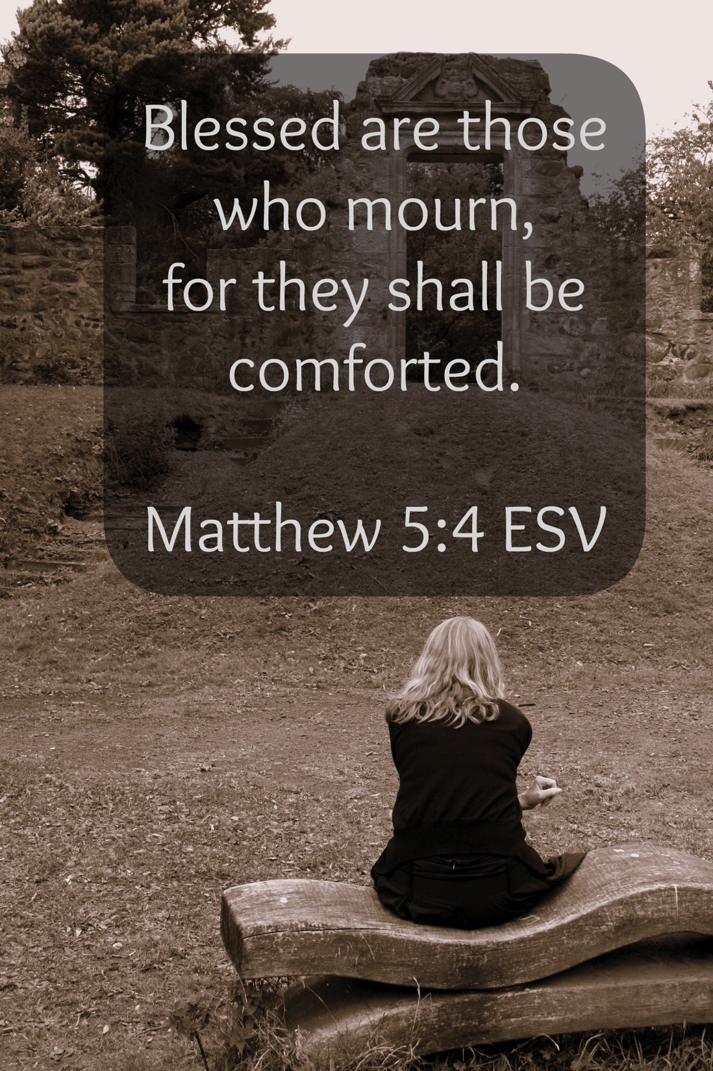
A Preacher’s Duty
“Preach the word; be ready in season and out of season; reprove, rebuke, exhort, with great patience and instruction.” (2 Timothy 4:2)
“Therefore comfort one another with these words.” (1 Thessalonians 4:18)
“Comfort, O comfort My people,” says your God. “Speak kindly to Jerusalem” (Isaiah 40:1-2)

Slide 3
Jesus’ Comforting Address (John 16:33)
“These things I have spoken to you, so that in Me you may have peace. In the world you have tribulation, but TAKE COURAGE; I have overcome the world.” (NASB)
“These things I have spoken unto you, that in me ye might have peace. In the world ye shall have tribulation: but BE OF GOOD CHEER; I have overcome the world.” (KJV)
“I have said these things to you, that in me you may have peace. In the world you will have tribulation. But TAKE HEART; I have overcome the world.” (ESV)

Slide 4
A Statement Of Fact: “In The World You Will Have Tribulation.”
Tribulation = Pressure, Rub
Perspective
Three Types Of Tribulation:
Trials Of Daily Living
A Thorn In The Flesh
A Cross To Bear

Slide 5
An Encouragement: “Be Of Good Cheer”
Qarsew
Be of good cheer
Take courage
Be of good comfort
“Take Heart”
Sins (Matthew 9:2)
Physical/Emotional Infirmities (Matthew 9:22)
Perspective (Matthew 14:27)

Slide 6
Basis For Encouragement: “I Have Overcome The World.”
We Can Have Courage & Cheer
The New Testament Shouts Victory
1 Corinthians 15:57-58
John 12:31
1 John 5:4-5

