Slide 1
Is Belief In God Reasonable?
God, Science, And Origins

Slide 3
The Law Of Universal Causation
Basic Cause And Effect
“True knowledge is knowledge by causes.”

Slide 4
The First Cause
There Cannot Be Infinite Regress!
Christians Believe This Is God – Cosmological Argument
Premise One: Whatever begins to exist has a cause. Things don’t come into being from nothing.
Premise Two: The universe began to exist.
Premise Three: Therefore, a cause of the universe exists.

Slide 5
The Atheist’s Response:
Naturalism/Evolution
Allegedly removes the difficulty of origins
Actually leaves more questions
Based on an unfounded and unobserved presupposition
Is NOT a fact established by science. It is a THEORY.
Theory:
A proposed explanation whose status is still conjectural and subject to experimentation, in contrast to well-established propositions that are regarded as reporting matters of actual fact. (Dictionary.com & American College Dictionary)

Slide 6
Michael Denton, Molecular Biologist
“[Naturalism] is still, as it was in Darwin’s time, a highly speculative hypothesis entirely without direct factual support and very far from that self-evident axiom some of its more aggressive advocates would have us believe.”
Evolution, A Theory In Crisis (Chevy Chase, Md.: Adler & Adler, 1986), 77.

Slide 7
Lee Strobel, Investigative Journalist
“what looks at first blush like an airtight scientific case for evolution beings to unravel upon closer examination. New discoveries during the past thirty years have prompted an increasing number of scientists to contradict Darwin by concluding that there was an Intelligent Designer behind the creation and development of life.”
The Case For Faith, 90.
He also said this: “My road to atheism was paved by science....But, ironically, so was my later journey to God.”

Slide 8
Michael Behe, Research Biochemist
“The conclusion of intelligent design flows naturally from the data itself—not from sacred books or sectarian beliefs....The reluctance of science to embrace the conclusion of intelligent design...has no justifiable foundation....Many people, including many important and well-respected scientists, just don’t want there to be anything beyond nature.”
Darwin’s Black Box (New York: The Free Press, 1996), 193, 251, 243.

Slide 9
Science Points To A 1st Cause!
“…the universe is something that begs an explanation.” (Antony Flew, There is a God, 145)
Radioactive Elements
Radiation Afterglow – God’s Fingerprints
The Law Of Biogenesis
The Laws Of Thermodynamics

Slide 10
Science Doesn’t Support Naturalism
Plenty Of Scientists Believe In God And Creation!
Yet Even If They Didn’t, Is Science Faultless?
“In 1861...the French Academy of Science published a little brochure in which they stated fifty-one facts that controverted the Word of God. Today, there is not a scientist in the world who believes a single one of those fifty-one so-called scientific facts that in 1861 were published as controverting the Word of God. Not a one!” (W.A. Criswell, The Bible for Today’s World (Grand Rapids: Zondervan, 1966), p. 30.)

Slide 11
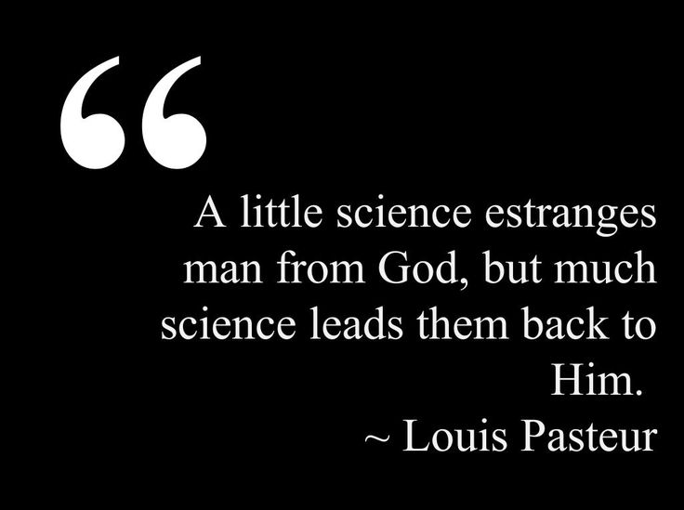
Science Doesn’t Support Naturalism
“For the scientist who has lived by faith in the power of reason, the story ends like a bad dream. He has scaled the mountains of ignorance; he is about to conquer the highest peak; as he pulls himself over the final rock, he is greeted by a band of theologians who have been sitting there for centuries.” (Robert Jastrow, God and the Astronomers, 116).

Slide 12
Linking Cosmology & Epistemology
Man Is Self-Aware
Either Eternal Mind Or Eternal Matter.
Unconsciousness Does Not Produce Consciousness
Nobody Denies God Purely Rationally

Slide 13
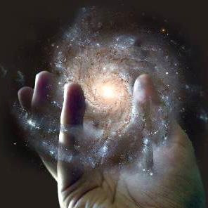
The Nature Of Our 1st Cause
Transcendent
Personal
Intelligent
Powerful
Moral
Singular

Slide 14
“Science without religion is lame; religion without science is blind.” (Albert Einstein)
“In the beginning, God created the heavens and the earth.” (Genesis 1:1)
“The fool says in his heart, ‘There is no God.’” (Psalm 14:1)
“God exists and He is the rewarder of those who diligently seek Him” (Heb. 11:6).

