Slide 1
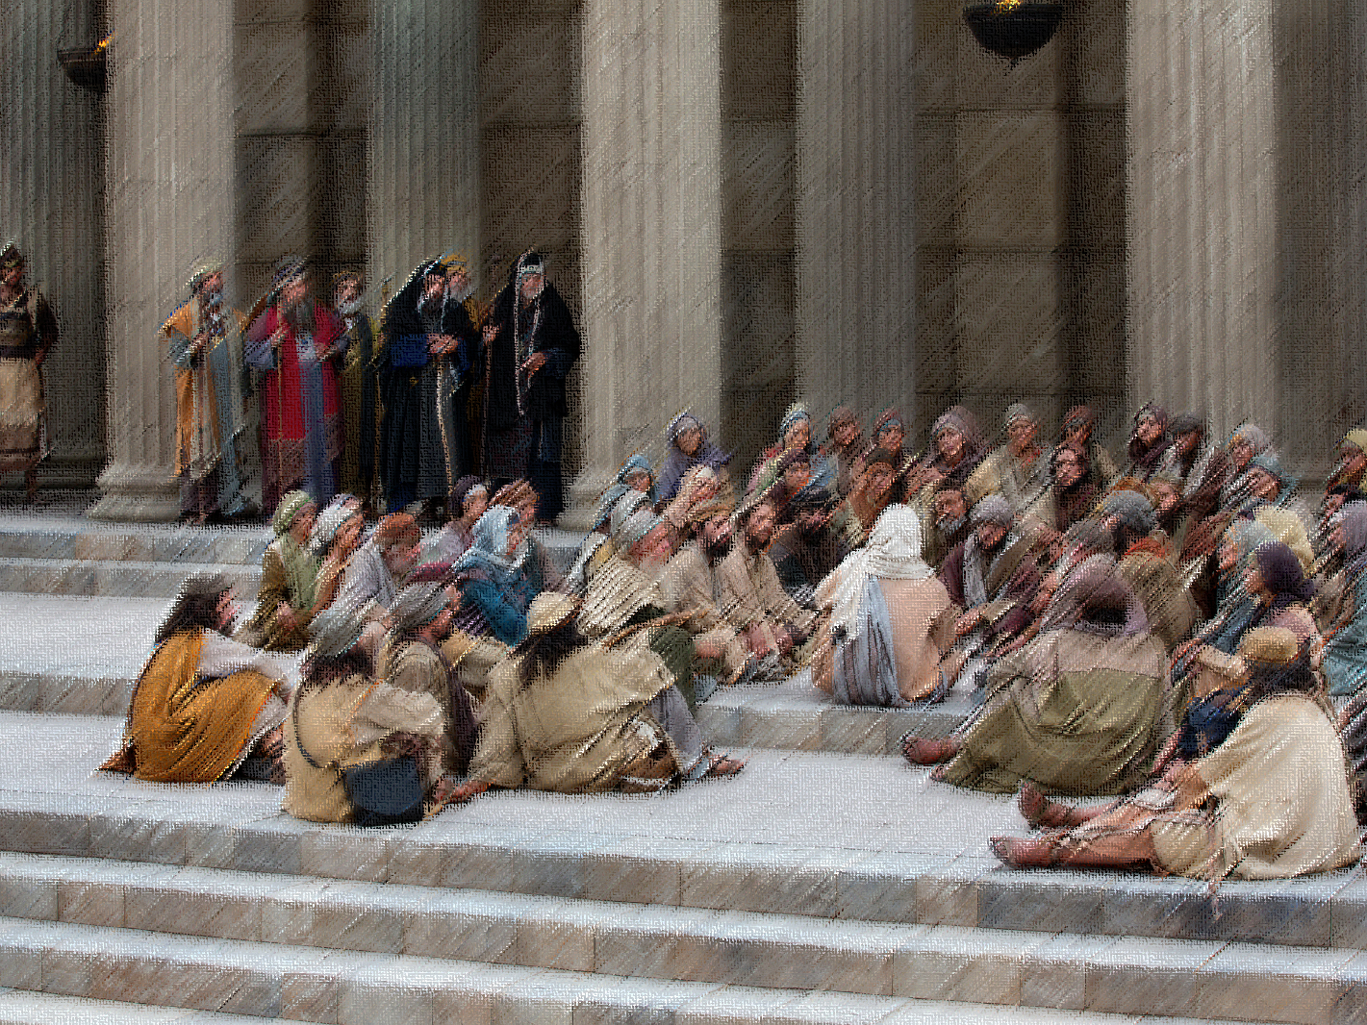
What Makes a Sermon
a
Great?
Great Sermons of the Bible (Series)
Notes:
What is a sermon? The word sermon comes from the Latin for “discourse” or “talk” but is primarily used today of a speech made during a religious assembly. But the recorded sermons in the Bible are typically given outside of a formal assembly of God’s people. While there are many great sermons in the Bible, we will focus on some of the great sermons in Acts. What made these sermons great? That is what we will discover together throughout the week.

Slide 2
An Unexpected Method
God has unpredictably chosen preaching as the means by which people will hear the good news of Jesus Christ and be saved – 1 Corinthians 1:18–25.
What is even more surprising is that God has entrusted people with the task of preaching to others – Romans 10:13–17; see Matthew 28:18–20.
Yet when we humbly and accurately preach the word of God to others, that preaching glorifies God – 1 Peter 4:11; see 1 Thessalonians 2:3–4.
Notes:
Romans 16:25–27

Slide 3
The Power of Preaching
Preaching is not only God-glorifying but also powerful because God himself works through it to accomplish his purpose – Isaiah 55:11; Romans 1:16.
For preaching to be powerful, it does not always have to be eloquent and evocative, but it must be inextricably linked to God – 1 Corinthians 2:1–5.
When God is the source of the sermon, it can accomplish the “impossible,” moving beyond what we can imagine – Luke 18:27; Ephesians 3:20; Hebrews 4:12; 2 Corinthians 10:4–5.
Notes:
“To be always relevant, you have to say things which are eternal” (Simone Weil).
“O God, let me preach with enthusiasm because of what Christ did, not because of what the crowds think..., because of the salvation we have, not the size of the group we have. Use me, O God, not because it’s the hour for the message, but because you’ve given me a message for the hour” (Ed Towne).

Slide 4
A Great Sermon
A great sermon focuses on Christ, confining itself to the revealed word of God – 1 Corinthians 1:23–24; 1 Peter 4:11; 2 Timothy 4:2; see 3:16–17; 2:15.
A great sermon starts where people are but boldly says what needs to be said, whether it is desirable or not – 1 Corinthians 9:19–23; 2 Timothy 4:2–5.
A great sermon “storms the will” of the hearer(s), compelling an appropriate response – 2 Timothy 3:16–4:2; Matthew 7:24–27; Ephesians 4:11–12.
Notes:
“I’ve heard a lot of sermons in the past ten years or so that made me want to get up and walk out. They’re secular, psychological, self-help sermons. Friendly, but of no use. They didn’t make you straighten up. They didn’t give you anything hard.… At some point and in some way, a sermon has to direct people toward the death of Christ and the campaign that God has waged over the centuries to get our attention” (Garrison Keillor).
“The preacher who brings the message people most need to hear will often be the preacher they least like to hear” (John MacArthur).
“If a preacher spends hours polishing a sermon that lacked scriptural substance, and even practices over and over until he can deliver the sermon with ease, his preaching is like acting in a play that has no plot. Preaching that is not biblically based is merely a performance. In a nutshell, a preacher must preach the word!” (Melvin Curry).
“The Bible was not given to increase our knowledge, but to change our lives” (Dwight L. Moody).
“C. S. Lewis went to visit one of his young preacher friends and listen to him preach. Everything was fine until the man reached the climax of his message. And he said, in so many words, ‘If you will not believe in Jesus Christ, if you refuse to take him as your Lord, you will suffer grave eschatological ramifications.’ And then he went on and ended his message. Lewis frowned. When he had occasion to talk with the young man about the conclusion of his message, he asked, ‘Did you mean that those who refuse to receive the gospel message would go to hell?’ ‘Well, yes,’ replied the young man. ‘Yes, that’s what I meant.’ Lewis’s response was beautiful, ‘Then say that!’” (Michael Green).
“The test of a preacher is that his congregation goes away saying, not ‘What a lovely sermon!’ but ‘I will do something’” (Francois de Sales).
“My grand point in preaching is to break the hard heart and to heal the broken one” (John Newton).

Slide 5
The Sermons in Acts
The sermons in Acts are great, because they exemplify God-honoring preaching; they are Christ-centered, Scripture-filled, direct, and applicable.
In our studies, we will examine Peter’s sermons in Acts 2 and 3, Stephen’s in Acts 7, Philip’s in Acts 8, Peter’s in Acts 10, and Paul’s in Acts 13 and 17.
These sermons are not only great because they are inspired but also because they are eternally applicable—and we should heed them!
Notes:
Acts 2 = Scripture, Christ, Indictment, Exhortation
Acts 3 = Christ, Indictment, Exhortation, Scripture
Acts 7 = Scripture, Christ, Indictment, Exhortation?
Acts 8 = Scripture, Christ, Indictment?, Exhortation
Acts 10 = Christ, Scripture?, Indictment?, Exhortation
Acts 13 = Scripture, Christ, Indictment, Exhortation
Acts 17 = Scripture?, Indictment, Exhortation, Christ

Slide 6
What Makes a Sermon
a
Great?
Great Sermons of the Bible (Series)

