Slide 1
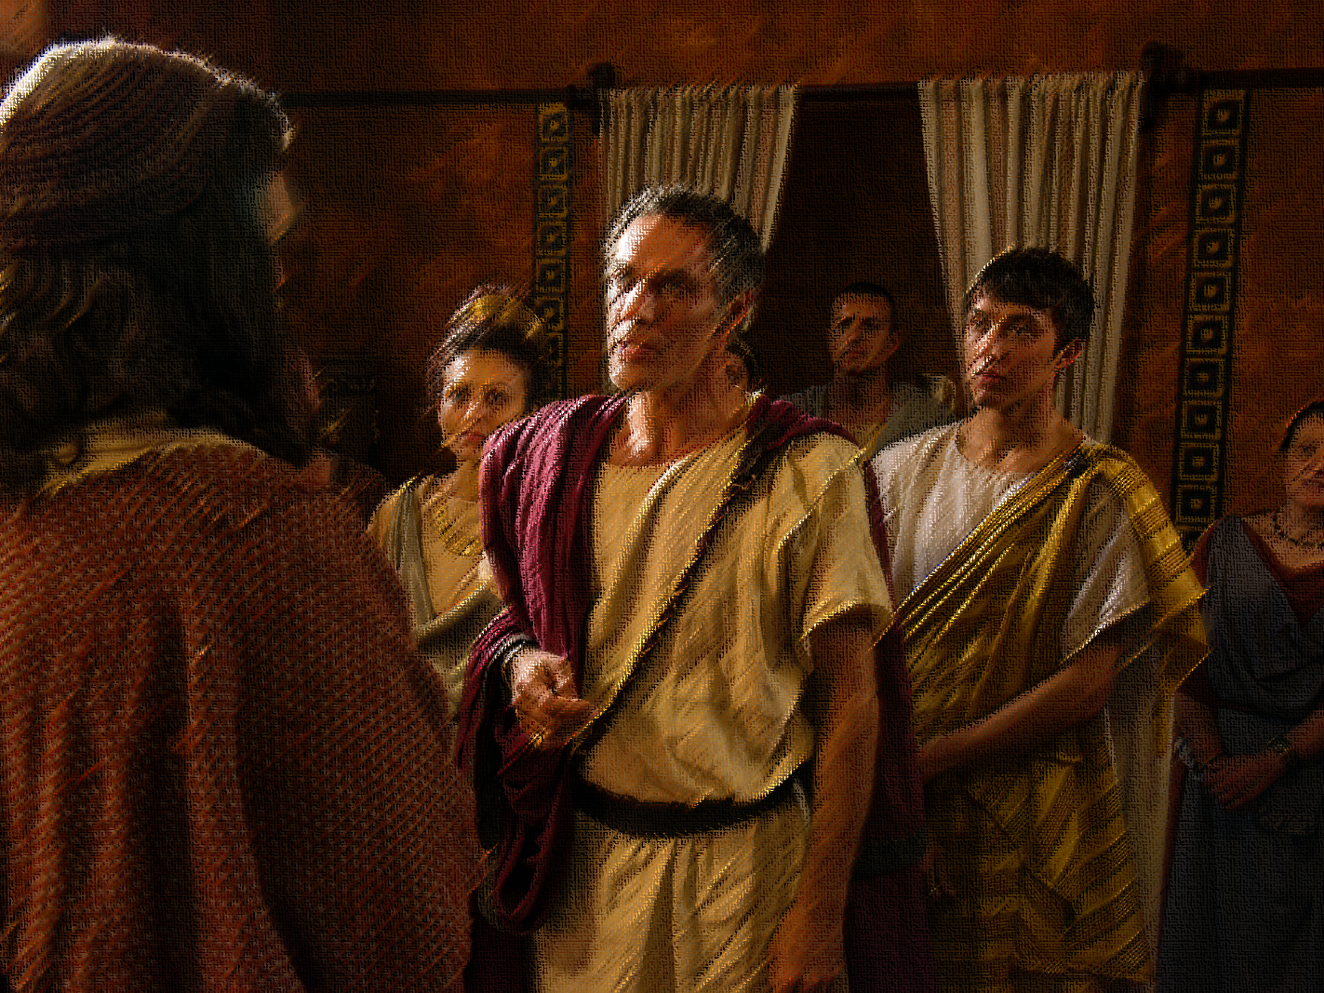
God Does Not
Acts 10:34–48
DiscriminatE

Slide 2
Introduction
Racism is not a new problem. It was just as prevalent in the first century as it is today, though then less a skin color issue – Colossians 3:11.
One of the chief racial concerns in New Testament times was the tension (and hatred) of Jews and Gentiles and how to resolve it.
Neither the Old nor the New Testament condones prejudicial attitudes. Instead God is God over all people – Romans 10:12–13; see Leviticus 19:33–34.
Notes:
“Yet the customs of this most base people [Jews] have so prevailed that they are adopted in all the world, and the conquered have given their laws to the conquerors” (Seneca, 6 BC to AD 65).
“The… practices of the Jews are sinister and revolting…. Wretches of the most abandoned kind…. But the rest of the world they confront with the hatred reserved for enemies” (Tacitus, AD 56–120).
“The best of the Gentiles, kill them!” or “The best of the Gentiles are killers” (Jerusalem Talmud, AD ?–400)

Slide 3
Introduction
It had always been God’s intention to bring Jews and Gentiles together, a promise that predated even the formation of Israel – Galatians 3:8, 26–29.
That God would unite Jews and Gentiles and the means by which he would do this were unknown to the earliest disciples (e.g., Peter).
The inclusivity of the gospel is revealed in the events of Acts 10–11, and the sermon Peter preached shows that God does not show partiality to any certain race. Everyone can be saved.

Slide 4
An Important Vision
Before the events of Acts 10, the gospel had only gone to the Jews. Yet when the time was right, God prepared Peter to preach to the Gentiles.
Peter was in Joppa, staying with Simon the tanner, when the Lord three times showed him a vision of unclean animals – Acts 10:9–16.
Peter did not immediately understand the divine message, but the vision—along with the events that followed—provided the instruction he needed to preach to Cornelius and his family – see 10:17–34.

Slide 5
No Partiality with God
When Peter met Cornelius, he finally understood the meaning of the vision and was equipped to preach Christ to him – Acts 10:34; see v. 28.
The point of Peter’s sermon was that God does not show partiality, but this does not imply unqualified acceptance – vv. 34–35; see Romans 2:2–11.
Though the Jews first heard the message of peace, Jesus is Lord of all, and it is only through him that people can have peace with God (and one another) – Acts 10:36; see Romans 5:1; Ephesians 2:11–22.
Notes:
Romans 2:9–11

Slide 6
No Partiality with God
The ministry of Jesus was initially limited to the Jewish people, but it hinted at God’s universal concern for sinners – Acts 10:37–43.
Peter provided reasons why Cornelius and his company should accept the gospel—their own knowledge of the events and the testimonies of the apostles and the prophets – see vv. 37, 39, 41, 43.
Since God does not show partiality, anyone who believes in Jesus Christ can receive the forgiveness of sins – v. 43; see 2:38; 3:19; Luke 24:47.
Notes:
Romans 2:9–11

Slide 7
No Partiality with God
Having reached a climactic point in his sermon, the Holy Spirit fell on the Gentiles, proving that God would accept them – Acts 10:44–48; see 11:17–18.
Though the Gentiles had received the ability to perform miracles, they still needed to be baptized to be saved – 10:47–48; see v. 43.

Slide 8
Modern Applications
Though individuals should do what they can to promote social justice, the answer to prejudice is not political reform but Jesus – Galatians 3:28.
The Bible forbids Christians from making judgments based on race, gender, or social standing. The gospel is for all – John 7:24; Matthew 28:18–20.
Christians must treat other Christians with love and respect, regardless of these kinds of differences, because they are family – James 2:1–4, 8–9.

Slide 9
God Does Not
Acts 10:34–48
DiscriminatE

