Slide 1
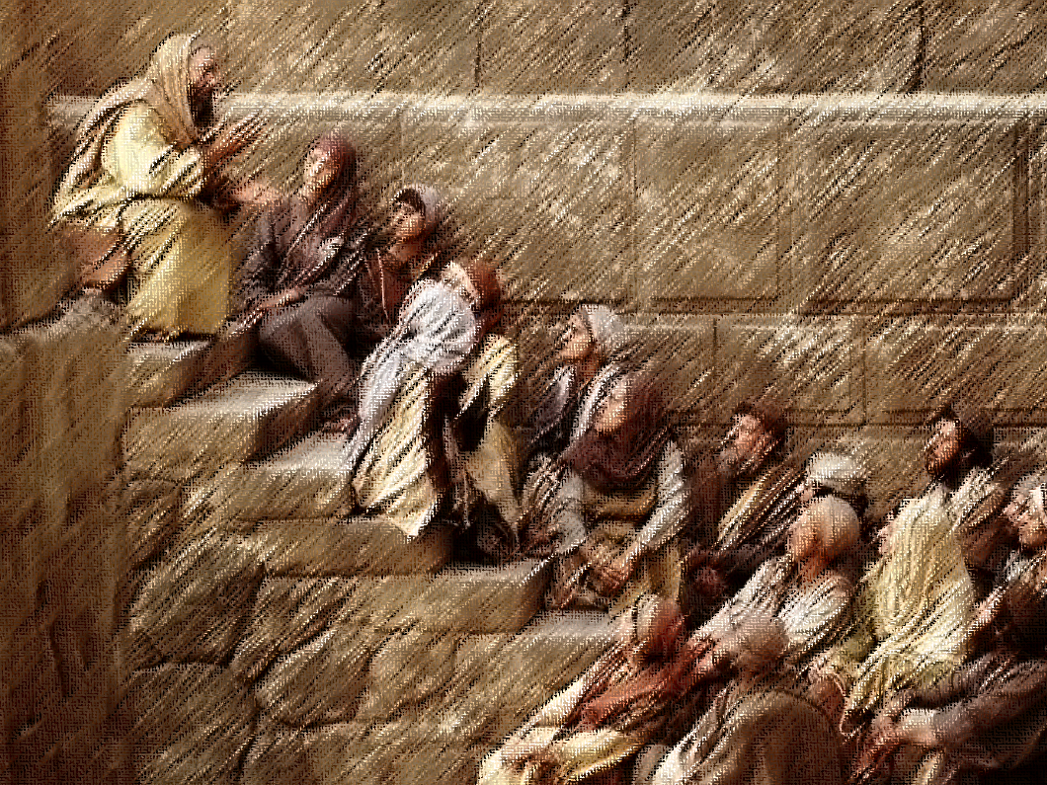
GOD ALWAYS KEEPS
Acts 13:16–41
HIS PROMISES

Slide 2
For I am convinced that neither death, nor life, nor angels, nor principalities, nor things present, nor things to come, nor powers, nor height, nor depth, nor any other created thing, will be able to separate us from the love of God, which is in Christ Jesus our Lord.
Romans 8:38–39

Slide 3
And we know that God causes all things to work together for good to those who love God, to those who are called according to his purpose.
Romans 8:28

Slide 4
Come to me, all who are weary and heavy-laden, and I will give you rest. Take my yoke upon you and learn from me, for I am gentle and humble in heart, and you will find rest for your souls.
Matthew 11:28–29

Slide 5
Be anxious for nothing, but in everything by prayer and supplication with thanksgiving let your requests be made known to God. And the peace of God, which surpasses all comprehension, will guard your hearts and your minds in Christ Jesus.
Philippians 4:6–7

Slide 6
Make sure that your character is free from the love of money, being content with what you have; for he himself has said, “I will never desert you, nor will I ever forsake you.”
Hebrews 13:5

Slide 7
This is the promise which he himself made to us: eternal life.
1 John 2:25

Slide 8
And he will wipe away every tear from their eyes; and there will no longer be any death; there will no longer be any mourning, or crying, or pain; the first things have passed away.
Revelation 21:4

Slide 9
Introduction
One of the constant themes of the Old and New Testaments is the faithfulness of God. This means that he will always keep his word – Hebrews 10:23.
We know that God is faithful because of Jesus Christ. He is the “Yes” to all of the promises of God – Romans 15:8–9; 2 Corinthians 1:20.
The apostle Paul was given the opportunity to preach to a group of Jews that the promises of the Old Testament had be realized in Jesus and that they needed to respond in faith – Acts 13:14–15.

Slide 10
A Brief History of Israel
Paul begins with a brief history of Israel. He focuses on the promises that were made to the Patriarchs, driving toward King David – Acts 13:16–22.
As God had promised, Israel became a nation and received the land of Canaan, being delivered and protected by God – Hebrews 6:13–18.
Yet after David was crowned king, God assured him that his house (kingdom) would be established eternally in his descendent – 2 Samuel 7:8–16.
Notes:
See also Psalm 89:1–4, 49–51.

Slide 11
The Good News of Jesus
Jesus is the fulfillment of the divine promises of the Old Testament. He is the Savior of Israel and the Son and Holy One of God – Acts 13:23, 33, 35.
The testimonies of John, of the eyewitnesses, and of Scripture confirm that Jesus is the only way to salvation (forgiveness) – Acts 13:23–37; see 4:12.
Because of the death, burial, and resurrection of Jesus, believers can receive the promised blessing of divine mercy – 13:34, 38; Isaiah 55:3.
Notes:
Paul quotes Psalm 2:7, then Isaiah 55:3, and finally Psalm 16:10. (Compare Romans 1:4.)

Slide 12
A Word of Exhortation
That God is faithful means he acts consistently, that is, in accordance with his word—forgiving the faithful and judging the rebellious – Deuteronomy 7:9–10.
God offers forgiveness and justification to Jews and Gentiles. To reject his offer will, however, result in condemnation – Acts 13:38–41; see Habakkuk 1:5.
The exhortation is clear: God wants to save us, but he will not force himself on us; we must choose to follow him – Acts 13:46; Deuteronomy 30:19–20.
Notes:
The word translated “freed” in Acts 13:39 (NASB) is the Greek word for “justified” (from δικαιόω). The Law could not provide full and final justification, but the gospel is able to add believers to the covenant people of God. Forgiveness and justification occur simultaneously, and they are available only in Jesus Christ. He took on himself the curse of the Law by hanging on a tree (Acts 13:29; Deuteronomy 21:22; Galatians 3:13).

Slide 13
Acceptance or Rejection?
While many in Pisidian Antioch were intrigued by the good news of Jesus, only some—mostly Gentiles—received the message – Acts 13:42–52.
What about us? God has made wonderful promises to us. Will we follow Christ, accept his forgiveness, and receive the promises of God?
God is faithful. He will keep his promises. They are “Yes” in Jesus. Are you in Christ? – 2 Corinthians 1:20; Galatians 3:26–27.

Slide 14
GOD ALWAYS KEEPS
Acts 13:16–41
HIS PROMISES

