Slide 1
Answering Arguments In Defense Of Abortion

Slide 3
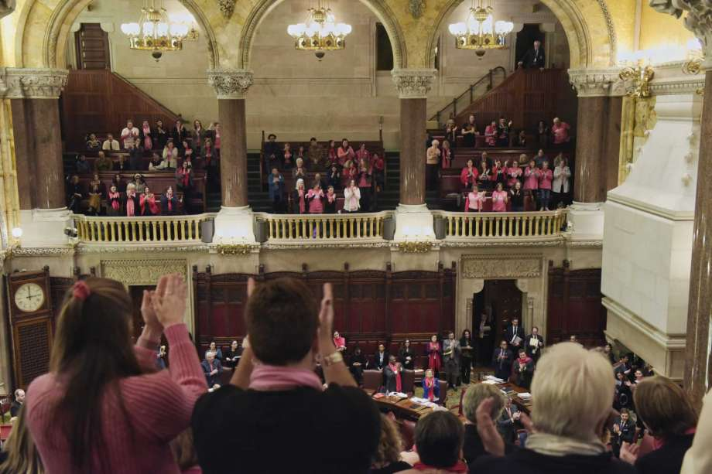

Slide 4
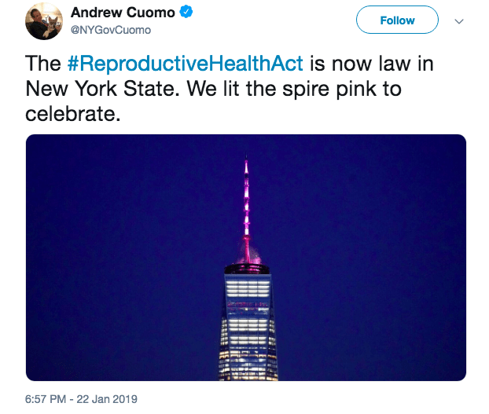

Slide 7
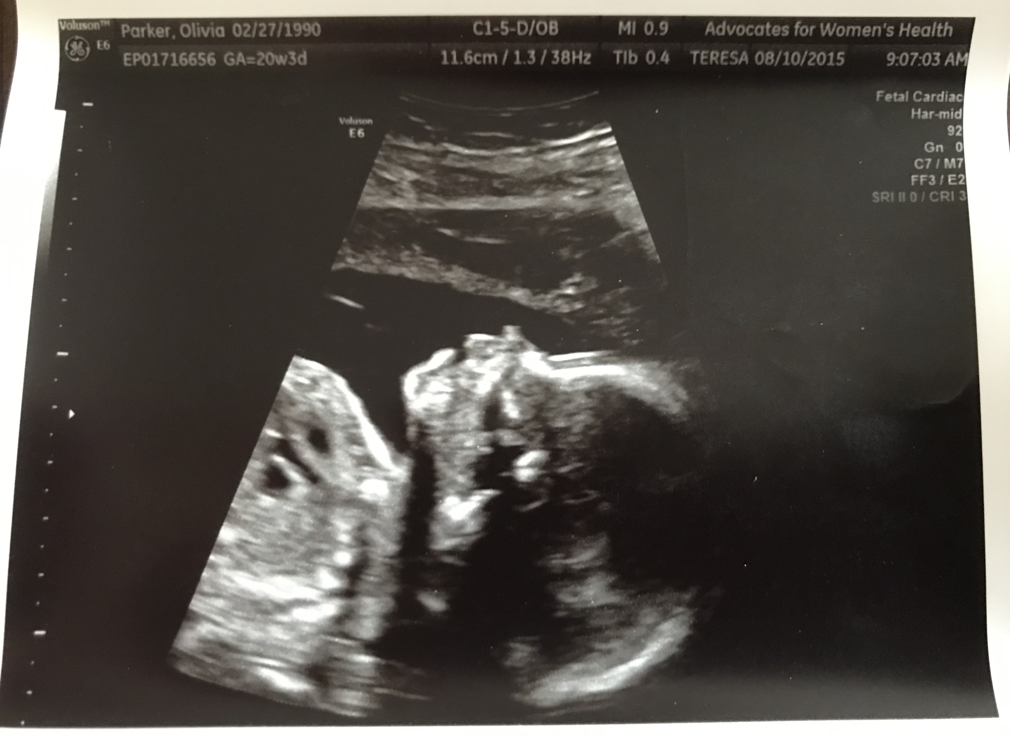
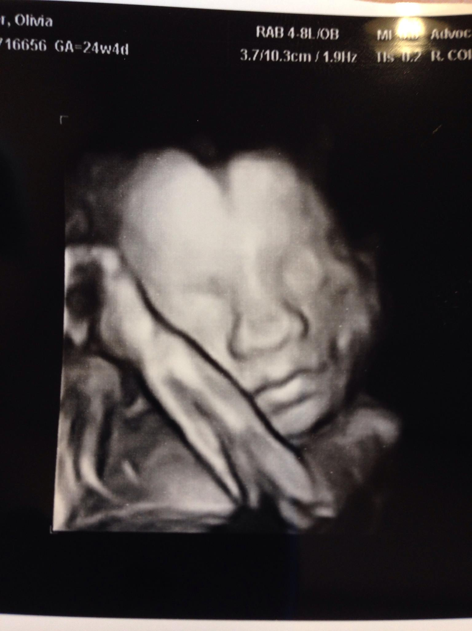
“It’s Not Really A Person!”

Slide 8
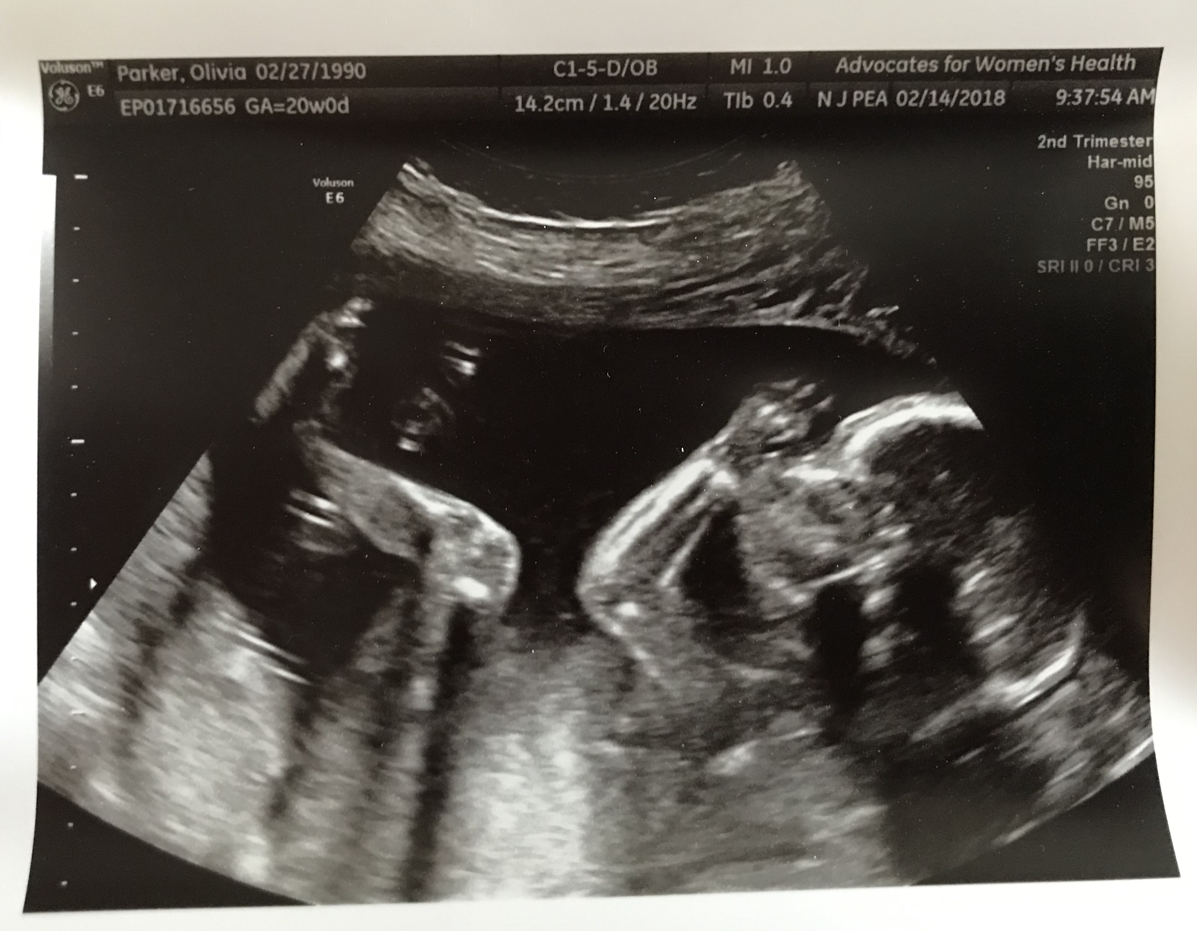
“It’s Not Really A Person!”

Slide 9
“It’s Not Really A Person!”
“When does life begin?”
Biologically, growth and multiplication of cells.
Life begins at conception when the fertilized egg begins to grow.
“When can it be considered a human?”
Biologically, our DNA determines our humanity.
DNA begins at conception.

Slide 10
“It’s Medically Required!”
“As an OB/GYN physician for 31 years there is no medical situation that requires aborting/killing the baby in the third trimester to ‘save the mother’s life.’ Just deliver the baby by C/Section and the baby has a 95+% survival with readily available NICU care even at 28 weeks. C/Section is quicker and safer than partial birth abortion for the mother.” (Dr. Lawrence K. Koning)

Slide 11
“It’s Medically Required!”
“As a board-certified practicing OB/GYN physician for over 30 years, I need to say publicly and unequivocally, that there is never a medical reason to kill a baby at term. When complications of pregnancy endanger a mother’s life, we sometimes must deliver the baby early, but it is always with the intent of doing whatever we can to do it safely for the baby too. The decision to kill an unborn baby at term is purely for convenience. It is murder...God help us.” (Dr. David Mcknight)

Slide 12
“It’s Medically Required!”
“I want to clear something up so that there is absolutely no doubt. I’m a board certified OB/GYN who has delivered over 2,500 babies. There’s not a single fetal or maternal condition that requires third trimester abortion. Not one. Delivery, yes. Abortion, no. There is absolutely no medical reason to kill a near term or term infant, for any reason.” (Dr. Omar L. Hamada)

Slide 13
“It’s Medically Required!”
“As an OBGYN I will not support this in my practice. The government may falsely lead women to think its safe and easy to have an abortion in the late 2nd or 3rd trimester but the young mother could end up loosing her life as well. I support and have dedicated my life to women’s health and this is NOT a win for women in any way. It will be the young and the vulnerable who will be the victims to this.” (Dr. Rebecca Cisneros)

Slide 14
“It’s Medically Required!”
“Necessary” Is Not What It Is Portrayed To Be
“Whether, in the words of the Georgia statute, ‘an abortion is necessary’ is a professional judgment that the Georgia physician will be called upon to make routinely. We agree with the District Court, 319 F. Supp., at 1058, that the medical judgment may be exercised in the light of all factors – physical, emotional, psychological, familial, and the woman’s age – relevant to the well-being of the patient. All these factors may relate to health.” (Doe v. Bolton)
Compare Micah 3:1-4, 8-12

Slide 15
“Options Need To Be Available For Victims Of Rape”

Slide 16
“Options Need To Be Available For Victims Of Rape”
Findings In The 2004 Guttmacher Institute Study
Less then 0.5% of over 1,200 post-abortive women said that rape was the reason for their abortion.
Children Of Rape Can Become Influential People
Abortion Actually Makes The Situation Worse! (Plus, Most Rape Victims Choose Not To Have An Abortion!)
WRONG + WRONG ≠ RIGHT

Slide 17
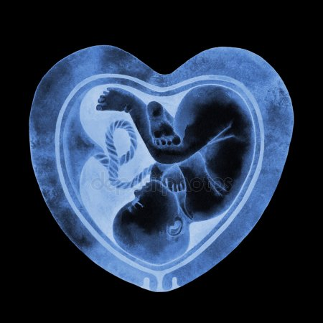
“You Can’t Tell A Woman What To Do With Her Own Body”
Women have every right to be responsible with their bodies!
Once pregnant, she is not merely making choices for her own body. Her decisions affect another that is not her own body. Placenta and umbilical cord separate the two bodies.
The application of this is clearly inconsistent!

Slide 18
“You Can’t Tell A Woman What To Do With Her Own Body”
The Scriptures Command Christians:
To Judge Un-Hypocritically (Matthew 7:1-5)
To Judge With Righteous Judgment (John 7:24)
To Call Evil What It Is (Ephesians 5:6-17)
To Say What Needs To Be Said, Though Difficult It May Be (Proverbs 24:11-12)
To Act When Action Is Right (James 4:17)
The Scriptures Command Governments To:
Reward What Is Good (Romans 13:1-7)
Punish What Is Evil (Romans 13:1-7)

Slide 19
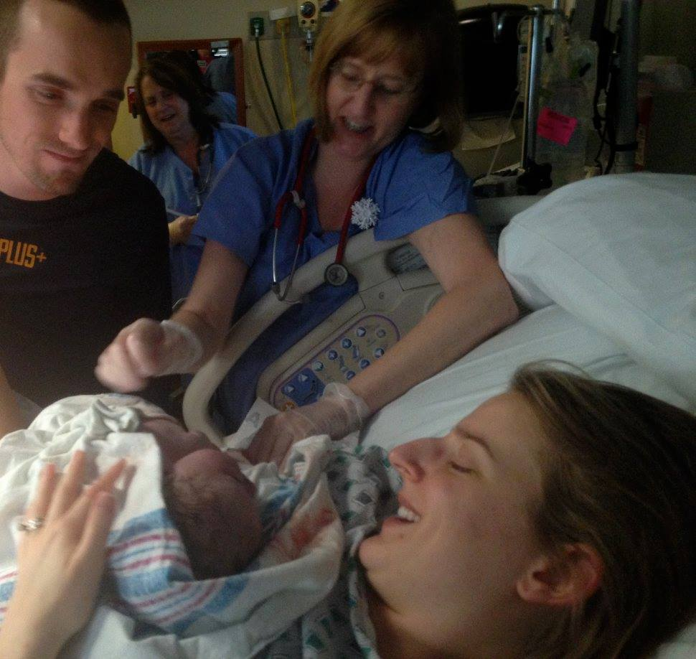

Slide 20
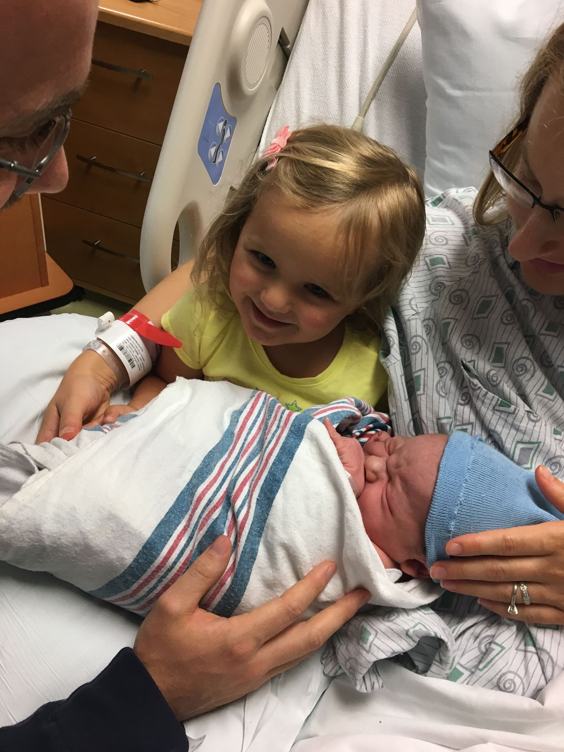

Slide 21
