Slide 2
This Week’s Sermons
Monday: What About the Thief on the Cross?
Tuesday: When Temptation Comes
Wednesday: Mediocrity
Thursday: Instrumental Music in Worship
Friday: Heaven is Better

Slide 3
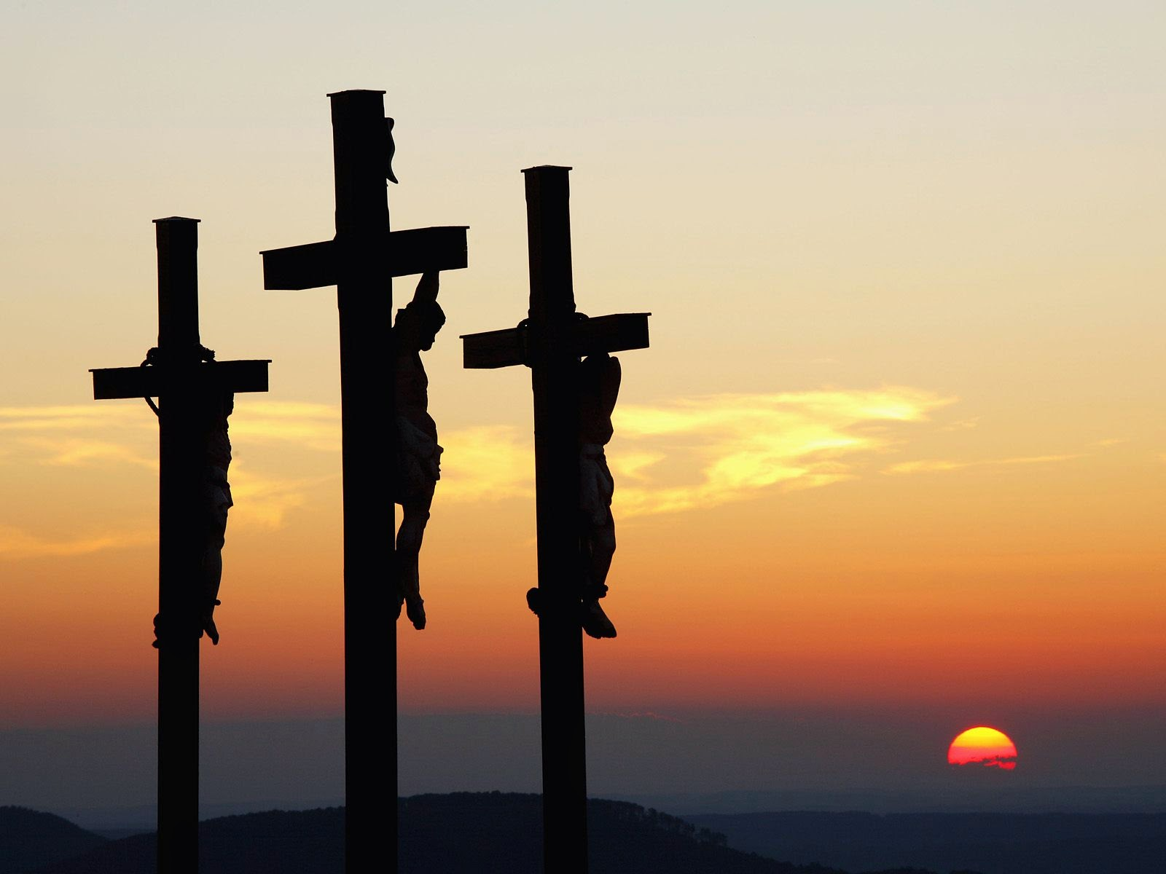
What About the Thief on the Cross?

Slide 4
The Lord’s Power on Earth to Forgive Sins
Luke 7:48-50 – “Your faith has saved you.”
Matthew 19:16-22 – “sell what you have…”
Matthew 9:1-8 – “Jesus saw their faith…”
Jesus had power on earth to forgive sins. He did so at His own discretion. The thief on the cross was one of these instances.

Slide 5
When Jesus Died on the Cross…
The Law of Moses was taken away.
Col. 2:14; Rom. 10:4; Matt. 5:17
Hebrews 8:7-13
The will of Jesus went into effect.
Hebrews 9:15-17

Slide 6
When Jesus Rose from the Dead…
He sent His apostles into the world preaching the gospel.
Matt. 28:19-20; Mark 16:15-16; Luke 24:46-47
The stipulations set forth in His will are…
Belief
Repentance
Confession of Faith
Baptism in Water

Slide 7
The Purpose of Baptism
Saves Us – 1 Pet. 3:21; Mark 16:16
Remission of Sins – Acts 2:38
Washes Away Sins – Acts 22:16
Puts us in contact with Jesus’ death – Rom. 6:3-4
Places us in Christ – Gal. 3:27
Places us in the Church – 1 Cor. 12:13; Col. 1:18

Slide 8
We cannot be saved like the thief on the cross was saved.
The Lord’s will is now in effect.
We must meet the conditions set forth in that will in order to be saved by Jesus today.

