Slide 1
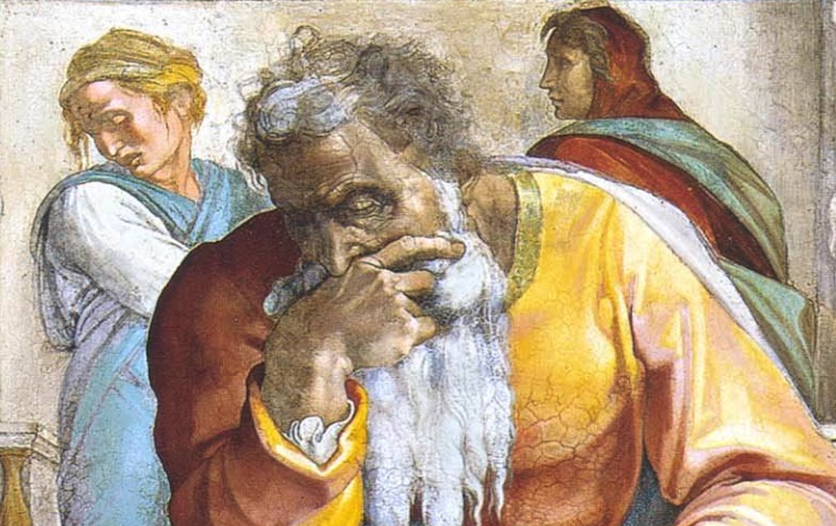
Jeremiah: Chapters 37-38

Slide 2
Jeremiah Memory Jogger:
The Yoke Of Babylon
Hananiah The Heretic
Letters to the Exiles
Glorious Future Ahead
The New Covenant
Kinsman Redeemer
I Will Cure Them
Violation of Sabbath Year
The Rechabites
Jehoiakim Burns The Scroll
Jonathan’s Cistern
Malchijah’s Cistern

Slide 3
John Humphries, “The Books of Jeremiah and Lamentations,” Truth Commentaries, 392
“The Babylonians attacked Jerusalem but then withdrew to battle the Egyptian army approaching from the southwest. This gave false hope to King Zedekiah and the people in Jerusalem. Has God changed his mind about the destruction of the city (cf. 18:7-8)? Are the Egyptians going to help save the city from the Babylonians (cf. 2:18, 36)? Can the prayers of the prophet Jeremiah save us from destruction at the hands of the Chaldeans (cf. 42:2; Is. 37:2ff.)? These questions are all answered in the negative. The Babylonians will not be distracted for long by the Egyptians…

Slide 4
John Humphries, “The Books of Jeremiah and Lamentations,” Truth Commentaries, 392
“…the Babylonians will drive the Egyptians away and soon resume the siege against Jerusalem. The city of Jerusalem will definitely fall to the army of Nebuchadnezzar. Mistreatment of Jeremiah at the hands of some of the princes continues, but Zedekiah delivers the prophet from their control—at least for the time being. The events in this chapter take place in the year 588/7 B.C., i.e., during the last eighteen months of the reign of Zedekiah.”

Slide 5
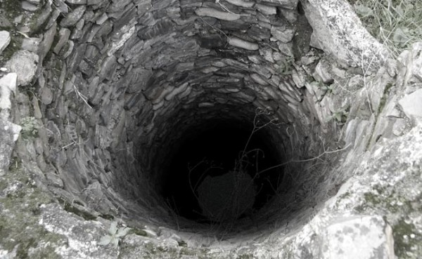
Chapter 37: Jonathan’s Cistern
The Siege Will Resume! (37:1-10)
Imprisonment For “Treason” (37:11-21)

Slide 6
Chapter 37: Applications
“Sometimes people dislike truth because it is presented in a hypocritical, unloving way; at other times, people simply do not like the truth of God, no matter how lovingly it is presented.” (Humphries, 397)
False hope will be exposed (v. 19; 5:30f; 6:14; 18:18; 23:16f; 28:1-4; Ezekiel 13:10-12). There is wisdom in exposing fraud & falsehood (cf. John 18:23; Acts 25:8, 11, 25)

Slide 7
John Humphries, “The Books of Jeremiah and Lamentations,” Truth Commentaries, 399
“The events in this chapter occur near the end of the eighteen-month siege by the Babylonians against Jerusalem. Jeremiah had been jailed in the ‘court of the prison’ (37:21) but continued to proclaim his messages to the people (38:8, 12). The princes were outraged against Jeremiah and wanted to silence the prophet. Jeremiah was then placed in a cistern and left to die. One of the king’s servants (Ebed-melech) obtained permission from Zedekiah to remove Jeremiah from the cistern and return him to the court of the prison. Zedekiah arranged a secret meeting with Jeremiah, asking for word from the Lord…

Slide 8
John Humphries, “The Books of Jeremiah and Lamentations,” Truth Commentaries, 399
“…The message given to the king was kept from the princes, who were suspicious of both Jeremiah and Zedekiah…The Babylonians were at the gates of Jerusalem (1:15), and emotions were running high in the city. The calls for surrender were considered by many to be treasonous. However, Jeremiah was only doing his job of telling the people that the Babylonians were going to capture the city no matter what the Israelite defenders did, and that lives could be saved if they would surrender.”

Slide 9
R.K. Harrison, “Jeremiah and Lamentations,” TOTC, 154-155
“The chronology of this chapter presents difficulties because of the similarities with 37:11-21. In both accounts Jeremiah is charged with treason and imprisoned (37:15,20; 38:6,26). Both chapters speak of a secret interview with the king, and both end with Jeremiah being placed in the palace stockade. There are differences in the two accounts, however, including the description of the rescue in chapter 38, the actual location of Jeremiah’s incarceration, and the fact that Zedekiah had sufficient authority to prevent the prophet’s summary execution on a charge of treason. Perhaps this chapter is an expanded form of chapter 37, though it could refer equally well to an entirely separate incident, since Jeremiah was no stranger to the wrath of his fellows.”

Slide 10
Lachish Ostraca VI – Jer. 38:4-6
“To my lord, Joash. May Yahweh show my lord this season one of peace. Who is your servant, a dog, that my lord has sent me the letter of the king and the letters of the princes saying: "Read!" Now, behold, the words of the princes are not good, weakening your hands and to make limp the hands of the men who are informed about. As for me, my lord, write them saying, “Why do you act like this, even in Jerusalem - behold, even against the king and against his house you have done this thing?” And as Yahweh your God lives, that since your servant read the letters, your servant has not had a moment’s peace."

Slide 11
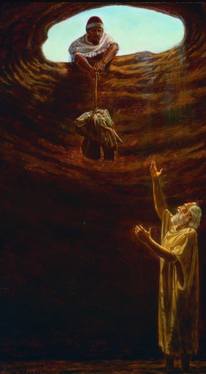
Chapter 38: Malchijah’s Cistern
Imprisonment For Discouraging Soldiers (38:1-13)
Zedekiah’s Private Discussion With Jeremiah (38:14-28)
“The deep respect and tender concern that this believing foreigner obviously had for God’s prophet is, indeed, touching. Forsaken and abandoned by his own people, Jeremiah found a believer and a friend among the Gentiles. An interesting parallel is seen here with what happened to Jeremiah and with the ‘suffering servant’ who was to come into the world (Isa. 53:3; John 1:11; Acts 13:45-46).” (Humphries, 402)

Slide 12
Chapter 38: Applications
“Jer. 21:1-2; 37:3, 17; 38:14: Though we may come time and again seeking a different answer, God’s word remains constant. Whether regarding marriage and divorce, baptism, the work of the church, or any other Bible topic, we must obey God’s word rather than the selfish desires of our own heart (Jer. 10:23; 2 Cor. 4:13; 1 Pet. 4:11; 2 John 9).” (Harkrider, 104)
We need to embody the soul-winning spirit of Jeremiah (v. 20).

