Slide 2
Tel es-Sultan &
Khirbet el-Maqatir

Slide 3
Jericho
& Ai

Slide 4
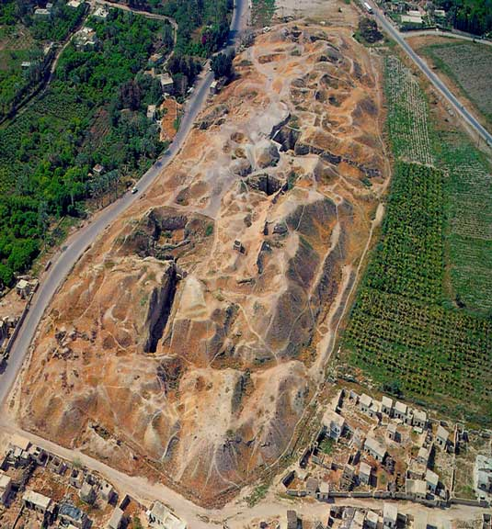
Jericho

Slide 5
City-states

Slide 6
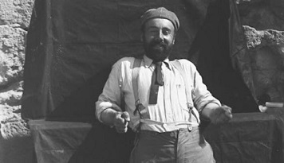
John Garstang
1930s

Slide 7
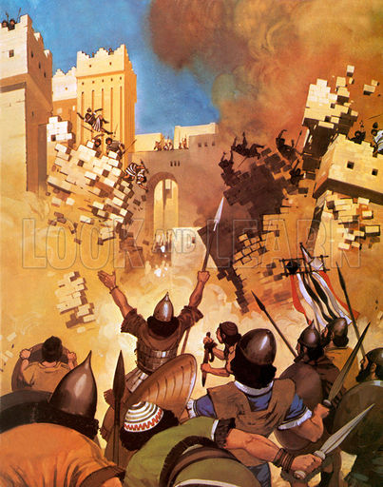
Jericho
destroyed
Late 15th cent.
(1400s BC)

Slide 8
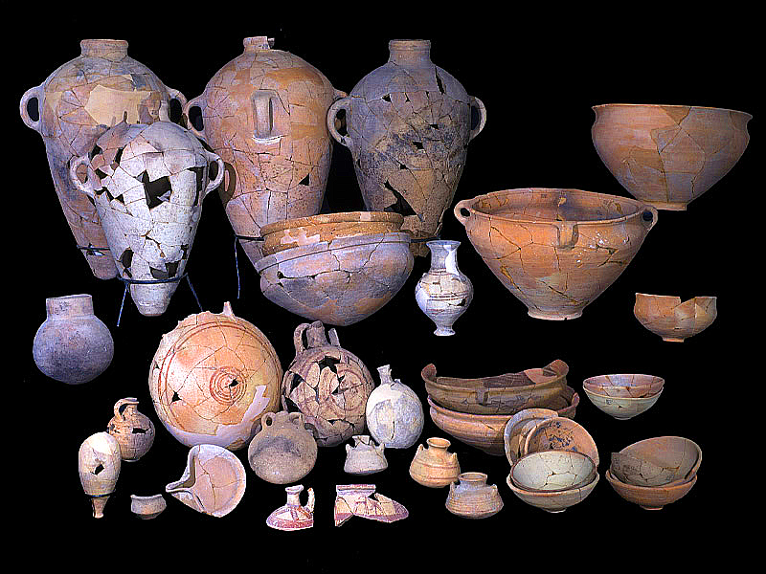

Slide 9
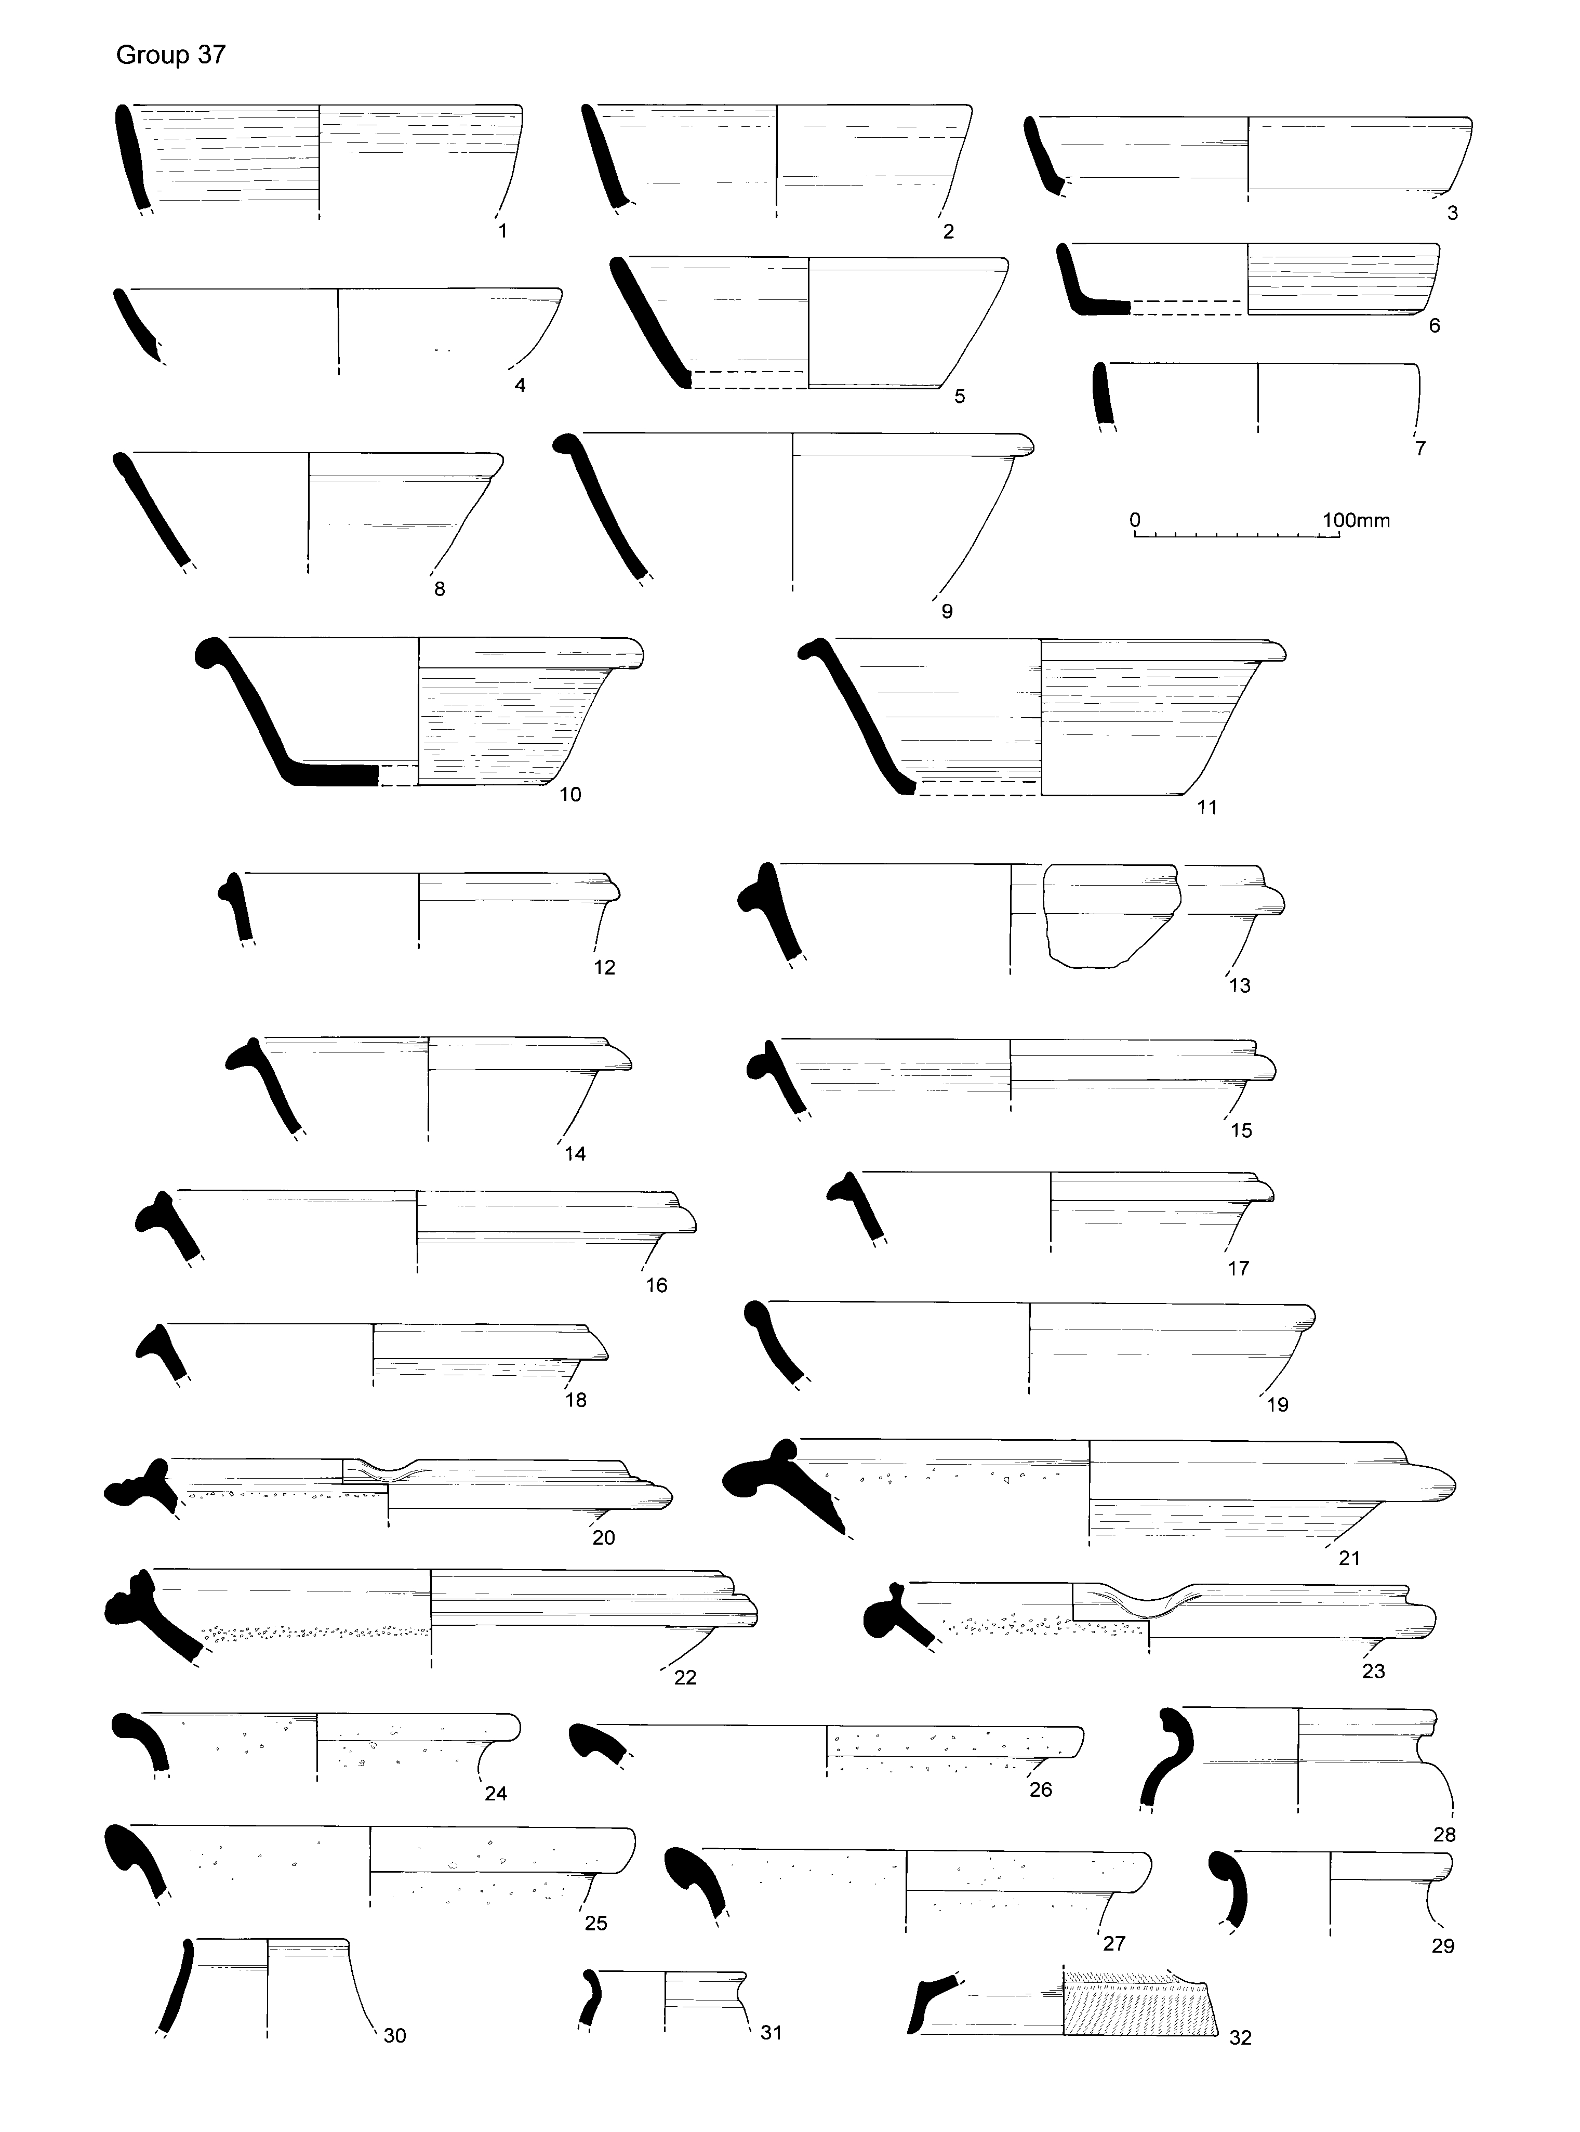

Slide 10
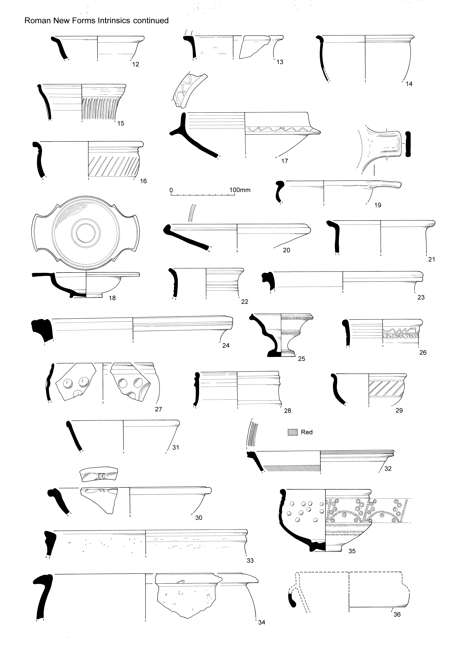

Slide 11
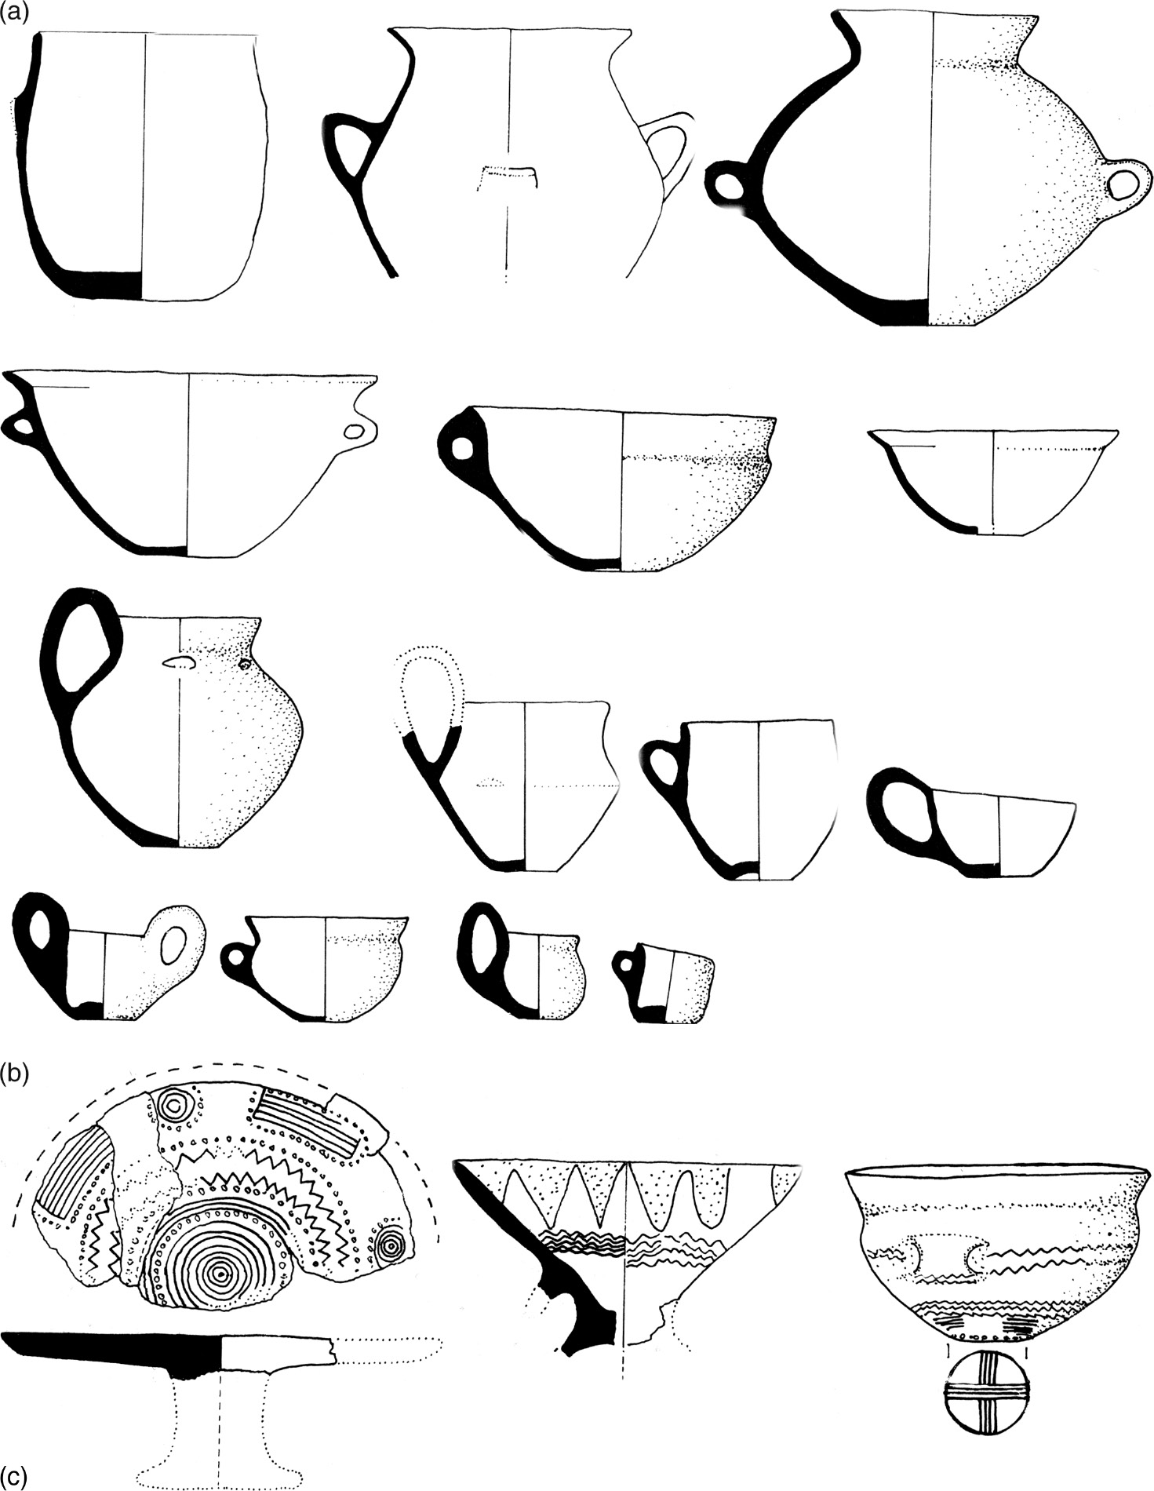

Slide 12
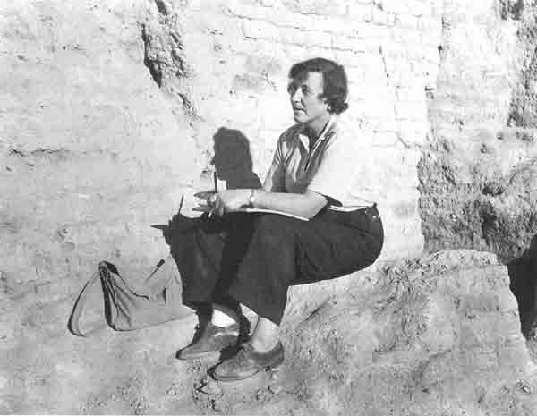
Kathleen Kenyon
1950s

Slide 13
Jericho
Destruction
Garstang
1400 BC

Slide 14
Jericho
Destruction
Garstang
1400 BC
Jericho
Destruction
Kenyon
1550 BC
Kenyon’s Date
150 years before Joshua

Slide 15
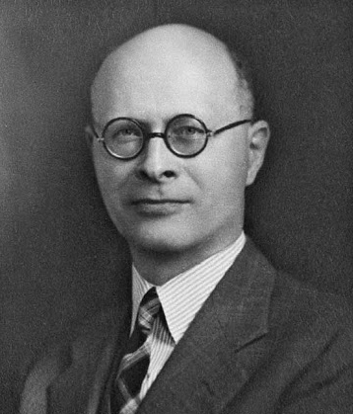
W.F. Albright
1960s

Slide 16
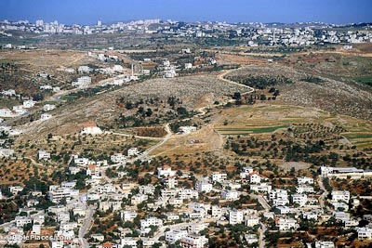
Et-Tell
(Ancient Ai)

Slide 17
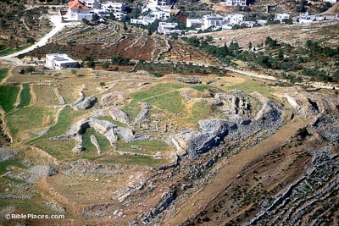
Et-Tell
(Ancient Ai)

Slide 18
Nothing found at Et-Tell (Ai)
Matches with Kenyon’s
assumptions of Jericho
“this discounts
the Biblical account”

Slide 19
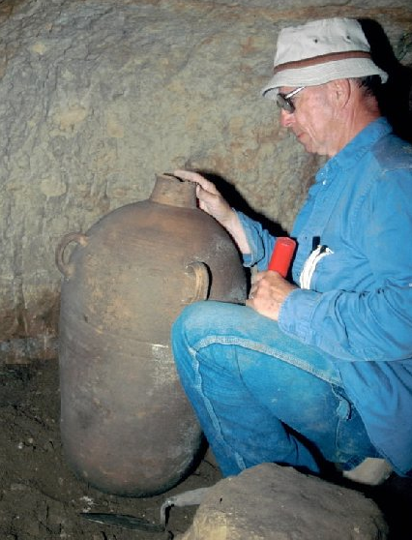
David
Livingston founded the Associates
for Biblical Research
(ABR)
in 1969

Slide 21
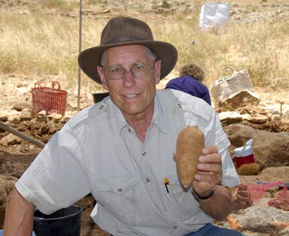
Dr. Bryant
Wood
Joined ABR
in 1994

Slide 22
Scarabs
Hatshepsut, Thutmose & Amenhotep II
All ruled 15th century (1400s BC)

Slide 23
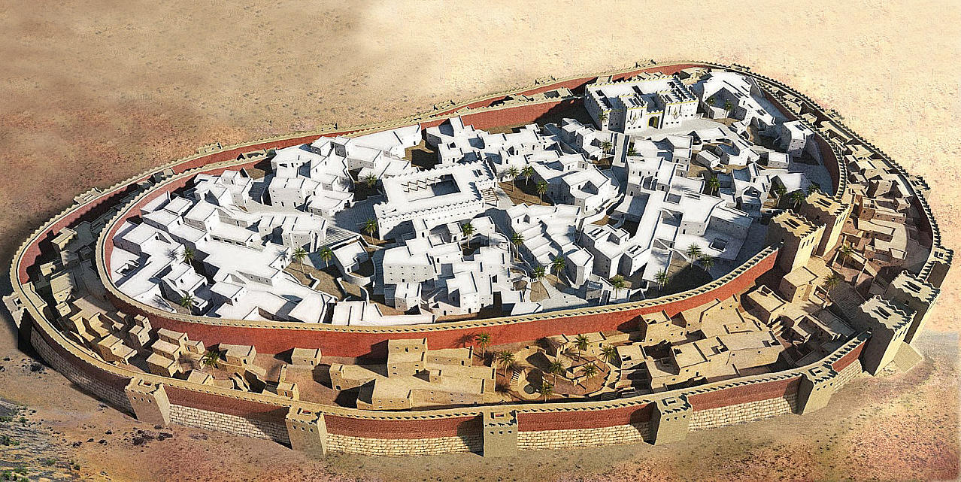
Jericho
Double wall defenses

Slide 24
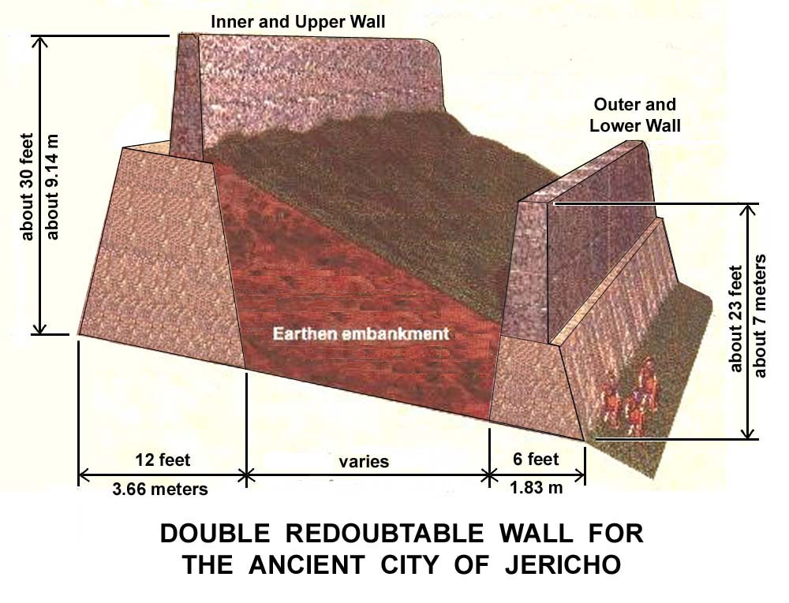

Slide 25
Lower stone & mudbrick wall
Embankment with dwellings
Upper wall enclosing upper city

Slide 26
Heb. Tachath = beneath itself

Slide 27
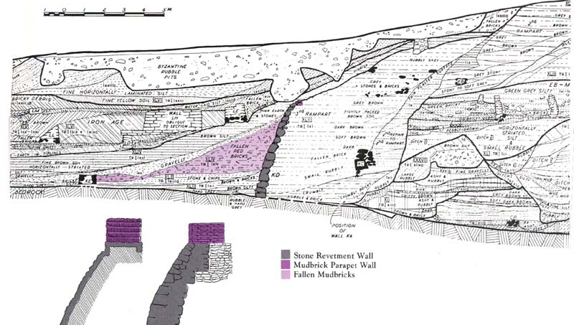
Heb. Tachath = beneath itself

Slide 28
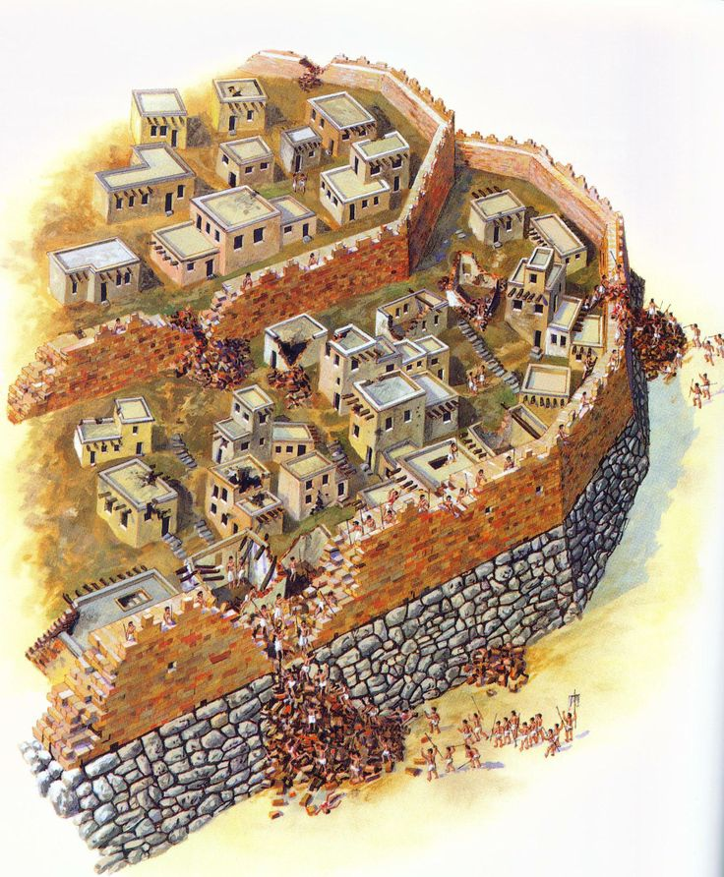

Slide 29
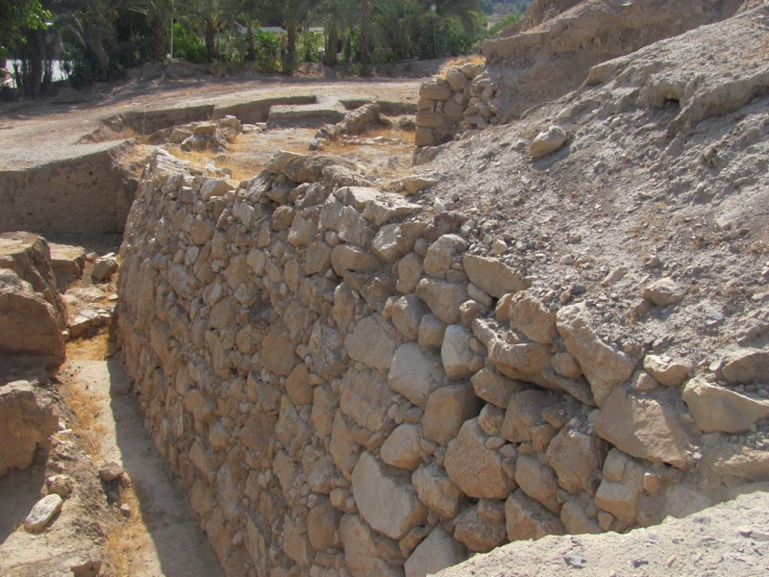
Stone Rampart
(base)

Slide 30
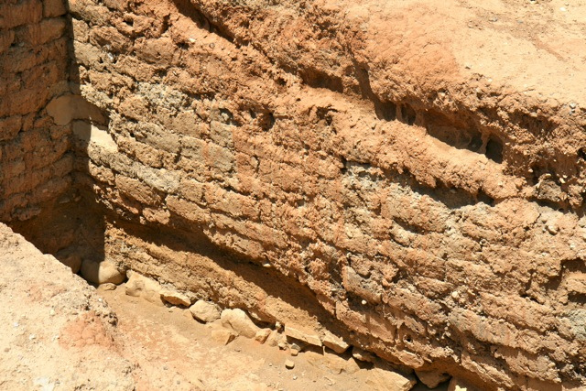
Mudbrick
wall

Slide 31
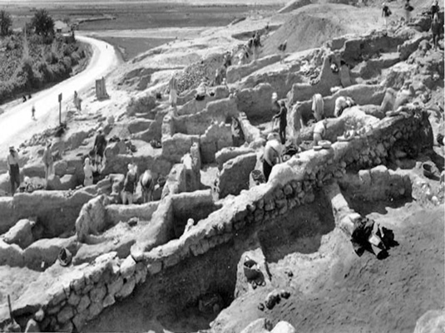
Dwellings
between walls

Slide 32
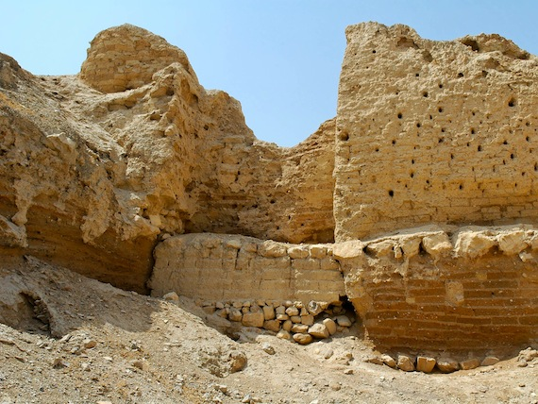
North wall
survived

Slide 33
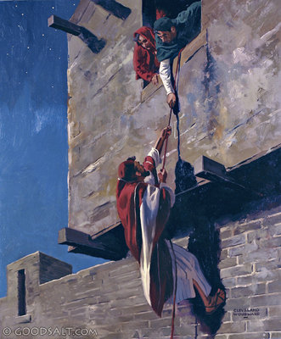
Heb. Is
“qir ha-chomah”
“qir” = inner or outer surface of the wall
“ha=chomah” = fortification wall or vertical surface of city wall

Slide 36
Specific requirements
for identifying a site:
Local tradition – indicated Maqatir

Slide 37
Specific requirements
for identifying a site:
Local tradition – indicated Maqatir
Geography – Look at Joshua 7 & 8

Slide 41
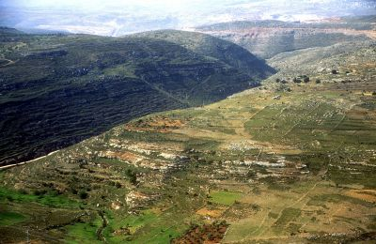
Wadi Sheban (deep)

Slide 42
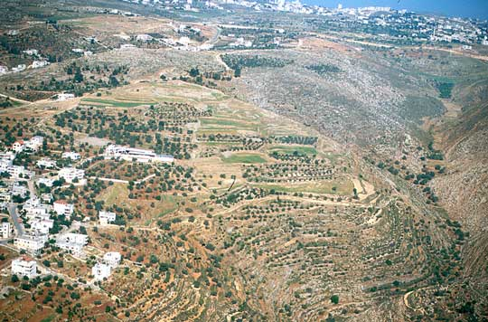
Wadi Gayeh (shallow)

Slide 43
Specific requirements
for identifying a site:
Local tradition – indicated Maqatir
Geography – Look at Joshua 7 & 8
Archaeology – Scarab, refired pottery, etc.

Slide 44
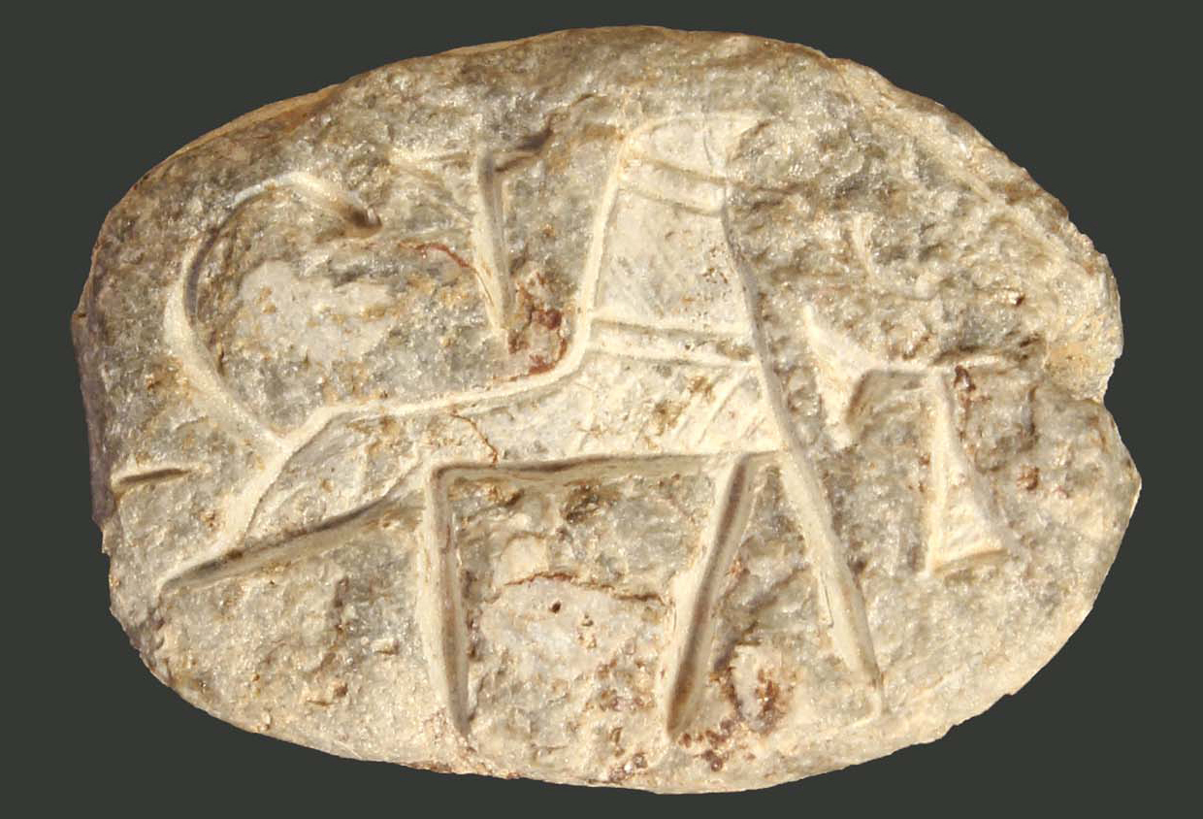
Egyptian scarab
Symbols for Thutmose &
Amenhotep…
Late Bronze (1400s), the time of Joshua

Slide 45
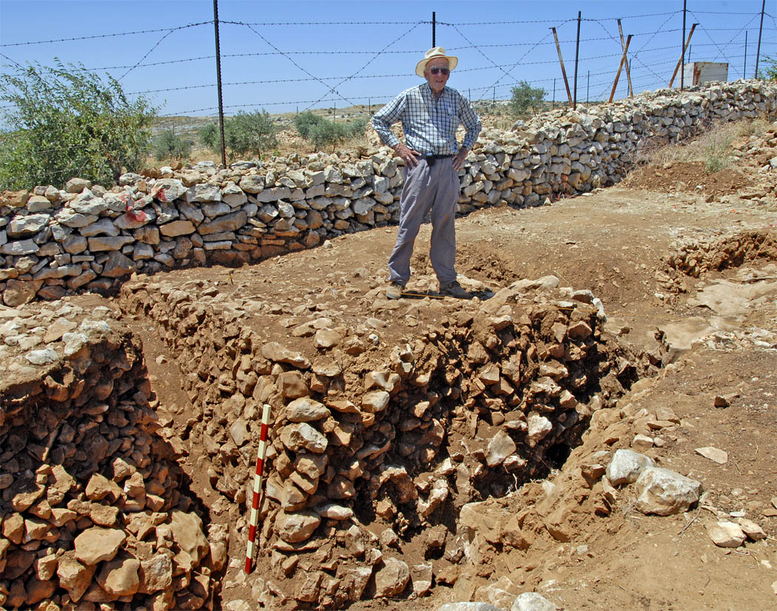
Fortress walls typical of Bronze age construction

Slide 46
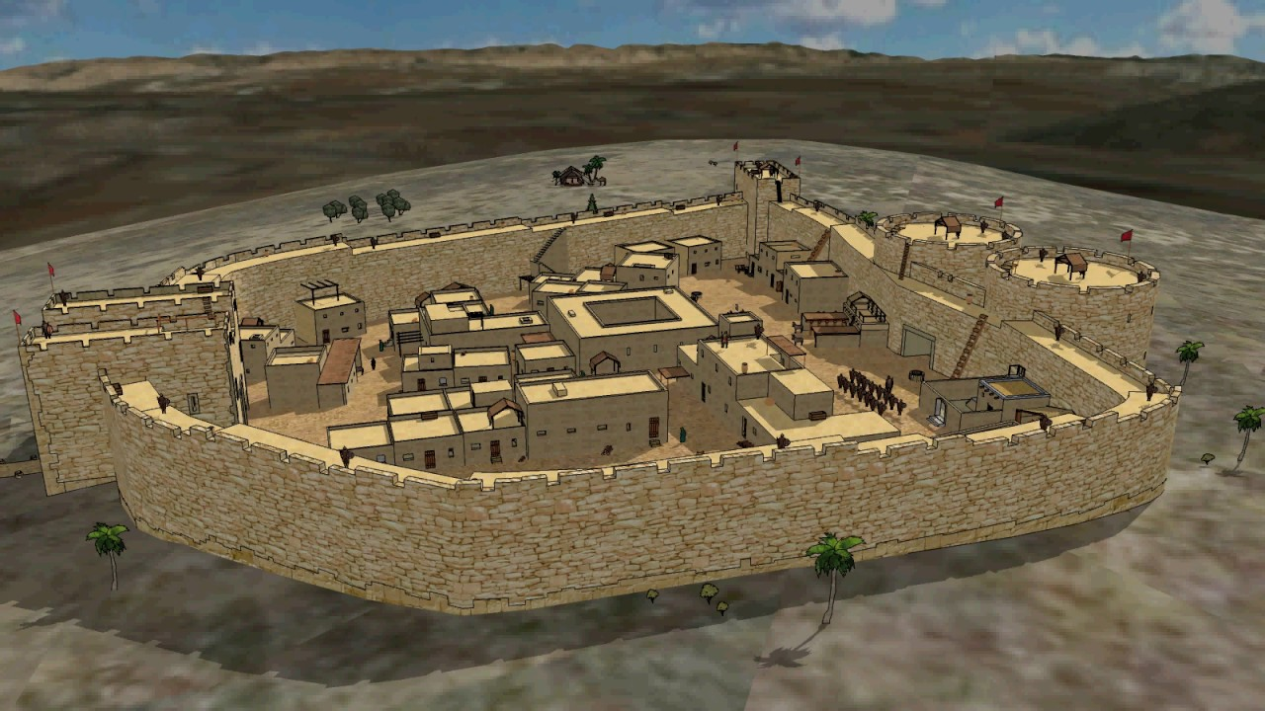
Four-chambered gate on north
Two round towers on south

Slide 47
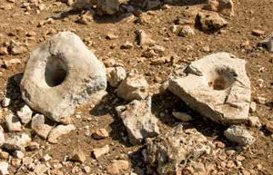
Socket stones for fortress gate

Slide 48
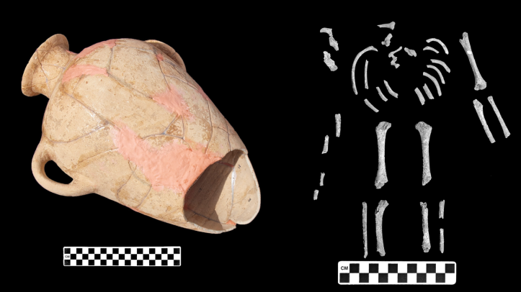
Burial jar holding
newborn’s remains

