Slide 1
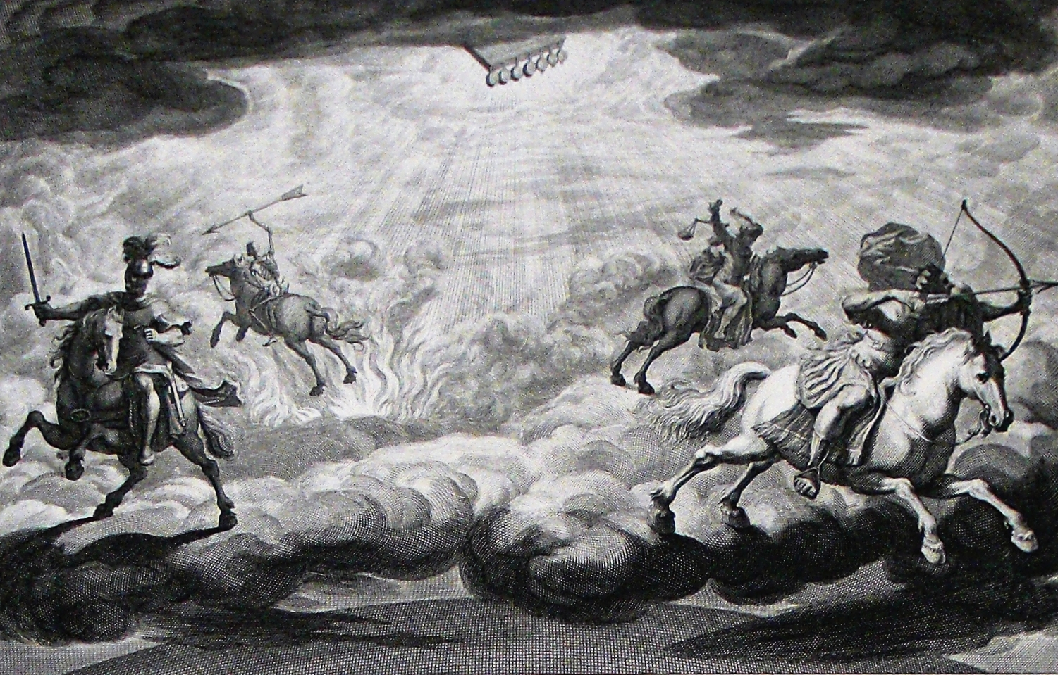
The Book of Revelation

Slide 2
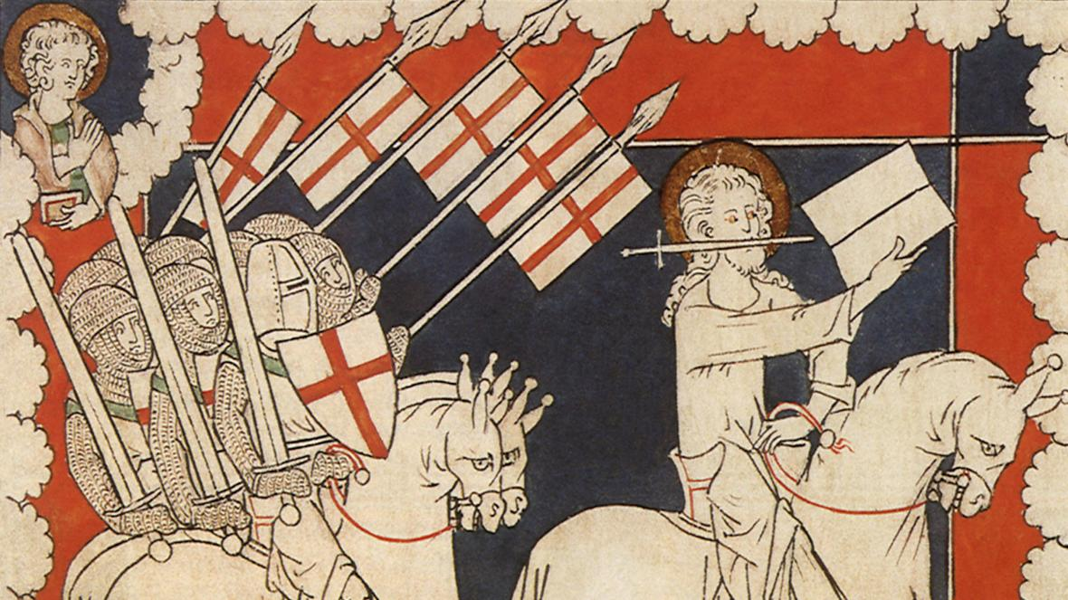
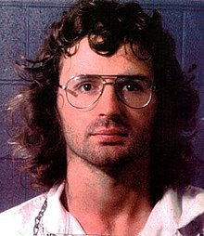
Danger in Ignorance of Revelation
David Koresh and the Branch Davidians (1993)
The Crusades (12th-13th centuries AD)
Hal Lindsey
(1970)

Slide 3
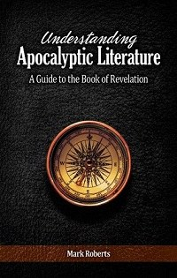
Putting Ourselves in the Original Readers’ Shoes
“the original readers lived in a time when the genre of apocalyptic was common and they had access to all kinds of material that reads very much like Revelation. To understand Revelation as they did, to read it with their eyes, means we must understand apocalyptic literature as they did” (38).

Slide 4
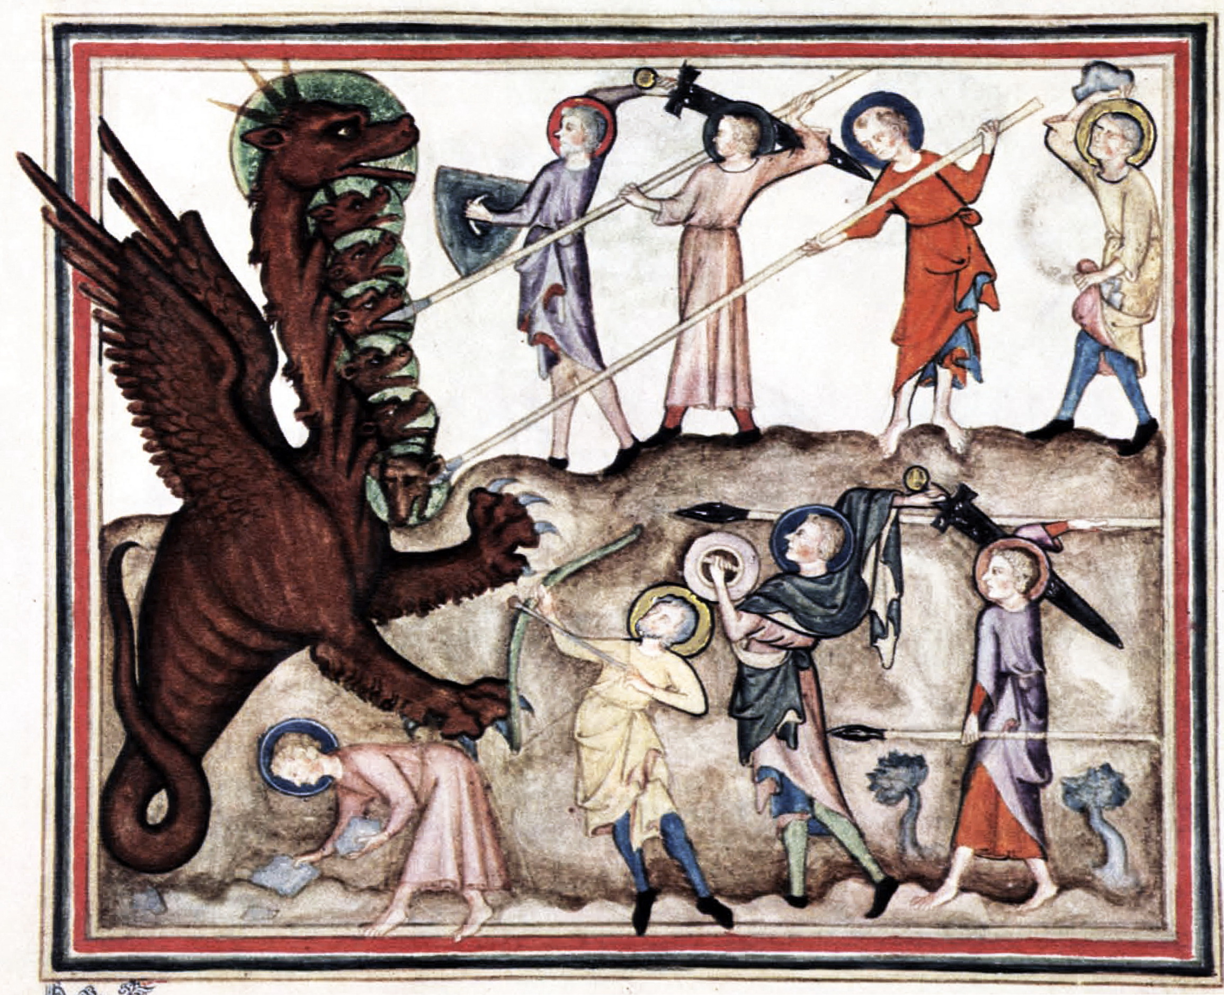
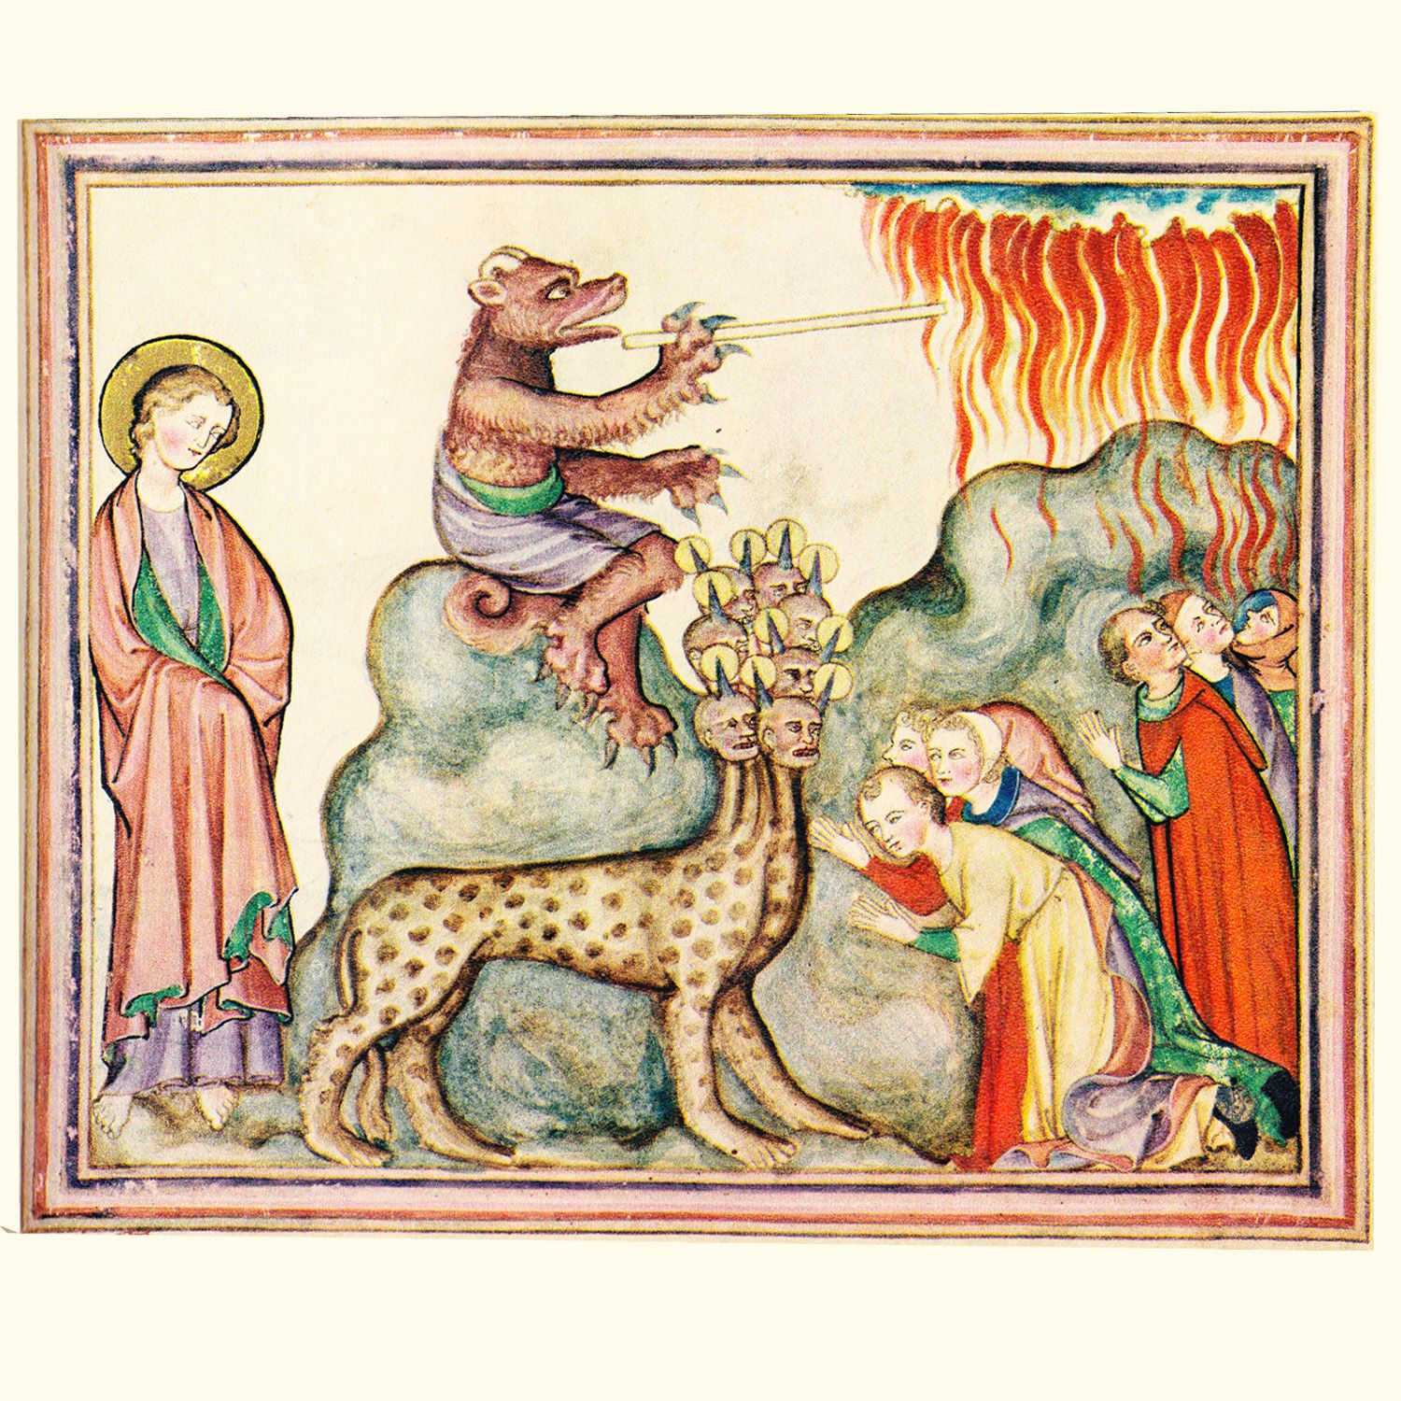
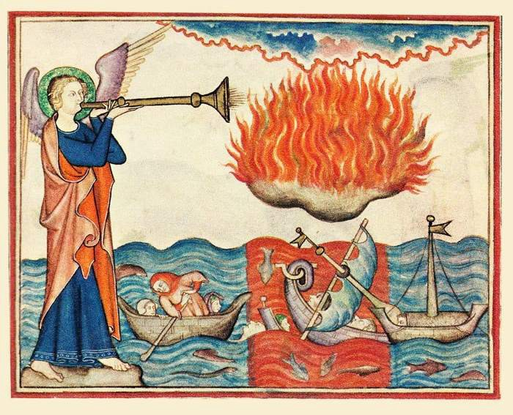
The “Apocalypse”
From the Greek word ajpokavluyiV
Revelation 1:1 – =ApokavluyiV =Ihsou: Cristou: h}n e[dwken aujtw:/ oJ qeovV dei:xai toi:V douvloiV aujtou: a} dei: genevsqai ejn tavcei kai; ejshvmanen ajposteivlaV dia; tou: ajggevlou aujtou: tw:/ douvlw/ aujtou: jIwavnnh/
The book is meant to be an unveiling (contrary to how it is viewed in the world today)

Slide 5
The Apocalyptic Worldview
A way of viewing God’s interaction with the world
Key ideas:
The old existing order of things has become corrupted and is even hostile to God and his people – evil reigns over God’s creation; no hope in politics or history
God will act in a dramatic way; opposite of deism
The old, corrupted order will be superseded; wrongs will be set right, wickedness will be judged/defeated
Righteousness will be manifested
A new order will be established/victorious over the old

Slide 6
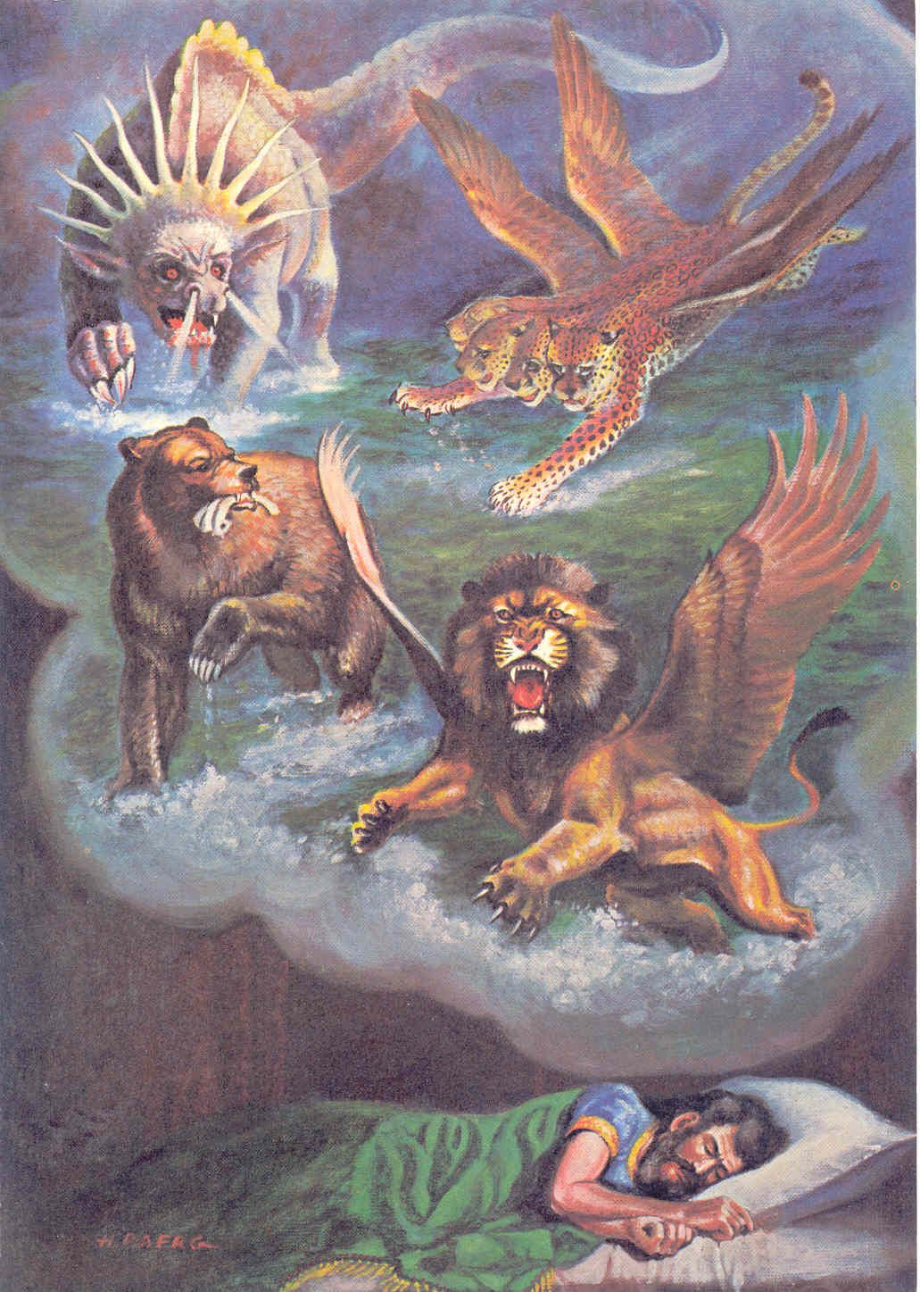
Apocalyptic Examples
Events: The Flood
Books: Daniel, Ezekiel, Isaiah, Zechariah
Teachings: Matthew 24
Various New Testament Passages: Romans 2:16; 16:20; 1 Corinthians 10:5; Galatians 4:4-5; Ephesians 2:5-6; 6:12; Hebrews 3-4 (cf. Psalm 95)
Non-Biblical Examples: Enoch, Assumption of Moses, Apocalypse of Baruch, 2 Esdras, Testaments of the 12 Patriarchs, Sibylline Oracles, Book of Jubilees, Shepherd of Hermas
Hymns: Glory, Glory, Hallelujah; Battle Hymn of the Republic

Slide 7
Characteristics of Apocalyptic Writings
Produced in times of perceived crisis and conflict
A response to the bewilderment of people because confusion brings fear, disorientation, tests faith, etc.
A defense of God’s goodness (e.g., 6:9-11)
Presents information in the form of a story
Not a strict chronology (overlooked by many views)
Can be a progressive revelation, telling the same story multiple times with different details
Highly symbolic and depends on figurative language
Emphasis heightens the sense of crisis and resolution
Imparts a sense of the cosmic dimensions of the struggle (e.g., Daniel 10:13; Revelation 12:7-10)
Shocks the faithful to see the world as it really is (e.g., 1:17f)

Slide 8
Characteristics of Apocalyptic Writings
The symbolic story reveals truths or outcomes that are otherwise unknown
Prophecy in a sense (1:3; 22:7, 10, 18, 19), but more than ordinary prophecy
A message from a heavenly messenger or visions/dreams to a human recipient; often interpreted by the heavenly messenger (e.g., 5:2; 10:1, 9; 17:7; 19:9; 22:6)
The revelation presents a view of the heavenly realm, its realities and activities
A big picture view behind the scenes (e.g., chapters 4-5)
The view of the heavenly realm provides a perspective on the present sufferings, crisis, and conflict
This perspective is meant to help readers cope and endure (2:7, 11, 17, 26; 3:5, 12, 21; 21:7)

Slide 9
Characteristics of Apocalyptic Writings
A message of coming judgment on the enemies of God and the vindication of His people
God is about to break into the situation, drastically, violently, (relatively) suddenly
A coming time of setting things right
Public and “final” (e.g., 18:20; 19:19-21; 20:1-3, 10)
A message that the kingdom of God will overcome all enemies and rival kingdoms, and will endure
The saints will be protected by God
Persecution and death cannot defeat God’s saints
The saints will live (again) to see victory (e.g., 2:10)

Slide 10
Characteristics of Apocalyptic Writings
A message of hope in a situation of perceived silence and inactivity by God
Reveals that God has not withdrawn and is concerned
Reveals that God will act to destroy the enemies
A message for “insiders,” not for the world at large (1:3; 2:7, 11, 17, 29; 3:6, 13, 13, 22; cf. 1 Corinthians 1:18f)
A message including moral exhortation and warning to God’s people
Warns the righteous not to be corrupted by the wicked and not to participate in the evil about to be judged (e.g., 2:20; 18:4)
Calls for endurance and faithfulness (e.g., 2:10)

Slide 11
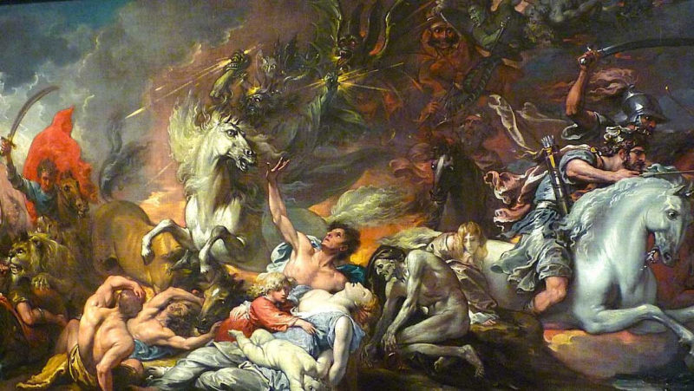
Apocalyptic Imagery
Symbolic language
Revelation is symbolism on steroids!
A verbal picture book, rather than a treatise
Pictorial richness!

Slide 12
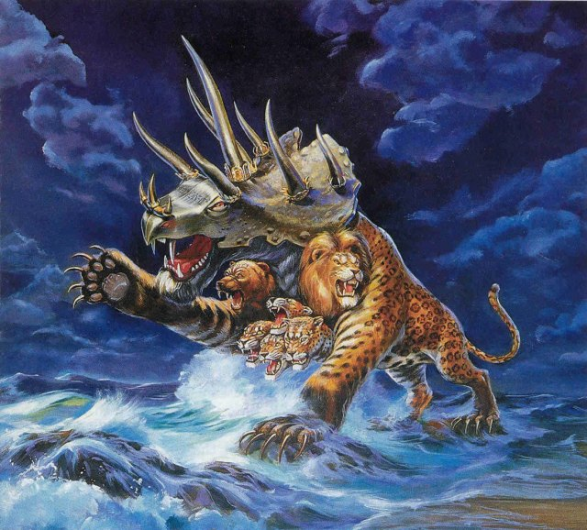
Some Keys to Interpreting the Imagery of Revelation
"The apocalyptic literature is marked by a highly dramatic quality whose language and style match the inexpressible scenes which it tries to portray. Such scenes cannot be portrayed in the sober language of common prose; they require for their expression the imaginative language of poetry. But it is poetry quite unlike the restrained language of the Old testament Scriptures. The apocalyptists give full reign to their imaginations in extravagant and exotic language and in imagery of a fantastic and bizarre kind. To such an extent is this true that symbolism may be said to be the language of apocalyptic." (D.S. Russell)

Slide 13
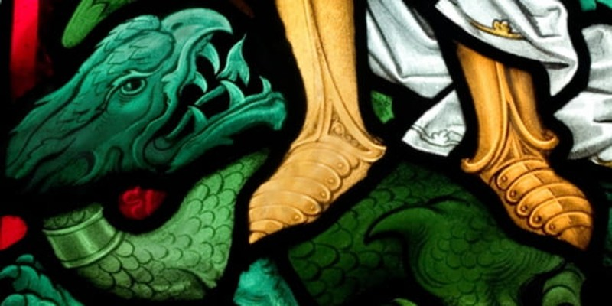
Some Keys to Interpreting the Imagery of Revelation
". . . Revelation is addressed chiefly to the imagination. As the expositor reads the book, he must seek to see in his mind's eye the various episodes intense with drama, . . . . Unless the reader can do this, he will miss the greatest messages of Revelation. The man who has not, or has and refuses to use, a fertile imagination, will do well to leave this book alone. This book was written to yield its message by creating an impression, and this impression makes itself realized as one yields himself to the drama that is enacted before him on the stage in Asia Minor A.D. 90-96." (R. Summers)

Slide 14
Some Keys to Interpreting the Imagery of Revelation
To understand the imagery in Revelation, one must understand the imagery as it was used in the Old Testament! (hundreds of OT allusions in Revelation)
“The book of Revelation is the most thoroughly Jewish in its language and imagery of any New Testament book. This book speaks not the language of Paul, but of the Old Testament prophets ...” (The Old Testament in the Book of Revelation, p 22).
Focus on the BIG PICTURE!
Don’t focus on chronology; focus on the angles of perspective on the overall message

Slide 15
The Overall Message
In spite of how things look from an earthly perspective, God’s people and their stand for righteousness will always be victorious and the enemies of God will be vanquished.
This does not mean God’s people won’t suffer, or that triumph will come quickly. But at the end of the day the rule of Christ and the church still stand – and where is Rome??
Just work toward a better understanding in this class

