Slide 1
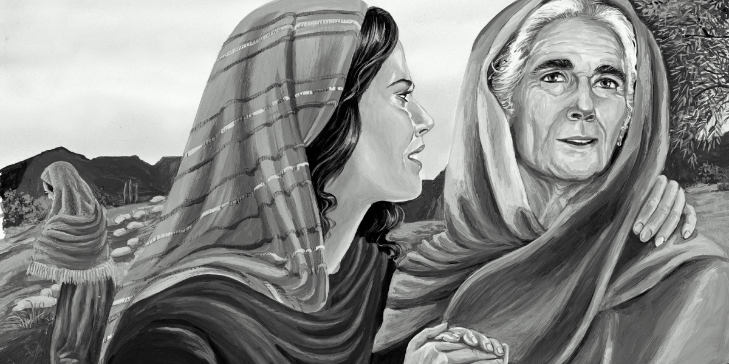
What’s In A Name?
Bethlehem House of Bread
Elimelech God is My King
Naomi Pleasant
Mahlon Sick or Weak
Orpah Neck or Fawn
Chilion Wasting Away or Weary
Boaz Fleetness
Obed Servant or Worshipper
Ruth Friend

Slide 2
Significance of Names
Elimelech (God is My King) left Bethlehem (House of Bread)—Question to Ponder: If God was the King of his life, then why not trust in his ability to provide?
Mahlon and Chilion—Both names described a state of feebleness. Both decided to marry outside of God’s chosen people (Israel) to Moabite women. Both died apparently young without heirs.
Naomi’s name means “Pleasant,” but asked to be called “Mara,” which means “Bitter.” Her bitterness did not last, nor did her name remain “Mara.”

Slide 3
Significance of Names
Boaz’s name means “Fleetness.” He was swift to act throughout this narrative.
Obed means ”Servant” or “Worshipper.” Through his descendants the Christ would come.
Ruth was a true “Friend” in every sense of the word. She remained faithful to her mother-in-law. In chapter 1:14, the word “clung,” means to literally be stuck together like glue. Her loyalty and humility shines as a bright example.

Slide 4
Kinsman Redeemer
The most significant point of the Book of Ruth.
Boaz restores/redeems back Ruth.
When Obed is born, Naomi was then restored. She takes this child as her own, and Obed redeems the line of Elimelech (Chapter 4:13ff).
Through the line of Obed will come David and eventually Christ Jesus (Chapter 4:22; cf. Matt. 1:5ff). Christ is our Kinsman Redeemer. He redeems His faithful children from their sin (cf. Gal. 4:4ff).

Slide 5
Key Passage to Remember
Galatians 4:4-7
But when the fullness of the time came, God sent forth His Son, born of a woman, born under the Law, so that He might redeem those who were under the Law, that we might receive the adoption as sons. Because you are sons, God has sent forth the Spirit of His Son into our hearts, crying, “Abba! Father!” Therefore you are no longer a slave, but a son; and if a son, then an heir through God.

Slide 6
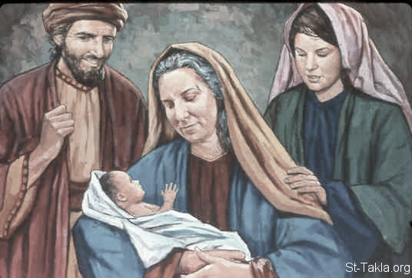
Salmon was the father of Boaz by Rahab, Boaz was the father of Obed by Ruth, and Obed the father of Jesse. Jesse was the father of David the king. Matthew 1:5-6

