Slide 3
Connections Between Ezekiel and Jeremiah
Priests called to be prophets (Jer. 1:1; Ezek. 1:3)
Spoke against Israel’s elders & prophets (Jer. 23:1ff; Ezek. 13:1ff; 34)
Destruction of Jerusalem (Jer. 6; Ezek. 24)
Each person responsible for their sins (Jer. 31:30; Ezek. 18:20)
New Covenant (Jer. 31:31ff; Ezek. 36:24ff)

Slide 4
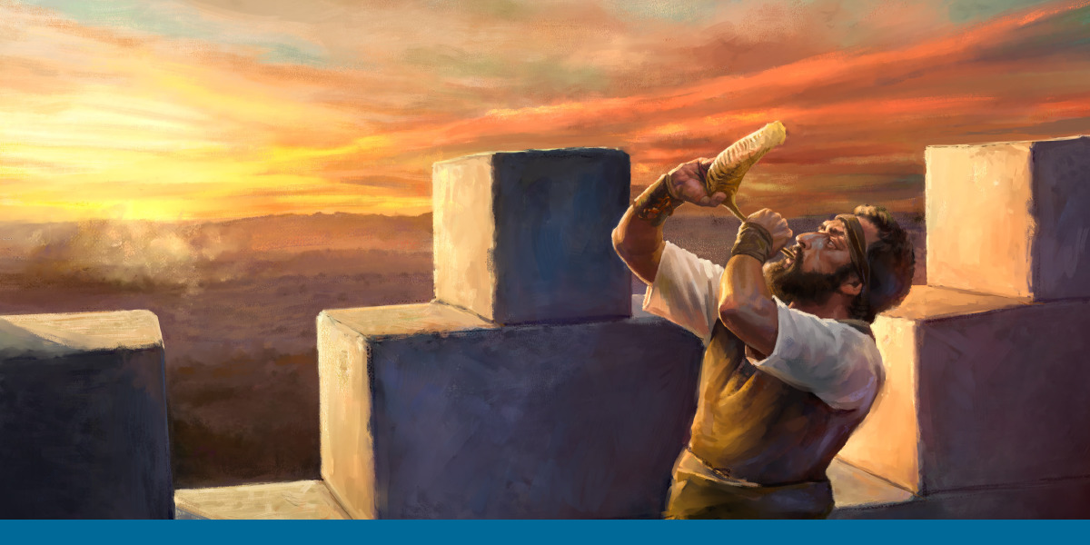
Pressing on Toward the Goal of Watching Out for One Another

Slide 5
Ezekiel 2:8-3:3
God’s Word is complete
Sweet & Delightful
Bitterness

Slide 6
Ezekiel 3:4-11
Given every opportunity to hear and have no excuse (cf. Rom. 1:20)
Commands His children to share His Word (cf. Deut. 6:6f)
Refuse to Listen due to calloused heart (cf. Isa. 6:10; Matt. 13:15ff)

Slide 7
Ezekiel 3:12-15
Consecration of a priest (cf. Lev. 8)
Mourning (cf. Gen. 50; Job 2)
Righteous Indignation
No desire

Slide 8
Ezekiel 3:16-21
Watch & Warn of Threats
Look for friend or foe
Positioned on Walls & Towers
Protection during harvest time
Biblical References for watchman: 2 Sam. 18:24ff; 2 Kgs. 9:17; Neh. 7:3; Jer. 31:6, etc.

Slide 9
Ezekiel 3:16-21
Thus Says the LORD!
Warn the wicked
Fail to warn—Wicked & Ezekiel will perish
Fail to heed warning—Wicked perish/Watchman spared
Warn the righteous
Fallen brethren—Fail to warn results in their death & yours
Remain faithful—Brethren delivered & Watchman as well

Slide 10
Ezekiel 33
Wicked can & will be saved--Repentance
Righteous can & will perish—Disobedience
“When a man sins he is eternally separated from God unless he repents. When a sinner sins and I say nothing to him I have not turned away his path to eternal spiritual death. I have in effect spiritually murdered the man.”

Slide 11
Ezekiel 3:22-27
I AM GOD
I AM in charge
Speak when told
Only MY words you will say
People will either listen or they won’t

Slide 12
Applications
SHARE THE GOSPEL!
Most will NOT obey
We are NOT to blame for those that refuse the Good News
All held accountable

