Slide 1
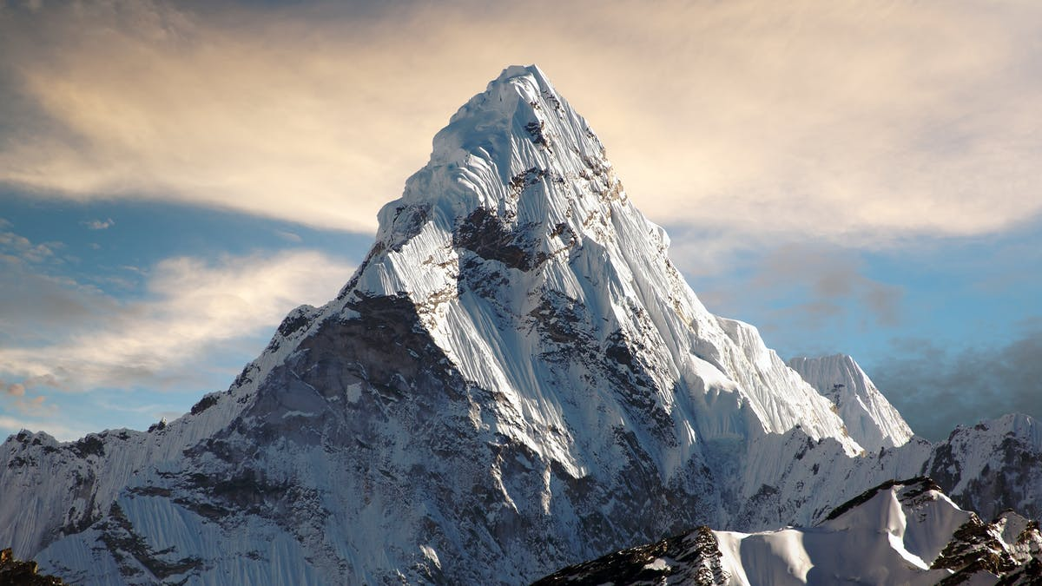
Three things the mountains teach us Regarding god

Slide 2
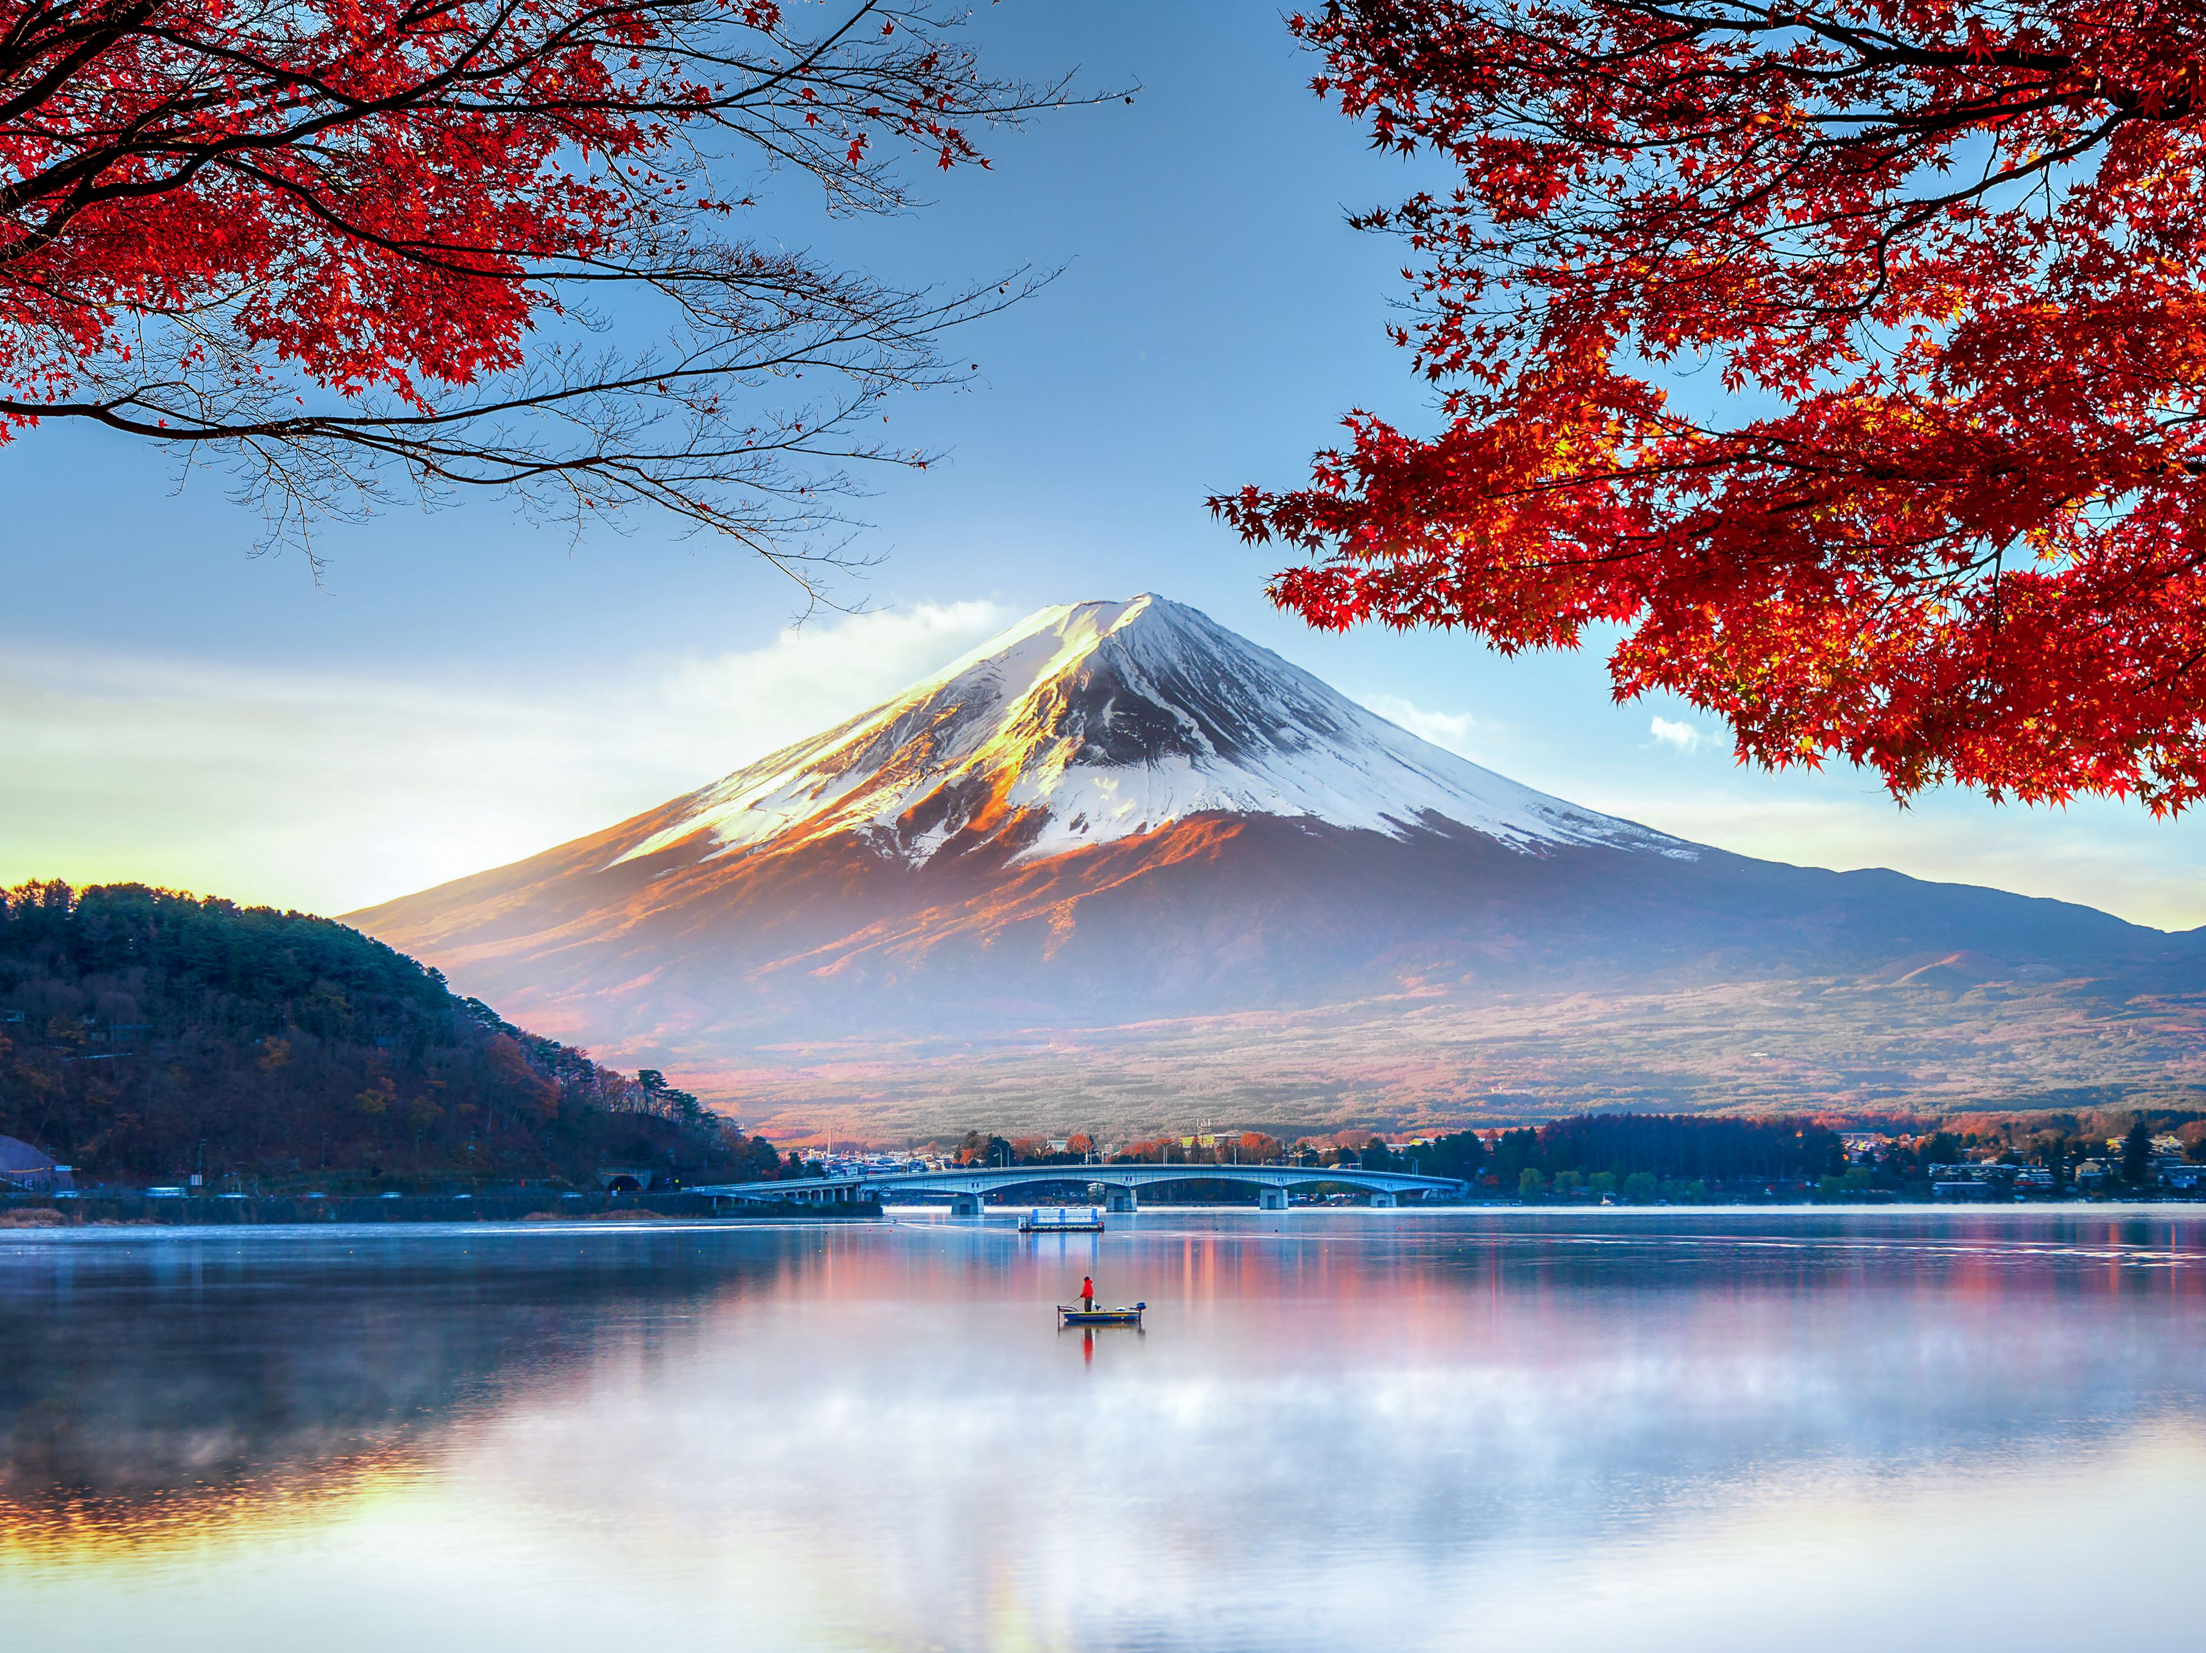
The Mountains Teach Us to believe in God

Slide 3
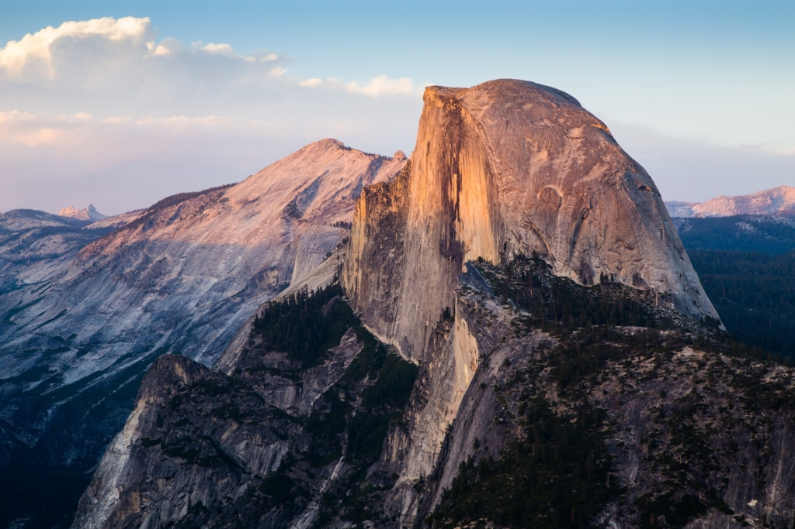
The Mountains Teach Us About God’s Love

Slide 4
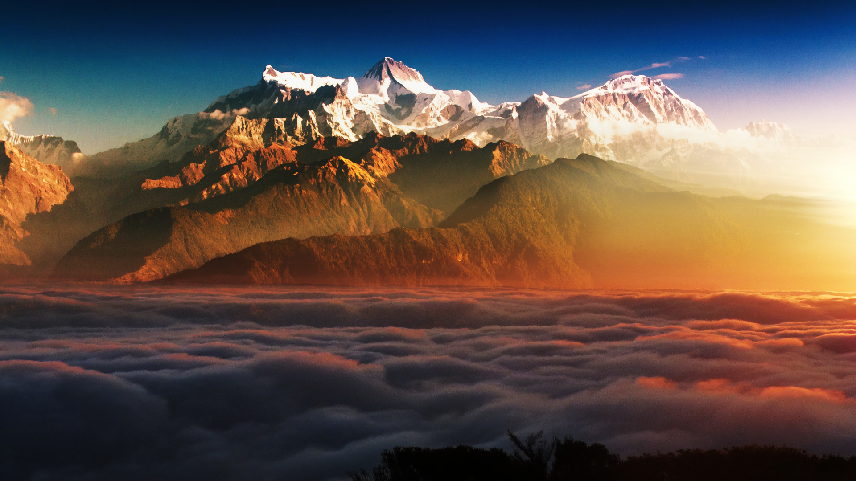
The Mountains Teach Us About God’s Home In Heaven

Slide 5
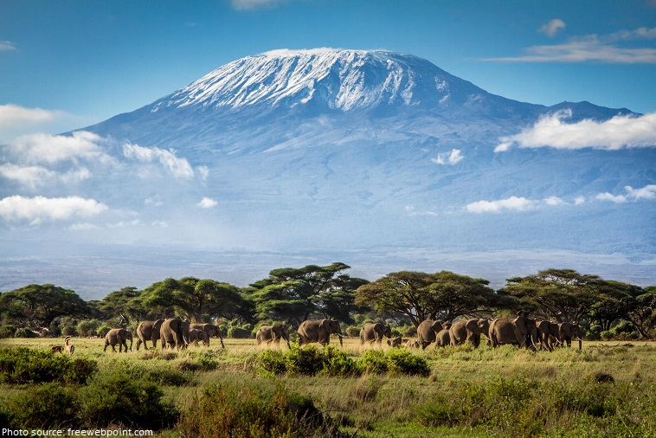
God has appointed the mountains as our teachers! Will we listen to their instruction?

