Slide 1
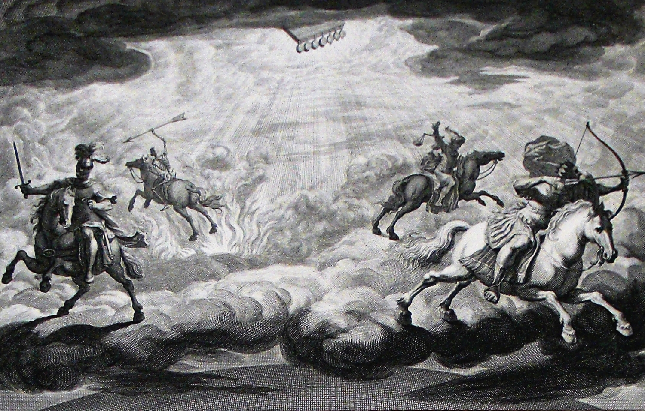
The Book of Revelation

Slide 2
Running Into Problems…
Even conservative commentators depart from their own principles of exegesis in chapter 20.
Poor interpretations, especially premillennialism, play a part in influencing many. Hollywood depictions also influence many.
“If verses 4, 5, and 6 of Revelation 20 had been omitted, no one would ever have dreamed of a literal thousand years of Christ’s reign upon the earth – his setting up of a temporal throne in Jerusalem and inaugurating a millennial reign as an earthly monarch. Yet whole systems of eschatology, theology, and philosophy of history have been constructed on this precarious basis of highly symbolical verses.” (Summers, 203)
To correct this, we must be consistent with:
The time context in Revelation (i.e., “things which will soon take place” – 1:1; 22:6). Superimposing far distant future events is inconsistent and unfaithful to the book.
The genre context of Revelation (i.e., apocalyptic symbolism). Treating symbolic elements as literal may make for a fanciful Hollywood interpretation, but it does not in any way accurately speak to God’s intent for the book.

Slide 3
The Binding of Satan (20:1-3)
The picture throughout Revelation has CONSISTENTLY been that Satan will lose in his efforts through Rome to destroy the church. We should expect the same here.
An angel from heaven binds Satan with a great chain and casts him into the pit (cf. 9:1f, 11; 11:7; 17:8). This is NOT “a curtailing of his power during the preaching of the gospel” (a common view based on a faulted connection to Matt. 12:29); it is a TOTAL defeat of his power through Rome. This is a COMPLETE defeat of Satan, RELATIVE to how he had been operative in the book (i.e., through Rome). Satan’s use of Rome will be obliterated in his binding.
He is bound “for 1,000 years” – this condition and time indicates COMPLETENESS (cf. Ps. 24:1; 50:10; Deut. 7:9). Relative to Rome, Satan is completely defeated. Rome would go away, but Christians would remain. Satan’s loss of Rome is a complete defeat. “The Devil is totally, perfectly and flawlessly defeated and bound. (This is of course, with reference to his working through Rome against the Church.)” (McGuiggan, 274)
One commentator among our brethren illustrates inconsistency here: “[1,000 years] is intended to emphasize the totality of Satan’s defeat. It is a perfect binding that will take him out of the picture for a long, long time.”

Slide 4
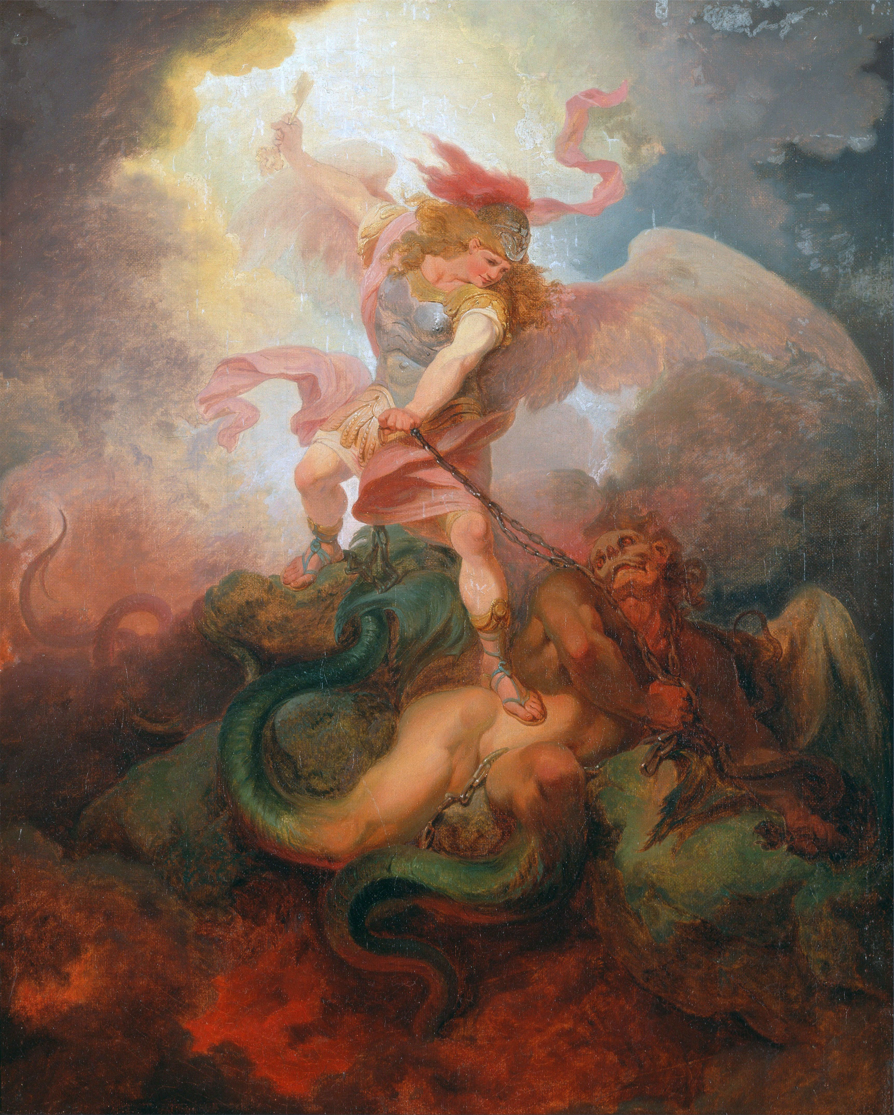
The Binding of Satan (20:1-3)
“after these things he must be released for a little while” – Rome would go away, but Satan’s influence is not singularly dependent upon this physical nation!
Even so, Satan’s influence through anything else will also ultimately prove ineffective. All political, cultural, and societal tools of the Dragon will result in his utter defeat. Jesus has taken away his dominating power through sin (John 12:31; Heb. 2:14; 1 John 3:8; Col. 2:15; Eph. 4:8).
Release for a “little while” (cf. 42 months, 1,260 days, 3.5 times, 3.5 days). Symbol of a broken 7, 10 days, a little while, etc. represents a brief, ineffective persecution during which God’s purposes via His people are not thwarted.

Slide 5
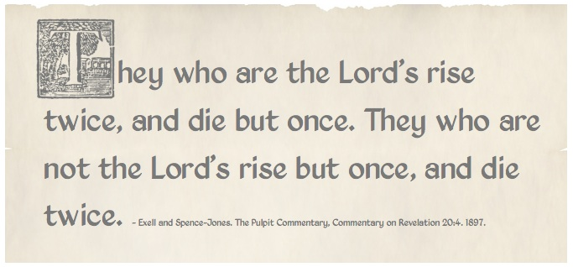
The First Resurrection (20:4-6)
Satan’s efforts via Rome are fully defeated for “1,000 years.” God’s people, and especially His martyrs, live and reign in total victory with Christ for “1,000 years.” The thrones of the persecutor have become the thrones of the persecuted.
The reign of the saints is called “the first resurrection.” The idea of saints reigning on thrones is a callback to Matt. 19:28. In contrast, the “rest of the dead” (i.e., the ungodly) remained dead (i.e., completely defeated). Note that the text does NOT say that the saints will reign with Christ on earth for 1,000 years.
The “first resurrection” = the victory of martyred saints over their tormentors (cf. Isa. 26:19; Hos. 13:14; Ezek. 37:10-14). How fitting that Christians are “resurrected” in Christ’s resurrection in baptism! (Rom. 6) and how fitting that those in sin are “dead” to sin (Eph. 2:1; 1Tim. 5:6). Compare resurrection as an image for victory in 1Jn. 5:4f; 2:13ff; Rev. 12:11; 15:2. This is the 5th of 7 beatitudes in Revelation.

Slide 6
Gog and Magog Defeated (20:7-10)
Will Christians survive Rome, only to be defeated by an even stronger power? NO!
Ezekiel 37-39 is the backdrop for this imagery.
Israel was a valley full of dried bones (Ezek. 37) decimated by slaughter, deportation, and fragmentation. This is the background for Revelation 20:4-6.
A national restoration is pictured as a resurrection, just as God’s nation is in Rev. 20.
After this resurrection, a vast international army comes against a land of unwalled villages, a peaceful people, who dwell safely having neither bars nor gates (Ezek. 38:10-12).
God would be glorified through and by the end of this (38:16, 18, 20) as He gloriously defends His people in language similar to Rome (and Satan’s) downfall in Revelation. Background of 20:7-10. In the original imagery in Ezekiel (39:12f), there are hundreds of millions of dead bodies and it takes the people 7 months to bury them all.
Gog and Magog become a symbol for ANY prospective enemy of God’s people. No matter their earthly advantages, Satan’s minions are destined for failure and God will always defend His people and overcome their (and His) enemy.

Slide 7
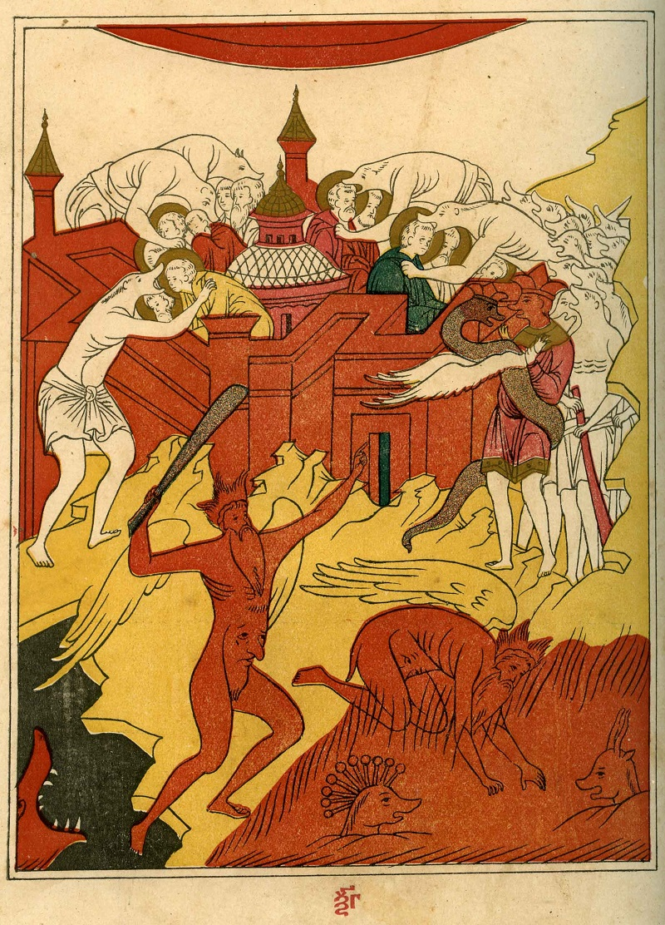
Gog and Magog Defeated (20:7-10)
“Evidences of Satan’s allies are abundant: secularism, materialism, atheism, astrology, false religion, fleshly lusts, drug cults, and all manner of evil. The Lord’s church is under attack from paganistic advocates who tolerate every immorality secular humanism can conceive, from abortion and homosexual marriages to the abolition of any faith that advocates trust in God. The idol of our day is not a God-Caesar; instead, man himself has become the object of worship. The ‘me generation’ is filled with greed, avarice, and the gratification of every lust. Even activities that may not be sinful in and of themselves, such as sports, the arts, or the film industry, have become the god worshiped by many.” (Harkrider, 233f)
God’s victory is related with brevity and restraint (20:9). None of the premillennial and Hollywood fantasy come into play.

Slide 8
The Judgment Scene (20:11-15)
Many are inclined to treat this as THE FINAL JUDGMENT. However, this judgment concerns “the rest of the dead” (v. 5) which in Revelation CONSISTENTLY refers to the unsaved. Contrast God’s people who are pictured as spiritually alive and in heavenly bliss. This is similar to the temporal judgment found in Dan. 12:1-3 which uses a lot of end times imagery to effect the symbol. Compare also Ps. 9:4-7; Dan. 7:9-12.
“The great white throne judgment that is described here is not the final judgment. It continues the previous theme in the book. It is a picture of God judging Rome and her allies. The dead are raised and judged. If they are not in the book of Life (verse 12), that is, if they are not faithful Christians, they will be lost. If they remain true to God, they will be saved. There are similarities here to the last great Day of Judgment, but this is saying that we must be certain to be on God’s side, not following the Devil. It is further proof that we can overcome Satan with the help of Christ.” (Roger Hillis)
The works of “the dead” are judged in this “second resurrection”. Their works condemn them (11:7-10; 13:7; 16:5f; 17:6). Their names are not in the Book of Life (20:15) and for good reason. Searching in the book does not mean that there was ever any realistic expectation that they were there but is a rhetorical tool in apocalyptic writing to enhance the drama.

Slide 9
The Judgment Scene (20:11-15)
The “sea” (cf. 13:1), “Death”, and “Hades” surrendering the dead is a symbol indicating that there is no place left to hide and no power to hide behind. The “dead”, “Death”, and “Hades” (cf. 6:8) are all cast into the “lake of fire.” Satan’s minions are again depicted as losers.
“Note once more, that the lake of fire is only a ‘second’ death with reference to those who died in the Roman conflict on Rome’s side. The beasts are thrown in alive – so are the Devil and death and Hades” (McGuiggan 288). The harlot, the beast, the false prophet, Satan, death, and Hades all are depicted as being cast into the lake of fire.
The book of life and book of remembrance draw on imagery throughout the Bible to intimate God’s knowledge of all deeds of the righteous & the wicked (e.g., Ex. 32:32f; Ps. 69:28; esp. Dan. 7:10; Mal. 3:16; Phil. 4:3; Rev. 3:5; 13:8; 17:8; 21:27).
While there may be a foreshadowing of final judgment, the images here don’t fit what we know of final judgment elsewhere in the NT. For example, the righteous have been alive long before (1,000 years) these wicked are judged. That does not square with John 5:28-29 where a resurrection of all people occurs simultaneously on the last day. Attempts to literalize what is obviously figurative end in contradiction. Dead/raised/judged/cast into the lake of fire signifies total defeat of all Roman allies who supported the empire’s effort to destroy the everlasting kingdom of God.

Slide 10
Key Concepts in Chapter 20
“What God wants made clear is: Just as surely as I’ve protected you right now, I will protect you in the future. Just as I have made you victorious through this present crisis, I will make you victorious in the future. As surely as I’ve defeated Rome for you, I can and will do it with anyone, and at anytime.” (McGuiggan, 277)
“Why is the Devil said to be bound a 1,000 years? To indicate he is perfectly and totally defeated in reference to his use of Rome against the Lord and his Church. Why is he loosed a ‘little time’? Because after Rome, there will be others to oppose the Church and that ‘little time’ is the way the future efforts of Satan are covered. To whom was judgment given? To those who sat on the thrones and who represented the saints who lived to see Rome go under. What of those who died in faith to Jesus? They are presented as experiencing a resurrection to thrones along with their brothers. Why is the reign said to be 1,000 years? To portray its perfectness and completeness. Why is their resurrection designated as the ‘first’? To differentiate it from the next one he sees—the ‘second.’ Who are the ‘rest of the dead’? Those who didn’t die for Jesus, but in the service of the beast. Why don’t they live again during the 1,000 years? Because that’s an experience only for the triumphant saints—victors over Satan and Rome. What do they endure? They endure 1,000 years of death while the saints reign and then they’re resurrected to die a second time. What does the 2nd death symbolize? Utter, irrevocable defeat.” (McGuiggan, 292)

Slide 11
The Overall Message

