Slide 1
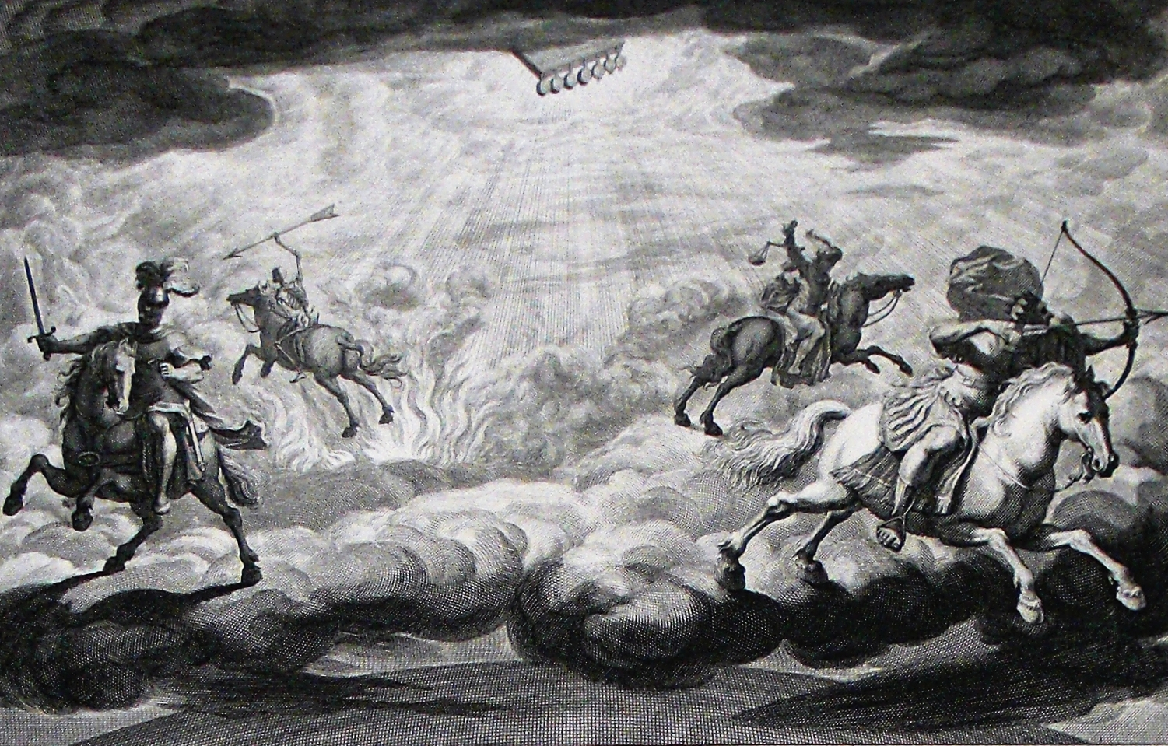
The Book of Revelation

Slide 2
Running Into Problems…
Many have taken for granted that the scene now shifts to heaven, and many of our songs of heaven borrow from this imagery, reinforcing the notion. But it seems more consistent to stay with the context and contrast the church’s victory with the defeat of the dragon, beasts and harlot in chapters 18-19.
To correct poor interpretation, we must be consistent with:
The time context in Revelation (i.e., “things which will soon take place” – 1:1; 22:6).
The genre context of Revelation (i.e., apocalyptic symbolism).

Slide 3
Inaugurated Eschatology - “Now, But Not Yet…” “I Will Dwell Among Them”
EDEN
TABERNACLE
TEMPLE
JESUS
THE CHURCH
HEAVEN

Slide 4
Jim McGuiggan, Revelation, 292
“The Church has come through a major crisis. She had defeated her enemy (thanks to her Lord), and there follows in these two chapters a description of the triumphant and vindicated Family of God. He will talk about her ‘newness.’ He will speak about the ‘newness’ of her environment. He will talk of her beauty and purity. He will speak of her stability and strength. He will speak of her importance and her testimony. He will speak of her holiness.
“And each of these things he will set forth in different figures. For example, her new environment will be spoken of as a ‘new heaven and earth.’ He will speak of her beauty in the terms of an unbelievably precious city with golden streets and jeweled walls. He will speak of her purity and dedication to him under the figure of a bride. He will talk of her stability and strength under the figure of her ‘four-squaredness’ and her incredible walls of height and thickness. He will speak of her importance and testimony in terms of the light she, as a city, gives to the nations around.”

Slide 5
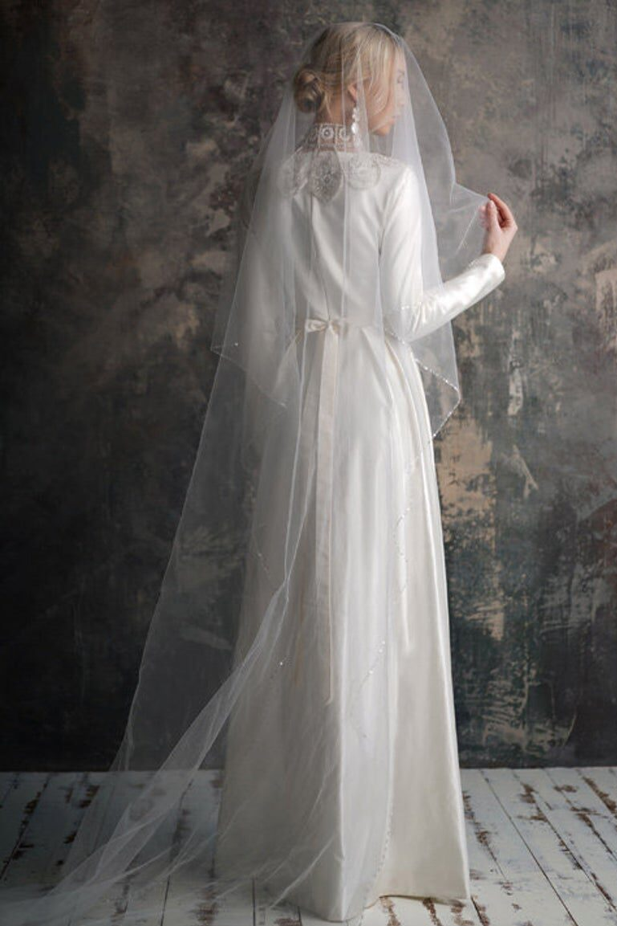
The Holy City (21:1-8)
A. new heavens and earth (1a)
B. 1st heaven and earth passed away (1b)
C. sea is no more (1c)
D. new Jerusalem bride (2)
D’. God with His bride (3)
C’. death, sorrow, pain are no more (4a-c)
B’. former things passed away (4d)
A’. all things made new (5a)

Slide 6
The Holy City (21:1-8)
“A new heaven and a new earth” (v. 1) –
Remember that the “old” earth and heaven fled away (20:11). That old situation was one of corruption, blasphemy, and persecution. The sea of chaos and death (12:12; 13:1), barrier (4:6; 15:2), and rebellion (Job 38:8-11; Ps. 89:9; Isa. 57:20) is no more. This envisions a new exodus for God’s people.
Compare the cosmic symbolism of temporal judgment in:
Isa. 13:6-22 – destruction of Babylon by the Medes
Isa. 34:1-17 – destruction of Edom; burning forever, yet animals live there
Mic. 1:1-6 – destruction of Judah
Nah. 1:1-14 – judgment upon Nineveh
With the demise of Rome, God’s people enter a better situation. Compare the new status – a “new heavens and a new earth” – given to God’s people in Isa. 51:16; 65:17-19; 66:22 where God’s spiritual kingdom would replace old order.
At the end of times, God will destroy ALL enemies and bring in a “new heavens and new earth” (2 Peter 3:7, 13).

Slide 7
The Holy City (21:1-8)
“The holy city, new Jerusalem”(v. 2) –
The church was already described as a holy city (11:2).
“Coming down out of heaven” – not heaven, but coming down out of heaven. In Revelation, things associated with heaven are related to God, salvation, purity, and victory. “The two beasts came up out of the sea and the earth. There is their human origin…This happens too in Daniel 7. While the beasts are said to rise out of the sea and the earth, the Messianic kingdom (embodied in the Son of Man) rides in the heavens. Here we have divine nature and origin contrasted to human and evil origin.” (McGuiggan, 301)
As people, not a place, the city is prepared as a bride (cf. 19:7-9; Isa. 51:1-10; 61:10; 62:1ff; contrast the harlot). This is a symbol of the victorious saints who maintained faith in the crucible of persecution.
The city of temporal victory will become the city of ultimate victory (Heb. 11:10, 13-16; 12:22-24; 13:14; Phil. 3:20; Gal. 4:26).
“He will dwell among them” (vv. 3f) –
Depicts intimate fellowship between God & saints (1Cor. 3:16; 2Cor. 6:16-18; Eph. 2:19-22)
Rooted in covenant language and prophecies and denotes an exclusive relationship (cf. 7:17; Lev. 26:12; Isa. 14:3; 25:6ff; 35:9f; 51:11; 65:19; Jer. 11:4; 30:22; 31:1, 31-34; Ezek. 37:27; 43:7). Points to the ultimate victory in 1Cor. 15:26.
Death shall be no more speaks to the dissolution of the source of death, Rome (cf. Isa. 28:14-18)

Slide 8
The Holy City (21:1-8)
“I am making all things new” (v. 5) – God is taking away persecution and martyrdom by the malevolent force of Rome (cf. temporal idea in Isa. 26:19; Hos. 13:14).
“It is finished” (v. 6) – Callback to 16:17 and the 7th bowl. Symbolic imagery for God relates to His completed purpose. The purpose for letting Rome reach its bloody zenith has been realized and brought to an end. All people are freely invited to drink from the fountain of living water (cf. 22:17; Isa. 55:1; John 4:14). Again, new exodus language (Neh. 9:15f; Isa. 48:21; 49:10; 41:17f).
“He who overcomes”(v. 7) – He will, as a son of God, inherit this new status and situation. OT background – Hos. 11:1; Jer. 31:1; Pss. 2:7; 89:20ff; 2Sam. 7:14//1Chron. 17:13; 22:5; Isa. 55:1-3). Recalls language of the latters (e.g., 2:7, 11; 3:5, 12; etc.).
“But…” (v. 8) – Those who do not overcome the influence of Rome and the crucible of persecution, who compromise with the imperial cult, are destined for a lake that burns with fire and brimstone. Again, honoring the context, this is not a general statement of final judgment but the fate that befell the beast and false prophet (19:20), the devil (20:10), Death and Hades (20:14) and anyone not found in the Book of Life (20:15). At one time it looked like the cowardly, abominable, murderers were winning, but they have been defeated in the end.

Slide 9
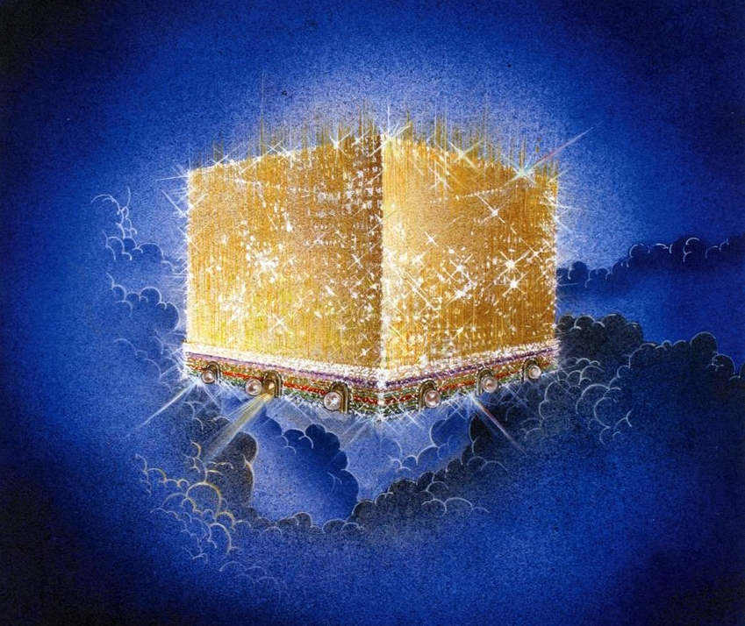
The Glorious City (21:9-21)
A. glory of God (10f)
B. gates (12f)
C. wall (14)
D. measurements (15-17)
C’. wall materials (18-20)
B’. gate materials (21)
A’. glory of God’s city (22-27)

Slide 10
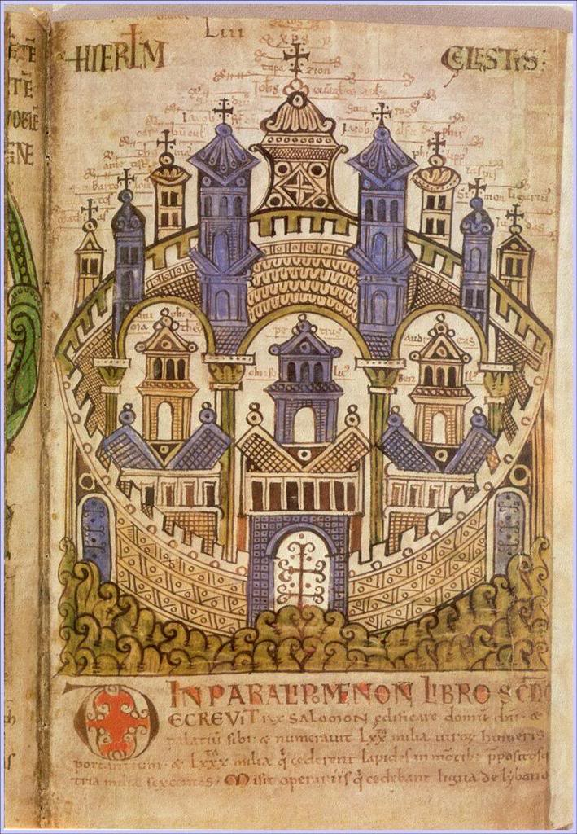
The Glorious City (21:9-21)
“Come here, I will show you” (v. 9) –
“He carried me away in the Spirit” (v. 10a; cf. Ezek. 40:2-4)
He will also measure the city in v. 15 (cf. 11:1f; Ezek. 40:3-5 for protection; Zech. 2:1-5 to indicate God’s presence within; here used to discuss the city’s perfection)
Measurements are all multiples of 12; NASB ruins the symbolic significance
vv. 19f have very difficult Greek words; some of which we have no idea what they mean

Slide 11
The Glorious City (21:9-21)
“the holy city, having the glory of God” (vv. 11-21) –
Brilliant as a costly stone like crystal-clear jasper (v. 11; cf. 4:3)
A great and high wall, 144 cubits thick, made of jasper (vv. 12a, 17, 18a) – symbol for security and protection
12 pearl gates, 3 on each side, angels at the gates, each gate bearing the names of the 12 tribes of Israel (vv. 12b-13, 21a; exits in Ezek. 48:31-35) – symbol illustrating entrance is available to anyone who wants to get in (2Pet. 1:10f)
12 foundation stones, adorned with precious stones, bearing the names of the 12 apostles of Jesus (vv. 14, 19f) – symbol for endurance and permanence; city of jewels in Isa. 54:11ff; 8/12 of HP’s stones (Ex. 28:17-20)
Laid out as a cube (cf. Solomon’s MHP in 1Kgs. 6:20), 12,000 furlongs (1,500 miles, 250x the size of Mt. Everest) on each side (vv. 15f) – symbol for abundance of blessings for all; this would cover Europe and reach into space; typical Roman cities laid out as a square
City was pure gold, like clear glass; street of pure gold, like clear glass (vv. 18, 21b) – symbol for beauty, splendor, and glory

Slide 12
The Overall Message

