Slide 1
The message of obadiah
A lesson on the dangers of pride, false feelings of self-sufficiency, and God’s perfect justice in His kingdom

Slide 2
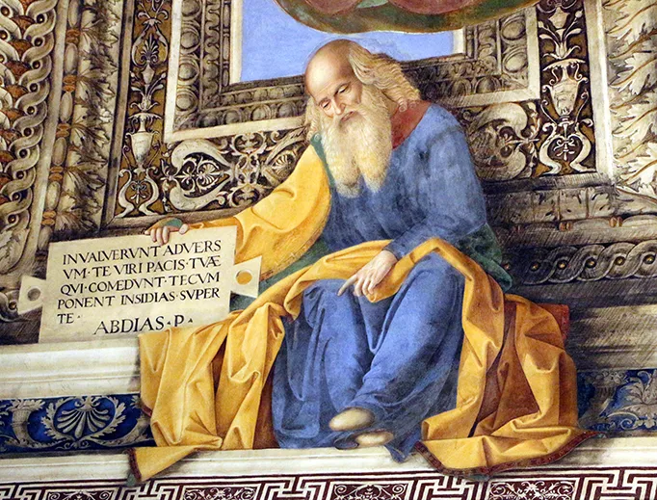
some background material
Indeterminate date of writing and historical situation. It was obviously some time of major hostility between Israel & Edom
Option 1 – Volatility during Jehoram’s reign, circa 845 BC
Option 2 – The fall of Jerusalem in 586 BC
The book is markedly short
We don’t know much about the human penman

Slide 3
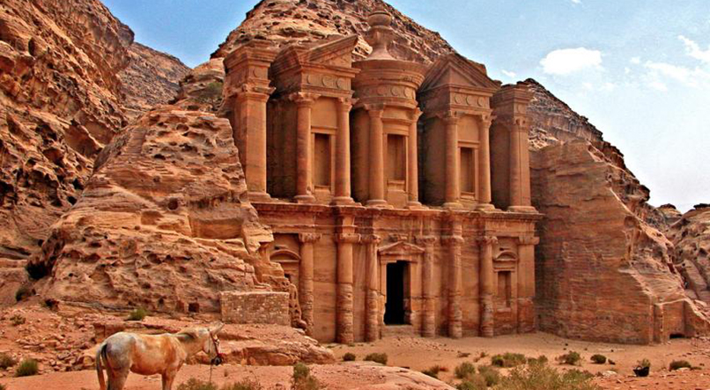
judgment of edom (verses 1-9)
The Origin of the Oracle: “Thus Saith The LORD”
Obadiah expresses the “climax of hatred” & outrage (Jack Lewis)
Edom is the kingdom that arose thru Jacob’s twin brother Esau
Continuous animosity between the kingdoms
Edom stands as a city of Satan; Israel stands as the “city of God”

Slide 4
judgment of edom (verses 1-9)
“Edom is the subject of more separate oracles against foreign nations and more brief or passing hostile references in the prophetical books than any other nation” (Longman & Dillard, An Introduction to the Old Testament, 439).
Examples: Isaiah 34:5-15; Jeremiah 49:7-22; Ezekiel 25:12-14; 35; Amos 1:11-12; Malachi 1:2-5).

Slide 5
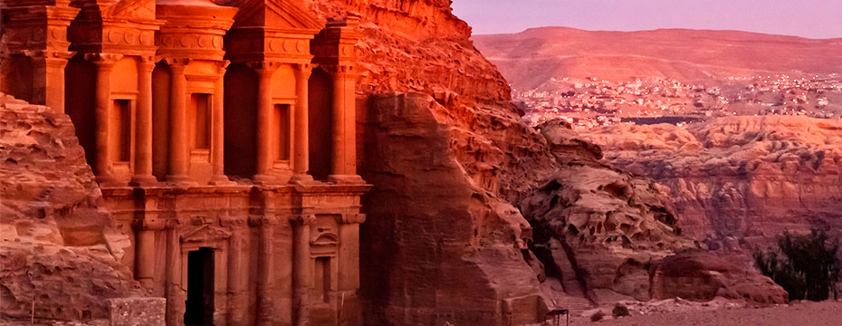
judgment of edom (verses 1-9)
A nation of self-exaltation who felt impervious to God’s standards (v. 3)
In other words, Edom’s big problem was PRIDE
Edom’s problem is congenial to us, isn’t it?
Edom was not beyond God’s power or knowledge (vv. 4, 6).
Do we view ourselves as untouchable & unanswerable to God’s laws?

Slide 6
why Edom was doomed (verses 10-14)
They are to be “cut off forever” – This is a DRASTIC judgment!
Look at the history and nature of their rebellion against God (Numbers 20; Judges 11)
Neutrality with God is not possible; you are either in or out, a friend or a foe (Matthew 12:30)
Edom ridiculed Jerusalem in its calamity (v. 12)
Obadiah expresses “the universal rule of Yahweh. The God of Israel is not the god of a single nation. He is the Lord of all nations and places.” (Longman and Dillard, 440). Our nation has lived in self-sufficiency and ungodliness for a long time. The cycle of the nations will play out. History will repeat itself unless our nation repents (Jeremiah 18:7-10).

Slide 7
The day of the Lord (Verses 15-16)
A day in which God overthrows His enemies
A time of terror for God’s foes, but a time of deliverance for God’s family
The expression is used in the New Testament to describe the great and final day of judgment (1 Thessalonians 5:2). The enemies of God will be destroyed, but the righteous will be saved (2 Thessalonians 1:7-10).

Slide 8
The kingdom of God (Verses 17-21)
This section reveals the future exaltation and glory of Israel and the defeat of all her enemies. This reaches beyond physical Israel to the true spiritual nation of God.
All who turn to the Lord will be saved
The animosity toward the Edomites in this book points forward to the time of Jesus. Herod the Great, an Idumean and as such inextricably bound to the Edomite history, sought to destroy the Christ, the son of Israel (Matthew 2:16). He comes to represent all that stands opposed to the plan and ordinance of God through His Son Jesus. God will execute justice against all who stand opposed to the Head of the church and His body. Justice against the enemies of Jesus is sure. It is still true today that God loves Jacob (the church) and He hates Esau (the carnal).

