Slide 1
EVANGELISM

Slide 2
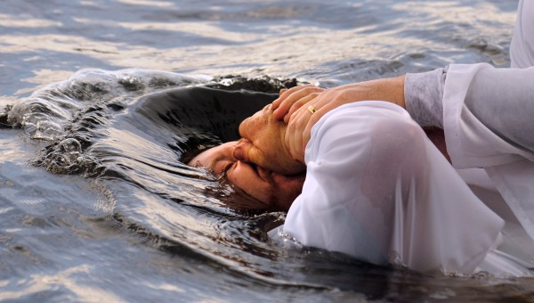
Matthew 28:19-20
“Go therefore and make disciples of all the nations, baptizing them in the name of the Father and the Son and the Holy Spirit, teaching them to observe all that I commanded you; and lo, I am with you always, even to the end of the age.”

Slide 3
Evangelism?
Linguistically –
Eu – good
Angelion – message
Christians = Evangelists!
“I will sing of the lovingkindness of the Lord forever; To all generations I will make known Your faithfulness with my mouth.”
“For if I preach the gospel, I have nothing to boast of, for I am under compulsion; for woe is me if I do not preach the gospel.”
“How then will they call on Him in whom they have not believed? How will they believe in Him whom they have not heard? And how will they hear without a preacher? How will they preach unless they are sent? Just as it is written, ‘How beautiful are the feet of those who bring good news of good things!’”

Slide 4
Our COLLECTIVEEvangelism
Our Congregational Website
Social Media
Bible Studies
Muscle and A Shovel
Gospel Meetings
Support of Local and Foreign Evangelists

Slide 5
Our INDIVIDUALEvangelism?
Invitations to Services (1/168th of their week!)
Invitations to Bible Studies
Follow-up with visitors – track them on the website!
In-home Studies – sometimes formality is intimidating
Community Influence (Matt. 5:16; 1Cor. 9:22; Col. 4:5f)
Praying for Laborers (Matt. 9:37f; Col. 2:2-4)
Creating Laborers (2Tim. 2:2)

Slide 6
Excuses
“I would, but I just don’t have the time or the energy!”
“I would, but I just don’t know how.”
“I would, but I am just so discouraged by previous failed attempts.”

