Slide 1
EVANGELISM

Slide 2
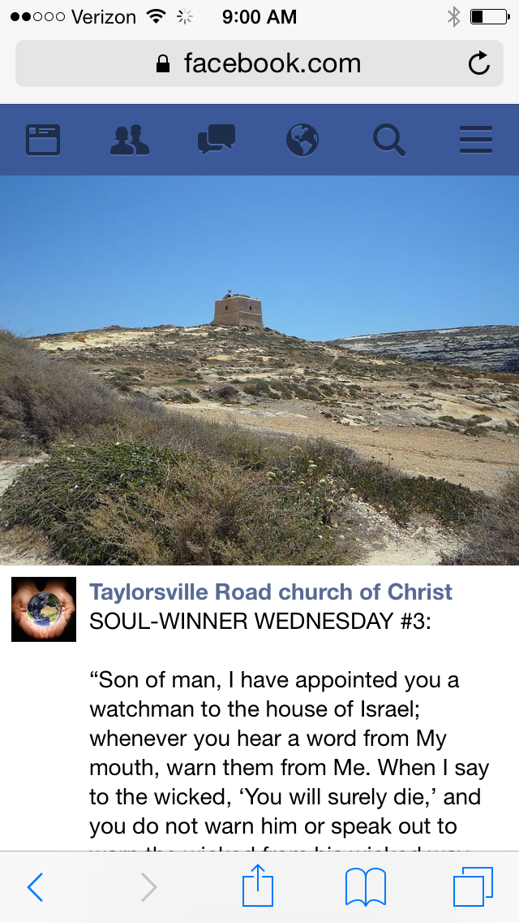

Slide 3
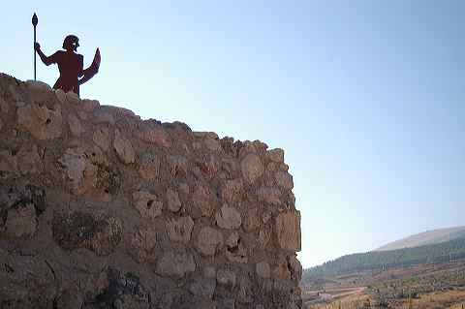
Watchmen imagery is common in the Bible
2Sam. 18:24-27; 2Kgs. 9:14-17
Is. 21:6-9; Jer. 6:17
His job was to warn
Num. 10:1-10; Hos. 9:8; Amos 3:6; Hab. 2:1

Slide 4
Relevance?
God imparts a message to a messenger
God holds that messenger accountable
People respond in different ways to the message

Slide 5
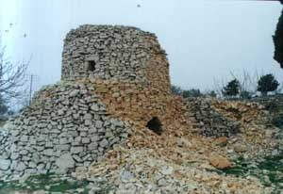
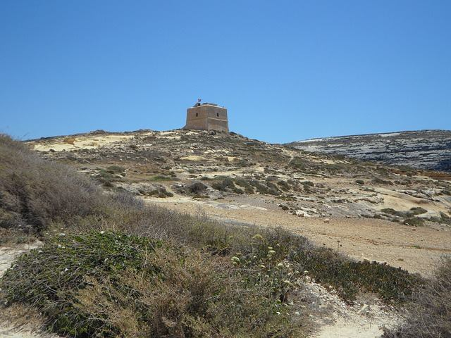
Three Possibilities…
He warns, the people hear but don’t heed the warning
He does not warn
He warns, the people hear and heed the warning

Slide 6
God Strengthens!
Heart of encouragement found in Ezekiel 2:1-3:15.
God doesn’t rejoice in judgment of wicked (33:11; 18:23, 32; I Tim 2:4; II Pet 3:9).
“He must judge his ministry neither by the numbers listening, nor by their enthusiasm in appreciation of his words, but only by the practical response of changed lives” Christopher Wright, “The Message of Ezekiel” in BST, Downer’s Grove: IVP, 2001, 226

Slide 7
Applications…
God has given the gospel, His message, and we are expected to preach it. He was not to stop if people refused to listen!
Not preaching His message holds us liable to the bloodguilt of those lost in judgment. Preaching His message frees us from all guilt.
Just as God gave Ezekiel the tools to accomplish the task, He provides us with the tools to accomplish our task. We have all that we need. What it really boils down to is resolve, discipline, and commitment.

