Slide 1
“The most pressing question on the problem of faith is whether a man as a civilized being can believe in the divinity of the Son of God, Jesus Christ, for therein rests the whole of our faith.” – Fyodor Dostoevski

Slide 2
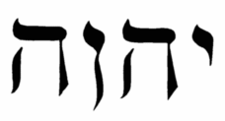
This is one of the most important words in the Bible. What is it?
The Answer:
YHWH/JEHOVAH
Texts:
Isaiah 8:13f//1 Peter 2:8
Isaiah 9:6//Isaiah 10:21
Isaiah 40:3//John 1:23
Isaiah 45:23//Philippians 2:5ff
Others: Rom. 10:9-13; Heb. 1:10-12; 1Pet. 2:1ff; 3:10-15
Jesus is JEHOVAH!

Slide 3
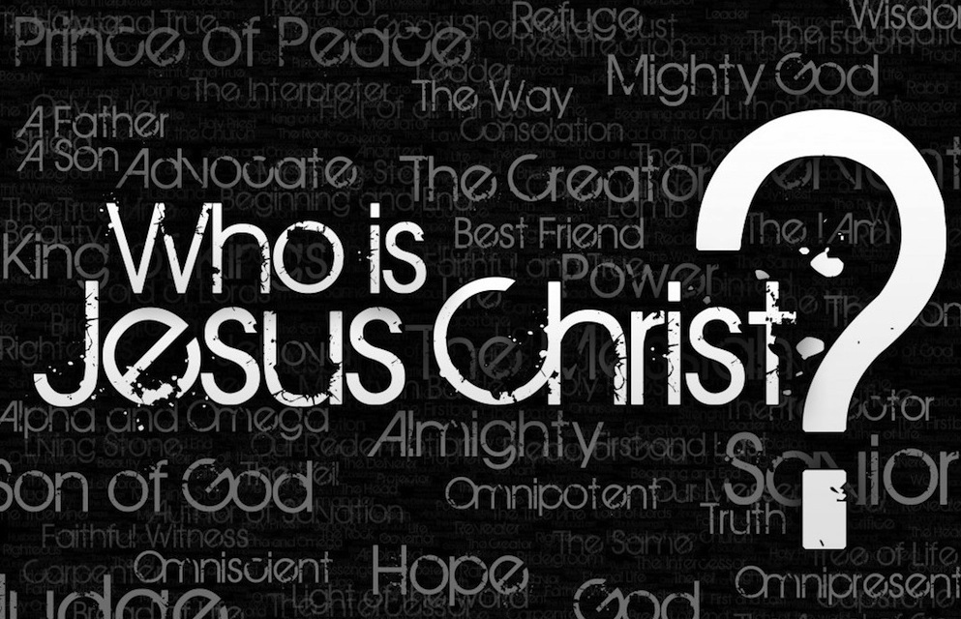
How Did Jesus Himself Answer This Question?

Slide 4
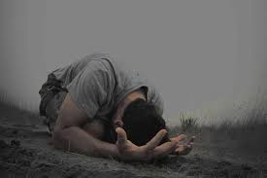
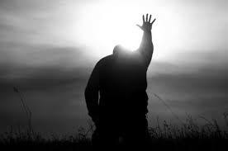
How Was Jesus Treated?
Worshipped! (proskuneo)
“My Lord and My God!”
This sort of treatment is forbidden even to angels!

Slide 5
Jesus Possesses Unique Divine Attributes
Isaiah 43:11; Hosea 13:4//Acts 4:12; Acts 2:11; John 4:42 – Only God is Savior
Titus 2:13 – “looking for the blessed hope and the appearing of the glory of our great God and Savior, Christ Jesus”
Granville Sharp’s Rule of Greek grammar states: “When the copulative kai connects two nouns of the same case, if the article ho or any of its cases precedes the first of the said nouns or particles, and is not repeated before the second noun or participle, the latter always relates to the same person that is expressed or described by the first noun or particle; i.e., it denotes a farther description of the first-named person” (Dana and Mantey, A Manual Grammar of the Greek New Testament, 147).

Slide 6
Jesus Possesses Unique Divine Attributes
Isaiah 44:24//Jn. 1:1-5, 10; Col. 1:15-18; Hebrews 1:2 – Only God is Creator
John 1:1 – “In the beginning was the Word and the Word was with God and the Word was God.”
Colwell’s Rule of Greek grammar states: “the definite predicate nominative does not have the article when it comes before the verb.”
Colossians 1:15-18 – “He is the image of the invisible God…”
The NWT arbitrarily inserts “other” into the text
“Firstborn of Creation” is a genitive of subordination, NOT a genitive of partition

Slide 7
Jesus Possesses Unique Divine Attributes
Is. 42:8//John 17:5; Col. 2:9 – If Jesus isn’t divine, why is God’s glory given to Him?
“Fundamentally, our Lord's message was Himself. He did not come merely to preach a Gospel; He himself is that Gospel. He did not come merely to give bread; He said, "I am the bread." He did not come merely to shed light; He said, "I am the light." He did not come merely to show the door; He said, "I am the door." He did not come merely to name a shepherd; He said, "I am the shepherd." He did not come merely to point the way; He said, "I am the way, the truth, and the life." (J. Sidlow Baxter)

Slide 8
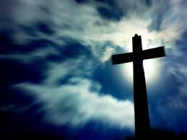
“Although He existed in the form of God, He did not regard equality with God a thing to be grasped, but emptied Himself, taking the form of a bond-servant, and being made in the likeness of men. Being found in appearance as a man, He humbled Himself by becoming obedient to the point of death, even death on a cross…” (Philippians 2:5-11)

