Slide 1
Left Behind?

Slide 4
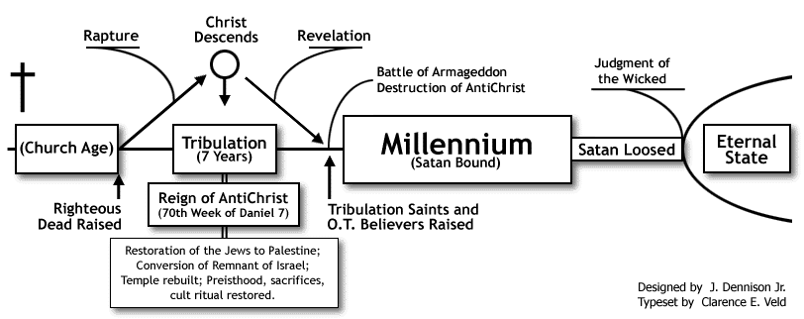
Dispensational Premillenialism

Slide 5
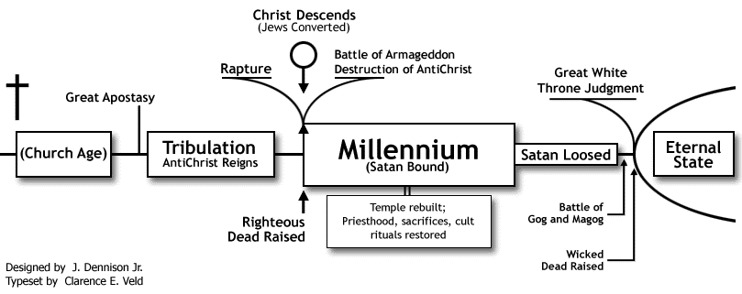
Historical Premillenialism

Slide 6
1st Problem: Assumes God Fails
“And He put all things in subjection under His feet, and gave Him as head over all things to the church, which is His body, the FULLNESS of Him who fills all in all.” (Eph. 1:22)
“God isn’t a man, that He should lie, nor a son of man, that He should repent; has He said, will He not do it? Or has He spoken, will He not make it good?” (Num. 23:19)

Slide 7
2nd Problem: Contradicts Scripture
Nature of the Kingdom
Timeline for the Kingdom
Nature of the 2nd Coming

Slide 8
3rd Problem: Language Failures
Apocalyptic Language
Used to give a sense of hope when God’s people are suffering
Provides a GENERAL picture of a blessed and triumphant future
Uses visions, symbols, and figurative language
Unknown future told in terms present generation understood
Figurative Language (e.g. 1,000)
Faulty Greek Scholarship

Slide 9
The Next Time Jesus Comes…
He Will Come In Judgment With His Mighty Angels like A Thief in the Night
No 2nd Chances!
No 7 Years of Tribulation!
Therefore, BE VIGILANT!

