Slide 1
Once Saved Always Saved

Slide 2
Charles Stanley (Free Grace Churches)
“The Bible clearly teaches that God's love for His people is of such magnitude that even those who walk away from the faith have not the slightest chance of slipping from His hand.” (Eternal Security: Can You Be Sure? Nashville: Oliver Nelson, 1990, p. 74; Represents Free Grace churches)

Slide 3
Westminster Confession of Faith, 17.1
They whom God hath accepted in His Beloved, effectually called and sanctified by his Spirit, can neither totally nor finally fall away from the state of grace; but shall certainly persevere therein to the end, and be eternally saved. (represents many denominations from reformation/restoration – e.g. Presbyterian, Baptist, Congregational)

Slide 4
Westminster Creed, 17.3
Nevertheless [believers] may, through the temptations of Satan and of the world, the prevalency of corruption remaining in them, and the neglect of the means of their preservation, fall into grievous sins; and for a time continue therein; whereby they incur God's displeasure, and grieve his Holy Spirit: come to be deprived of some measure of their graces and comforts; have their hearts hardened, and their consciences wounded; hurt and scandalize others, and bring temporal judgments upon themselves.

Slide 5
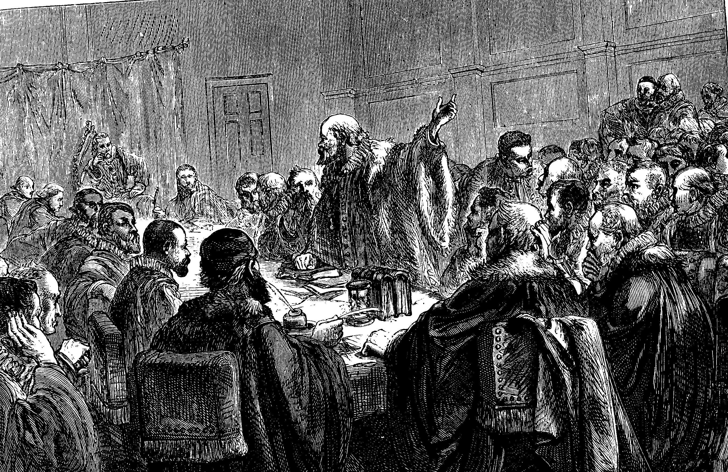
Canons of Dort, Chapter 1, Article 11
Just as God is most wise, unchangeable, all-knowing, and almighty, so the election made by him can neither be suspended nor altered, revoked, or annulled; neither can God’s chosen ones be cast off, nor their number reduced.

Slide 6
Direct Statements
“If I killed my wife and mother and debauched a thousand women, I couldn’t go to hell if I wanted to.”
“If I left my wife and ran off with a 16 year old girl, God would work it out for my good.” (Hoyt Chastain)
Dr. Albert Gardner was asked, “Is the eternal salvation of the child of God, saved by the blood, absolutely unconditional in that he is not required to do anything to go to Heaven?” He said, “YES!”
“If you seek it you can’t find it; if you find it you can’t get it; if you get it you can’t lose it, and if you lose it you never had it.”

Slide 7
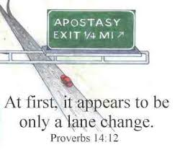
OT Warnings and Examples
The OT = the apostasy of Israel
Iniquity nullifies former righteousness (Ezek. 18:24).
Adam and Eve
Samson and Saul
David

Slide 8
NT Warnings
Mt. 13:21; 24:10; 26:31; Luke 22:32; John 15:6-10
Gal. 5:4; 1Tim. 4:1; 1Jn 4:1; Gal. 1:6-9; cf. 2Co. 11:4; Rom. 11:22
1Cor. 9:27; cf. Col. 1:21-23; 2:6f
1Tim. 4:1; cf. Col. 2:8
Hebrews 3:12; 6:4-6; 10:26-39; 12:15, 25
2Pet. 2:1, 20-22; 3:15-18 ; cf. Tit. 1:16; James 5:19f

Slide 9
NT Examples
Judas
Simon
Ananias, Sapphira
Peter (Gal. 2:11-14)
Demas (2Tim. 4:10)

Slide 10
Reasons People Refuse These Truths
The Intellect
The Emotions
The Will

