Slide 1
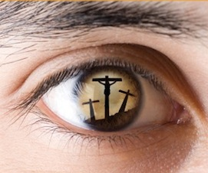
Sounding Good Sound and Good

Slide 2
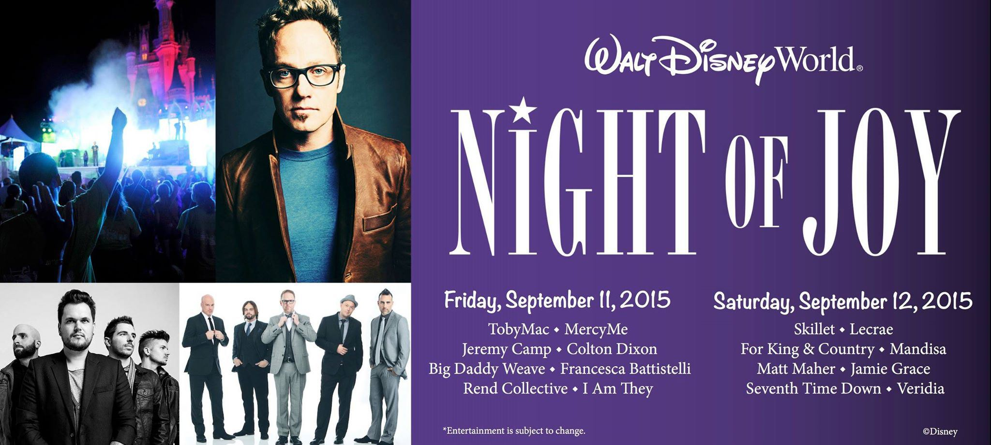

Slide 3
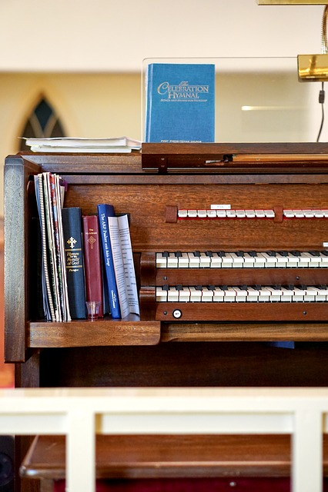
A “Defense” of Instrumental Music
“It’s just a matter of preference.”
“Christians play them at home!”
“It’s merely a cultural objection.”
“People that don’t accept it don’t have the resources to purchase or play them.”
“If people want to exercise their musical gifts to glorify God, they can.”

Slide 4
A “Defense” of Instrumental Music (Pt. 2)
“It’s just an aid to worship like a songbook.”
“The Greek terms psallo and psalmos mean to sing with instrumental music.”
“They used instruments in the OT and in Revelation.”
“Denominational traditions support the use of musical instruments in worship.” *
“The Bible doesn’t say not to use mechanical instruments.” *

Slide 5
Catholic Church
“Our church does not use musical instruments, as harps and psalteries, to praise God withal, that she may not seem to Judaize.” (Thomas Aquinas, 13th century; Bingham’s Antiquities, Vol. 2, p. 483, London)
“Although Josephus tells of the wonderful effects produced in the Temple by the use of instruments, the first Christians were of too spiritual a fibre to substitute lifeless instruments for or to use them to accompany the human voice. Clement of Alexandria severely condemns the use of instruments even at Christian banquets.” (Catholic Encyclopedia, Vol. 10, p. 652)

Slide 6
Reformed and Presbyterian Churches
“Musical instruments in celebrating the praises of God would be no more suitable than the burning of incense, the lighting of lamps, and the restoration of the other shadows of the law.” (John Calvin, Commentary on Psalm 33, see also commentary on 1Sam. 18:1-9)
“It has been proved, by an appeal to historical facts, that the church, although lapsing more and more into defection from the truth and into a corruption of apostolic practice, had no instrumental music for twelve hundred years; and that the Calvinistic Reformed Church ejected it from its services as an element of Popery, even the Church of England having come very nigh to its extrusion from her worship. The historical argument, therefore combines with the Scriptural and the confessional to raise a solemn and powerful protest against its employment by the Presbyterian Church. It is heresy in the form of worship.” (John Girardeau, Instrumental Music, p. 179).

Slide 7
Methodist Church
“I have no objection to instruments of music in our chapels, provided they are neither heard nor seen.” (John Wesley; Cited by Methodist commentator Adam Clarke, Clarke’s Commentary, Vol. 4, p. 684)
“Music as a science I esteem and admire; but instruments of music in the house of God I abominate and abhor. This is the abuse of music, and here I register my protest against all such corruptions in the worship of the Author of Christianity.” (Adam Clarke, Methodist Commentator)

Slide 8
Lutheran and Baptist Churches
“The organ in the worship service is a sign of Baal.” (Martin Luther, Realencyklopadie Fur Protestantische Theologie und Kirche, Bd, 14, s.433; cited in Instrumental Music & NT Worship, James D. Bales, p. 130)
“We might as well pray by machinery as sing by it” and “Israel was at school, and used childish things to help her learn; but in these days when Jesus gives us spiritual food, one can make melody without strings and pipes…we do not need them. That would hinder rather than help our praise. Sing unto Him. This is the sweetest and best music. No instrument like the human voice.” (Charles Spurgeon, Commentary on Psalm 42)

Slide 9
Christian Church
“The use of organs in churches is ascribed to Pope Vitalian (657-672). Constantine Copronymos sent an organ with other presents to King Pepin of France in 767. Charlegmane received one as a present from the Caliph Haroun al Rashid, and had it put up in the cathedral of Aixla Chapelle…The attitude of the churches toward the organ varies. It shared to some extent the fate of images except that it never was an object of worship…The Greek church disapproved the use of organs. The Latin church introduced it pretty generally, but not without the protest of eminent men, so that even in the Council of Trent a motion was made, though not carried, to prohibit the organ at least in the mass (Schaff, History of the Christian Church, Vol. 4, p. 4309).

Slide 10
The Truth…
“The testimony of history is that the use of mechanical instruments in worship was introduced in the worship of the church many years after the first century and over the protest of many leaders. The use of mechanical instruments of music in worship was not a part of the worship of the church of the New Testament. Though instruments of music were available, the early church chose not to use them.” (Mike Willis, “Why I Oppose Instrumental Music In Worship”, Truth Tract)

Slide 11
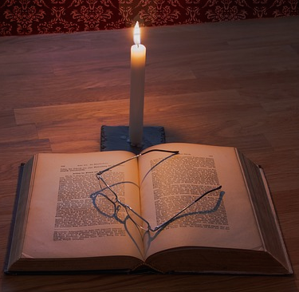
WHAT GOD SAYS ABOUT ACCEPTABLE MUSICAL WORSHIP:
They sang a hymn (Mt. 26:30; Mk. 14:26)
Singing hymns unto God (Acts 16:25)
Sing unto Thy name (Rom. 15:9)
I will sing with the Spirit (1Cor. 14:15)
Singing, making melody in heart (Eph. 5:19)
Singing w/ grace in your hearts (Col. 3:16)
In…the congregation will I sing (Heb. 2:12)
Is any cheerful? Let him sing psalms (Jms. 5:13)

Slide 12
Principle: Soundness and Goodness
God dictates the terms of acceptable worship.
Anyone who disregards those terms is liable to judgment.
That which is approved is called sound (hugiene) teaching.

