Slide 1
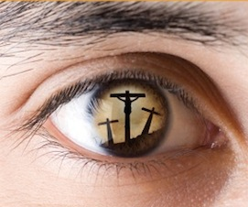
The Sinner’s Prayer

Slide 2
Preliminary Precautions
Feelings Are Not A Faultless Guide
Prov. 14:12; Jer. 17:9; Mt. 15:18-20
The Nature of Communication
CENI – Command, Example, Necessary Inference
Wisdom
No matter how much lipstick you put on a pig, it is still a pig.
Humility
Acts 17:11; 2 Cor. 13:5; Ezra 7:10
James 1:21-25; Luke 6:46; Jn. 15:14

Slide 3
God’s Role in Salvation
Divine Initiative
The Father – “But when the kindness of God our Savior and His love for mankind appeared, He saved us…” (Titus 3:4-5)
The Son – “…having been made perfect, He became to all those who obey Him the source of eternal salvation” (Hebrews 5:8-9)
The Holy Spirit – “Such were some of you; but you were washed, but you were sanctified, but you were justified…in the Spirit of our God.” (1 Corinthians 6:11)

Slide 4
God’s Role in Salvation
Divine Character
Grace and Mercy – “For the grace of God has appeared, bringing salvation to all…” (Titus 2:11)
Love – “For God so loved the world, that He gave His only begotten Son, that whoever believes in Him shall not perish, but have eternal life.” (John 3:16)

Slide 5
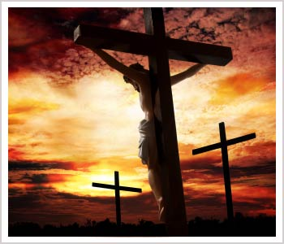
God’s Role in Salvation
Founded & Rooted In…
Hope
The Cross
Blood
Sacrifice
The Name of Christ
The Gospel
Truth
Messengers

Slide 6
Man’s Initial Role in Salvation
Hear
Believe
Repent
Confess
Immersion

Slide 7
Man’s Further Role in Salvation
Faith is Perfected in Action
“…faith without works is useless...as a result of the works, faith was perfected…You see that a man is justified by works and not by faith alone…” (James 2:18-26)
Spiritual Endurance
“You will be hated by all because of My name, but it is the one who has endured to the end who will be saved.” (Matt. 10:22)

Slide 8
The Sinner’s Prayer…Is A LIE!

