Slide 1
“What’s Your Name?”

Slide 2
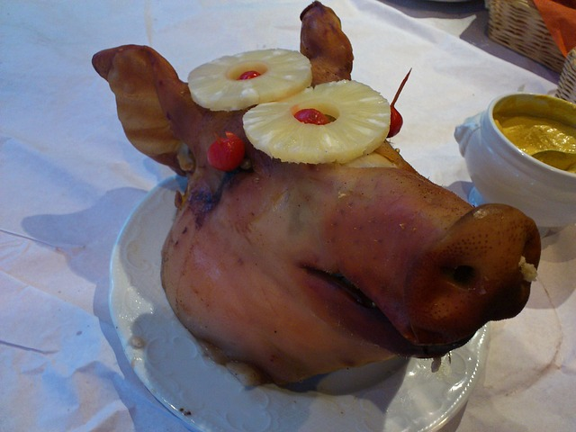
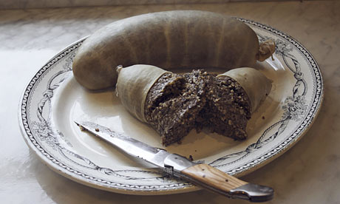
A Bad Taste in My Mouth…
Bad tastes leave a strong and lasting impression
An unpleasant experience = a “bad taste in the mouth”
My story – a people who didn’t know my name

Slide 3
What the Church Should Look Like…
The Lord’s Church
Not the Lord’s Church
Designed By God
Ephesians 1:21-23
Matt. 16:18; Acts 20:28
Named by Christ
Acts 4:12; 11:26; 26:28
Eph. 5:22-33; 1Pet. 4:16
Names Known by God
Exodus 33:17; Ps. 91:14
Matt. 10:29-31; Jn. 10:3
Designed by Men
Named by Men
Lutheran, Wesleyan
Episcopal, Presbyterian
Baptist, Methodist
Unrecognized by Christ

Slide 4
God’s People Know Each Other
One Body with One Goal (Eph. 4; 1Cor. 12)
E.g. 1 Corinthians 1:11
Romans 16
Over 1,000 km away!
33 names listed!

Slide 5
What’s In A Name?
Not something to be devalued or deemphasized; the names of Christians are recorded in the Lamb’s Book of Life (Philippians 4:3; 2 Timothy 2:19)
The fact that God knows our names suggests members of the church get to know us & know us well. If this is missing, you aren’t worshiping with the right people.
If we can’t claim to love God unless we love one another, can we be saved by the name of His Son if we do not care for the names of His people? (1 John 4:20)

