Slide 1
A Strong Husband

Slide 2
Marriage and Family
Then…
The Backbone of Society
The Nucleus of Civilization
Now…
Paralyzed
Frankenstein’s Monster

Slide 3
The Problem: Men who do not imitate Christ
“When a man understands and appreciates what Christ did for the church, it becomes easier and easier to follow that example in his own marriage.”
Comparison is made frequently in the OT
Ezek. 16:8-14; et al.
Song of Solomon; Proverbs
Comparison is made frequently in the NT
Christ = The Groom (Jn. 3:29; et al.)
Church = The Bride (2Cor. 11:2; Rev.)

Slide 4
Our Key Text
And be subject to one another in the fear of Christ. Wives, be subject to your own husbands, as to the Lord. For the husband is the head of the wife, as Christ also is the head of the church, He Himself being the Savior of the body. But as the church is subject to Christ, so also the wives ought to be to their husbands in everything. Husbands, love your wives, just as Christ also loved the church and gave Himself up for her, so that He might sanctify her, having cleansed her by the washing of water with the word, that He might present to Himself the church in all her glory, having no spot or wrinkle or any such thing; but that she would be holy and blameless…

Slide 5
Our Key Text
…So husbands ought also to love their own wives as their own bodies. He who loves his own wife loves himself; for no one ever hated his own flesh, but nourishes and cherishes it, just as Christ also does the church, because we are members of His body. For this reason a man shall leave his father and mother and shall be joined to his wife, and the two shall become one flesh. This mystery is great; but I am speaking with reference to Christ and the church. Nevertheless, each individual among you also is to love his own wife even as himself, and the wife must see to it that she respects her husband.

Slide 6
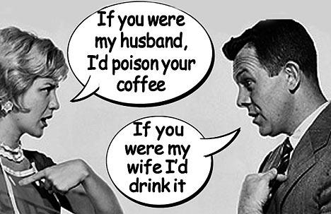
Things That Get In the way
Bickering
Conflict
Money
Work
Entertainment

Slide 7
The Solution: Men who imitate Christ!
Be imitators of me,
just as I am of Christ. (1Cor. 11:1)
Pursue a Heart of Godliness
1Pet. 3:8-12; Gal. 5:22f; Phil. 4:8
Be A Real Man (1 Peter 3:7)
Supportive Wives! (1 Peter 3:1-6)

