Slide 2
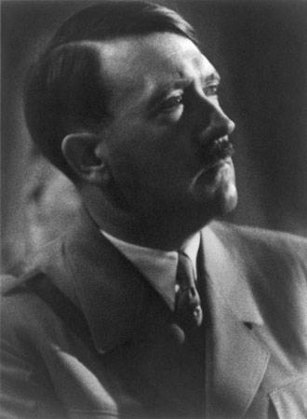
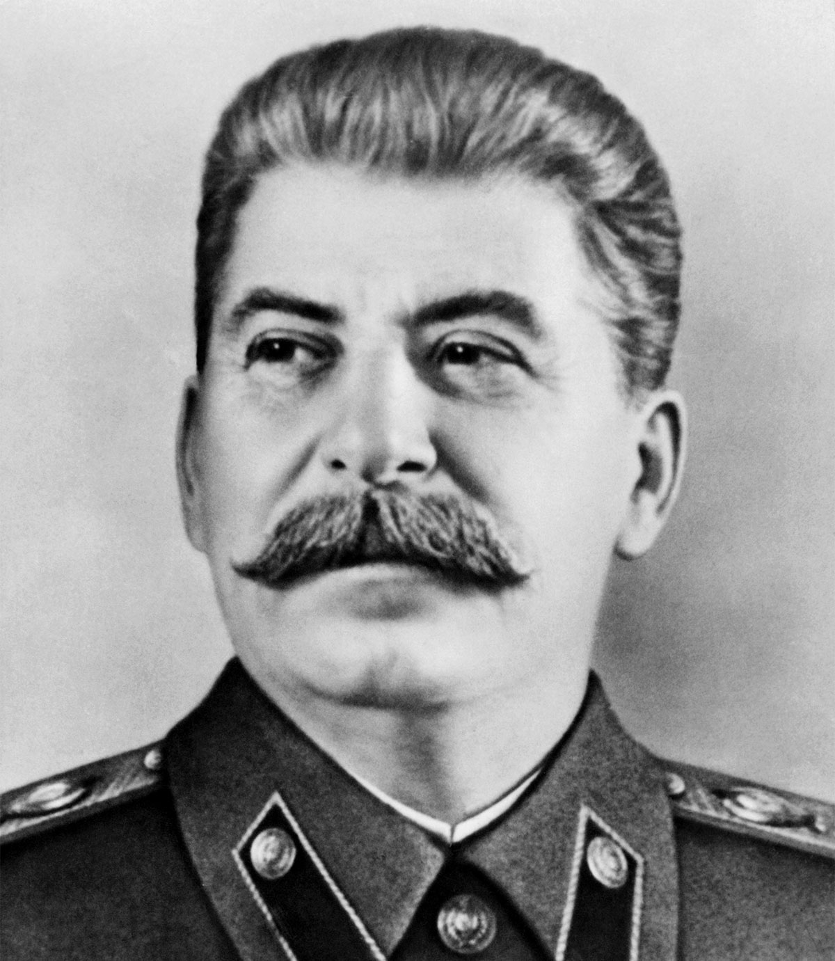
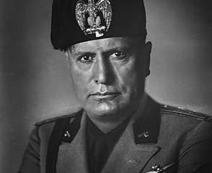

Slide 3
ANTICHRIST

Slide 4
Questions/Misunderstandings
Equivalent to Man of Lawlessness? (2Th. 2:1-12)
First Beast of Rev. 13? Prophesied in Dan. 7?
Capitalized inconsistently (e.g. NKJV)
One of Many? Literal, figurative, or both?
Inadequate Definitions never answer our questions

Slide 5
Definition:
Jesus Said:
Anti = “against”, “opposed to”, or “un-”
Christ(s) = “anointed one(s)”
Literally, the word antichrist, when fully defined, means “against the anointed one(s)”
“He who is not with Me is against Me; and he who does not gather with Me scatters.”
(Matthew 12:30)

Slide 6
1 John 2:18, 22
“Children, it is the last hour; and just as you heard that antichrist is coming, even now many antichrists have appeared; from this we know that it is the last hour…Who is the liar but the one who denies that Jesus is the Christ? This is the antichrist, the one who denies the Father and the Son.”

Slide 7
1 John 4:2-3
“By this you know the Spirit of God: every spirit that confesses that Jesus Christ has come in the flesh is from God; and every spirit that does not confess Jesus is not from God; this is the spirit of the antichrist, of which you have heard that it is coming, and now it is already in the world.”

Slide 8
2 John 7
“For many deceivers have gone out into the world, those who do not acknowledge Jesus Christ as coming in the flesh. This is the deceiver & the antichrist.”

Slide 9
The antichrist is one of many biblical ways of referring to an unbeliever who is militant toward the cause of Christ. They are the un-anointed, those choosing to be outside of Christ &, as such, are on the highway to Hell.
Are you an antichrist? Christ said, “if they are not for us, they are against us.” If you are not in a relationship with Christ, you are un-anointed with His saving blood; you are an antichrist. Would you like to change that? You must be anointed with the waters of baptism, clothed w/ Christ, & washed by His saving grace.

