Slide 1
W.A.I.T. for god
Isaiah 40:27-31

Slide 2
Walk In His Way!
God is aware of our faulty ways (40:27-31)
God is Our Lighthouse!
The Light is His Word (Ps. 119:105f)

Slide 3
Anticipate HIS Coming!
God is in control; therefore, we lay all our cares at His feet (1Pet. 5:6f)
At the proper time, our confident hope is rewarded (1Pet. 5:8-10)
Habakkuk had to learn anticipation!
God is LONG-suffering!

Slide 4
Increase Your Patience!
Patience is required if we are to understand God’s timeline.
Our View of Time v. God’s View (2Pet. 3:8)
The Spirit Produces Fruit in Us (Gal. 5:22f)
“Patience is bitter, but its fruit is sweet” (Aristotle)

Slide 5
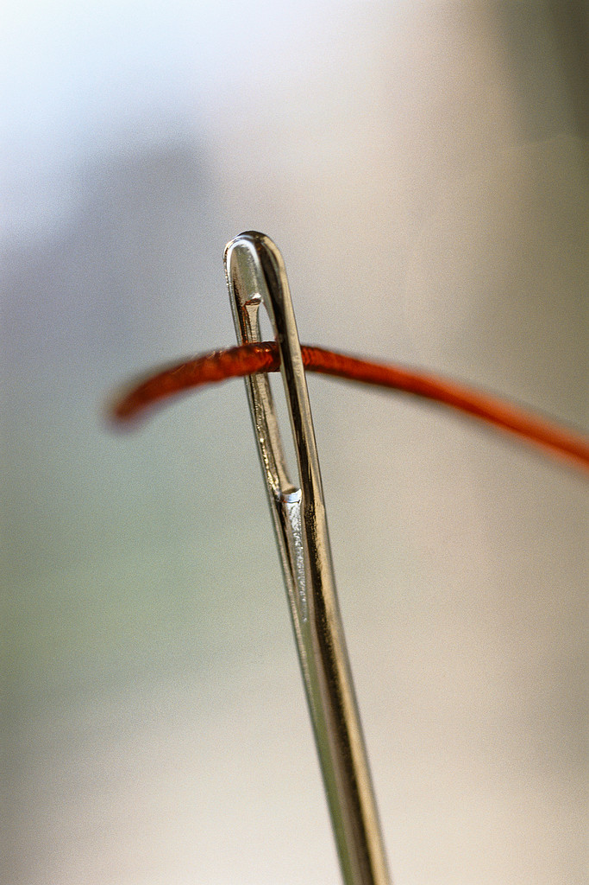
Trust in HIM!
God’s Tapestry; Our Single Thread
God is Superior to Us (Is. 55:8f)
Trust In The Lord With All Your Heart! (Prov. 3:5f; Ps. 130:5f)

Slide 6
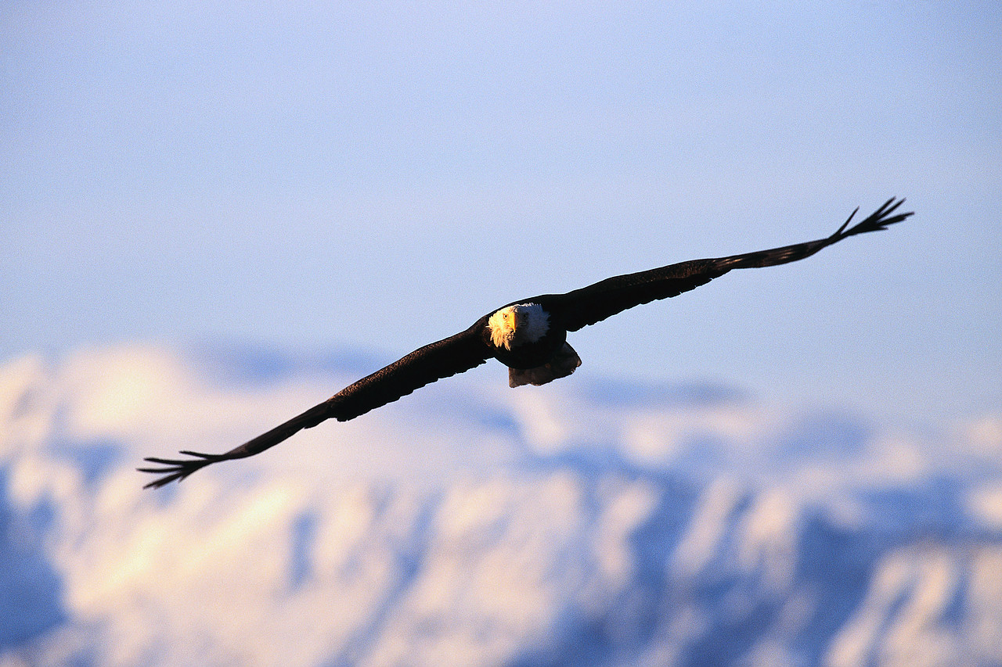
“Yet those who wait for the LORD will gain new strength; they will mount up with wings like eagles, they will run and not get tired, they will walk and not become weary.”
Isaiah 40:31

