Slide 1
Why Is Jesus’ Death Important?

Slide 2
Jesus Is The Son of God
Personal & Eyewitness Testimony
(John 10:36; Matt. 16:16; John 6:69; Matt. 27:54)
Morally Pure & Spiritually Sinless
(1Pet. 1:19; Heb. 7:26f)
No Mere Man Could Change Our Fate

Slide 3
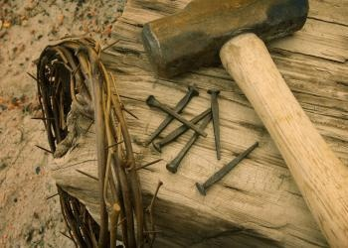
Jesus’ Death Was Vicarious
The Law of Moses
Prophetically Attested
Is. 53; 2Cor. 5:21
1Pet. 2:24; 1Jn. 3:5
Took Our Punishment
Rom. 6:23; Eze. 18:4
He also Saved Them
Heb. 9:15; 11:40

Slide 4
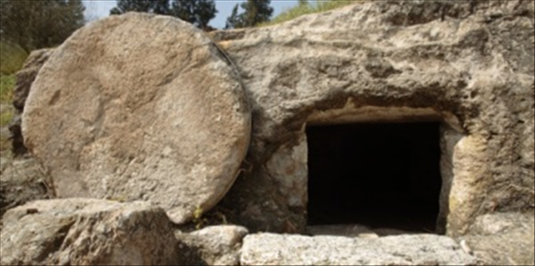
Jesus Volunteered His Life
John 10:18; 13:18, 21, 26f; 15:13
He laid a foundation for His spiritual kingdom!
“No One takes it from Me, I lay it down of My own accord…”

Slide 5
Death Activates New Covenant
Hebrews 9:16-22
New Covenant = Jesus’ Will & Testament
His Death Provides Validity to the Will

Slide 6
Jesus’ Death Was Predicted
The Lamb – John 1:36
The Broken Temple – John 2:19
The Serpent in the Wilderness – John 3:14
The Sacrificial Shepherd – John 10:11
The Grain of Wheat – John 12:24
The Ransom – Matt. 20:28

Slide 7
He did not stay dead, but vanquished death and established a pattern for us to follow. If He stayed dead, His life would have no meaning.
Jesus revolutionized the world two thousand years ago. He continues to change people’s lives for the better and offers a hope beyond this life.

