Slide 1
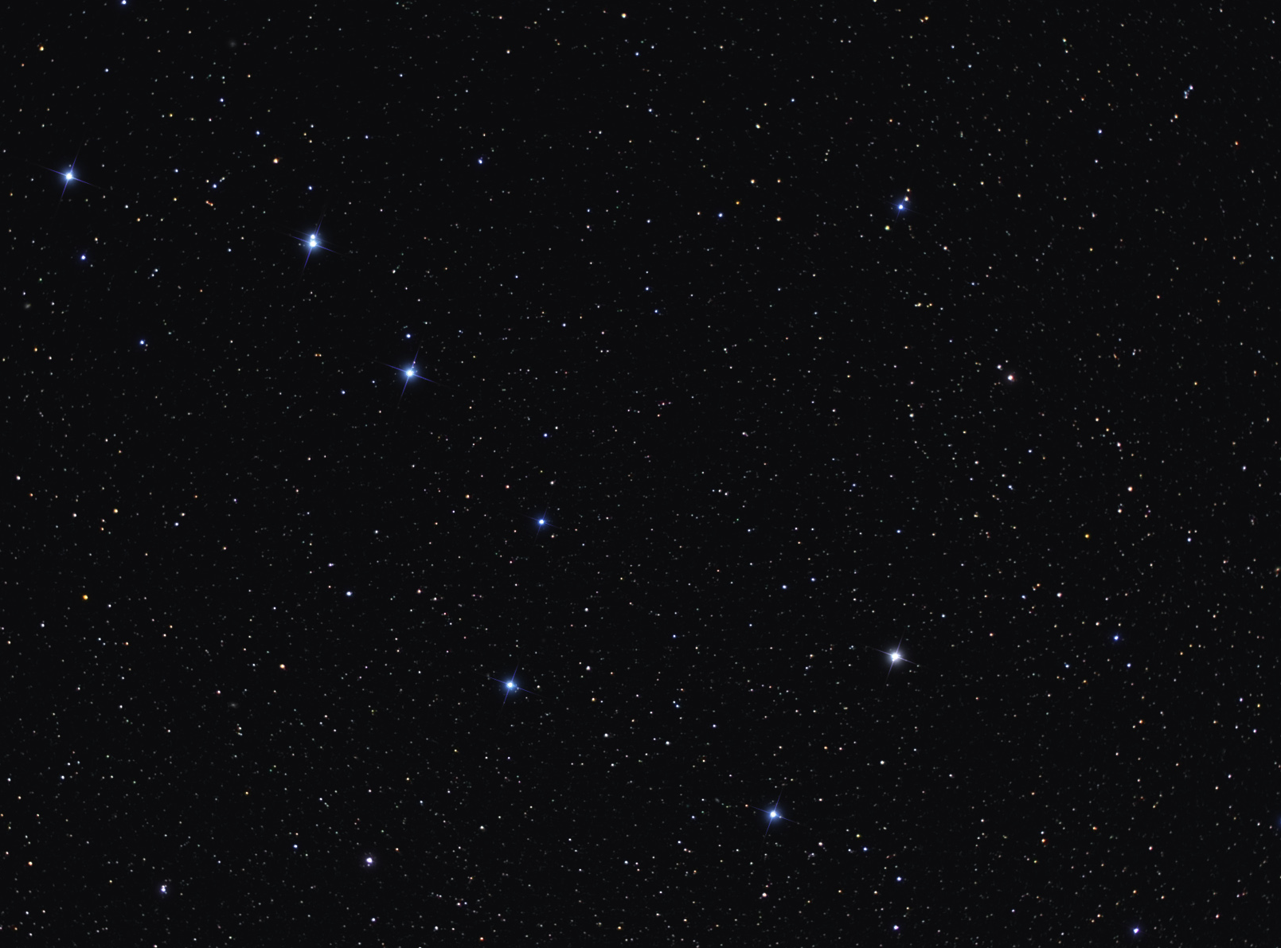
Alkaid
Mizar
Alioth
Megrez
Dubhe
Phecda
Merak
Notes:
Alkaid is the third brightest star in the constellation and places number 35 in the list of the brightest stars
Almost exactly 100 light years away. 6 x 10^14 miles. 6.3 million times as far as the sun is from us.
35000 degrees F on its surface. 6 times more massive than the sun. 700 times brighter.
We would have to be living on Neptune to survive if Alkaid were our sun.
Dubhe → head of Ursa Major, orbited by a much dimmer star
Merak → orbited by a cooling cloud of dust, some think that it implies that planets are about to be formed.

Slide 2
The Big Dipper
Notes:
Each star has a story.
But each story together forms a larger story.
Also consider the story of the Big Dipper and how it affected humanity (slavery, “Follow the drinking gourd”)

Slide 3
Why Study this Way?
While we can admire each individual star in a constellation, we miss greater meaning unless we see the connections and the significance.
This is true about many other things in life as well, but especially our study of the Bible.
To fully appreciate the Bible, we must know:
Each event in the Bible (each star)
The connections between each event (constellation)
The overall message (significance)

Slide 4
NT Survey: First Corinthians

Slide 5
Two Key Elements…
1) Problems
2) Questions
First Corinthians is a letter of Answers

Slide 6
First Series of Problems:
A Party Spirit
Acquiescence to Sinful Brother
Litigation in Courts
Paul Offers Solutions!

Slide 7
Questions, Problems, and Answers
Marriage?
Food Offered to Idols?
Head Coverings?
Lord’s Supper?
Miraculous Gifts?
Resurrection?
Collection?
Peri; de;
“Now concerning…”

Slide 8
The Message of 1st Corinthians: The inspired apostle Paul not only wanted people to become Christians, he wanted them to live and worship acceptably as Christians!

