Slide 1
Making Wise Decisions In the Presence of Fools

Slide 2
“It is not good for man to be alone.”
- God

Slide 3
We Need Godly Counsel and Should Desire It!
Where there is no guidance the people fall, But in abundance of counselors there is victory.
Through insolence comes nothing but strife, But wisdom is with those who receive counsel.
Without consultation, plans are frustrated, But with many counselors they succeed.
Listen to counsel and accept discipline, That you may be wise the rest of your days.

Slide 4
The Fool
Avoid at all Cost!
Iniquitous
Stubborn
Reckless
Dangerous
Contagious

Slide 5
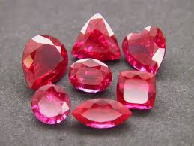
The Wise!
Know by Fruit!
Sound/Objective!
Have Self-Control!
Numerous!
Imperfect!
Experienced!
Bring Blessing!

Slide 6
God’s Answer!
Surround Yourself with Wise Counselors!
Depend on the Wonderful Counselor!
Grow in Experience and Utilize the Experience of Others!
Diligently Pursue Righteousness!

