Slide 1
A Good Wife:
The Account of Abigail

Slide 2
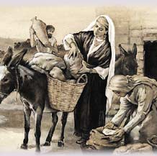
ABIGAIL
“Cause of Joy” or “My Father Is Joy”
Intelligent and Beautiful
Married to Nabal and then to David

Slide 3
1 Samuel 25
Nabal Wrongs David
Abigail Propitiates
David Is Appeased
Nabal Dies
David Marries Abigail

Slide 4
Abigail’s Qualities
Respected
Able To Soothe Anger
Great Faith
Assertive and Decisive
She Didn’t Hesitate
Cared For Her Household
Humble and Meek

Slide 5
Abigail Challenges Modern Women
To Become Women Whose Presence Is A Blessing
To NOT Become Cynical And Harsh
To Soothe The Angry And Irritated
To Help Others Find Greater Meaning And Purpose
To Have Faith, Meekness, Generosity, Concern, Sympathy, Grace, And Charm
To Possess Joy In God
To Remain Faithful Despite Their Circumstances

