Slide 1
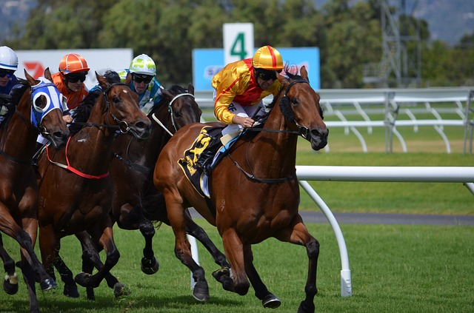
No Dice On Gambling!

Slide 2
True Gambling
“To game for money or stakes”
Deliberate, Uncertain, Arbitrary
Not Determined By Degrees
Not Equivalent To Risk
e.g. Stocks, Insurance, Farming
“What’s Wrong With It?”
“The Bible Doesn’t Mention It!”

Slide 3
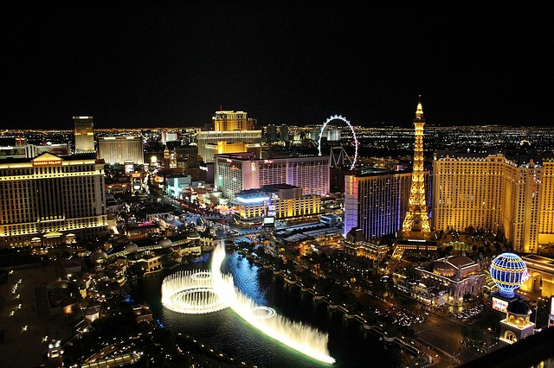
One Key Argument Against
God Authorizes Three Ways of Obtaining Wealth:
The Law Of Labor
The Law Of Exchange
The Law Of Goodwill
Where Does Gambling Fit?

Slide 4
Four Additional Arguments Against
1. Principal of Stewardship
2. Improper Influence
3. Greed
4. Idolatry

