Slide 1
OLD PATHS

Slide 2
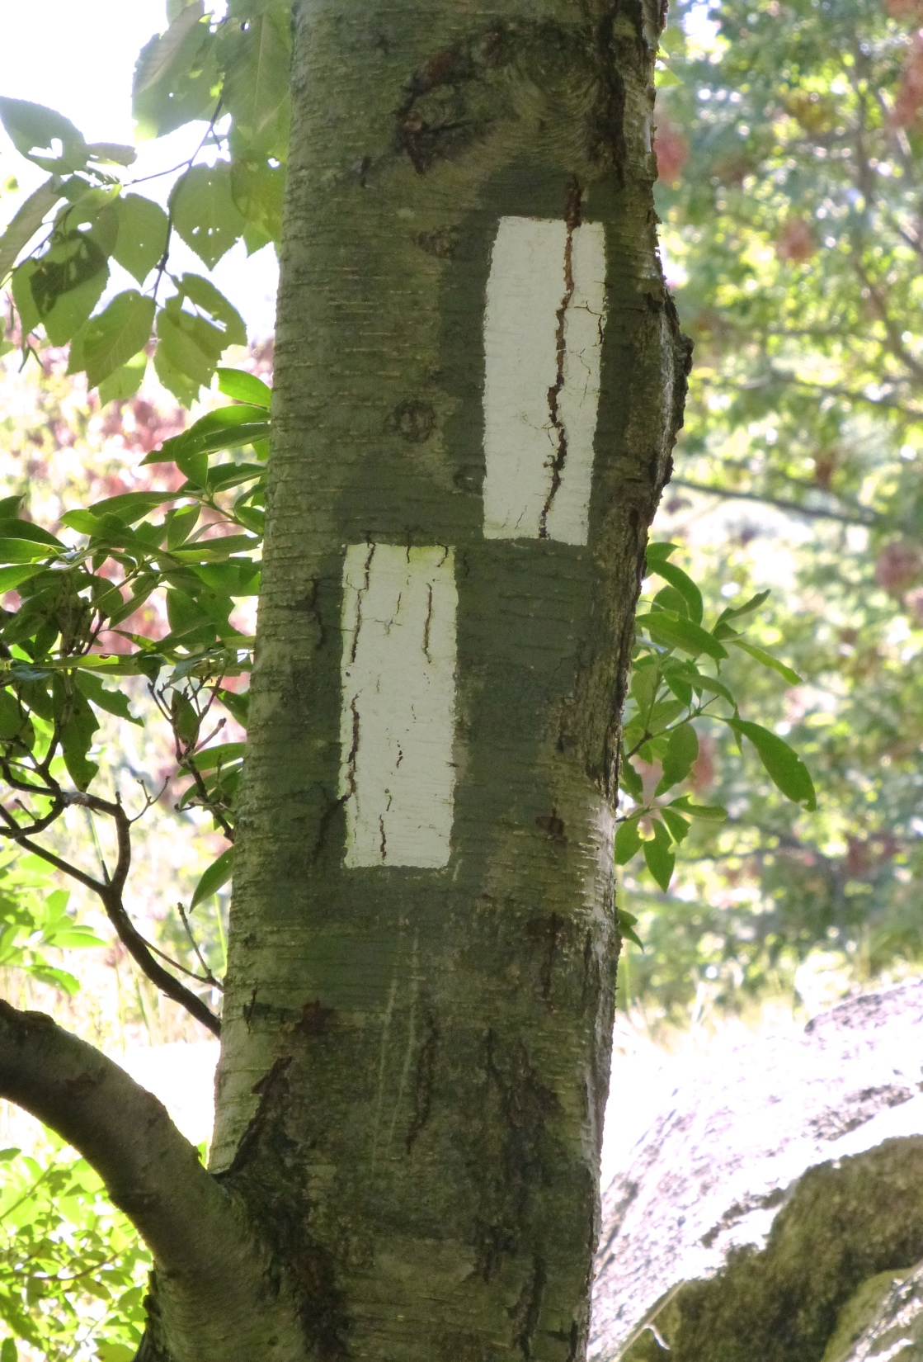

Slide 3
It Is Called The Path
The “good old way”. Opposes wicked way (Ps. 36:4; Is. 57:20f)
Must be the way of Scriptural piety (Ps. 119:1, 165).
Faith working in love (Gal. 5:6).
Belief of Christ in all His offices (Mt. 11:28-30; Jn. 1:12).
Walks in Him as we have received Him (Col. 2:6). Love for God & for mankind (Matt. 22:36-39). The sum of all God’s precepts (Rom. 13:10; Matt. 22:40).
Called a path because it leads to a destination. That goal is the eternal life (Rom. 2:7; Ps. 84:11). It is the only way; there are no shortcuts, back-roads, or recalculations of the spiritual GPS (Heb. 12:14; Mt. 7:21).

Slide 4
It Is Called Old
God’s good way is not dispensational.
Special emphasis: The new covenant signed two millennia ago.
Jesus discussed the old path (Jn 14:1-6; 15:12).
Apostles preached the old paths (2Pet. 1:5-7; 1Jn 3:23).
Foreseen in Moses (Heb. 11:24-27; Dt. 6:4f; Lev. 19:18)
The Patriarchal Age: Noah, Enoch, and Abel

Slide 5
It Is Called Good
Those who walk in this way are called good because they do good (James 3:17; Eph. 5:8f) They, as a general rule, prove to be blessings to their family (Deut. 5:29), country (Prov. 14:34), & the world (Matt. 5:13f).
The Good Way By Default.
Divinely originated in infinite goodness (Ps. 143:10).
Good in tendency to grant happy results (Pro. 19:23)

Slide 6
God’s Commands Respecting It – “Stand in the ways and see…”
Facts Assumed:
Only ONE Good Way
Everybody’s Problem (Is. 53:6)
Our Ignorance (Jer. 10:23).
God’s Help
Duties Enjoined:
Stand!
See!
Ask!
Walk Therein!

Slide 7
The Destination & Encouragement – “And you will find rest for your souls”
1. Gracious Rest in this world:
From the Anguish of Guilt (Is. 9:1) & Satan’s Oppression (Mt. 11:28)
From Tormenting Fears (Ps. 34:4) & Inward Ruin (Jn. 15:2; 1Jn. 1:9)
Rest in the Pleasant Service of Beloved Master (Mt. 11:30; 1Jn. 5:3)
2. Glorious Rest in Heaven (Heb. 4:9)
From All Temptation (Job 3:17)
From All Suffering (Rev. 21:4)
From All Danger (Mt. 6:20)

Slide 8
The path of righteousness is actually the OLDEST path. Sin was a new and ungodly innovation brought in by Satan for the purpose of leading and condemning men to Hell. Submission to the yoke of Christ is the good way. Won’t you choose the old path today by submitting to Christ?

