Slide 1
Ruth:
An Illustration of Choice

Slide 2
A Fascinating Case Study
“[Ruth] is of special interest because [she] reminds us that King David was a descendant of [her] and her husband, Boaz. Furthermore, on the human side Jesus could trace his ancestry back through Ruth (Matthew 1:5). Thus the book tells us that the messianic family from which over a thousand years later the Messiah was born included someone who was not a Jew.” (The Complete Survey of the Bible. Ed, by John Balchin, 47).

Slide 3
A Fascinating Case Study
Demonstrates the importance of decision making from a positive perspective
“But Ruth said, ‘Do not urge me to leave you or turn back from following you; for where you go, I will go, and where you lodge, I will lodge. Your people shall be my people, and your God, my God. Where you die, I will die, and there I will be buried. Thus may the Lord do to me, and worse, if anything but death parts you and me.’” (1:16-17)

Slide 4
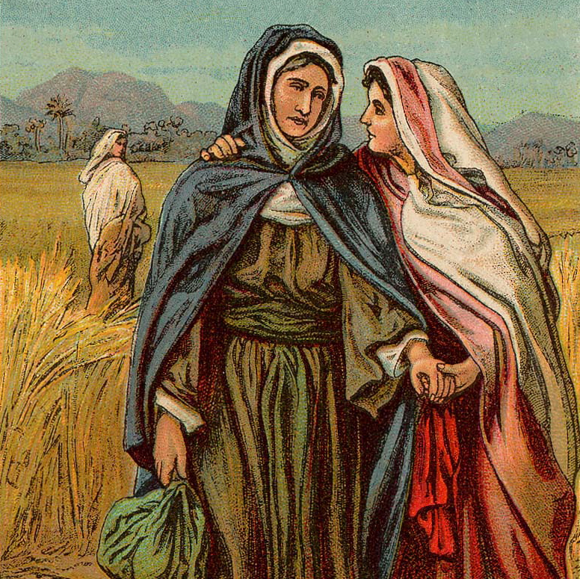
A Personal Choice
“It is our choices…that show what we truly are, far more than our abilities.” (J.K. Rowling)
“Deny self” (Mt. 16:24)
“Wherever you go, I will go” (cf. Phil. 2:7-8)
“We must make the choices that enable us to fulfill the deepest capacities of our real selves.” (Thomas Merton)

Slide 5
A Determined Choice
No excuses! (1:14-15)
Steadfast (1:18)
Compare Paul (Acts 20:24)
We Must Not Pull Back! (Heb. 10:36-39)
We Must Give Priority To God (cf. Acts 20:10-14)

Slide 6
Comprehensive Choice
“Where you go, I will go”
“Your people shall be my people”
“Your god will be my God”
Our choice requires the same sort of sacrifice.

Slide 7
A Choice In Youth
“Young Woman” (2:5, 8)
“Remember also your Creator in the days of your youth…’” (Eccl. 12:1)
“Let no one look down on your youthfulness, but…show yourself an example of those who believe.” (1 Tim. 4:12)

Slide 8
A Choice For All Time
Her Choice Was Not An Experiment
God Demands Such A Determined Choice From Us (cf. Luke 9:61-62)

Slide 9
Ruth, An Example For Us
“One's philosophy is not best expressed in words; it is expressed in the choices one makes... and the choices we make are ultimately our responsibility.” (Eleanor Roosevelt)
“Look for your choices, pick the best one, then go with it.” (Pat Riley)

