Slide 1
Three Reliable Facts And Three Inescapable Conclusions

Slide 2
FACT #1: God Wants Us To Be Saved
“This is good and acceptable in the sight of God our Savior, who desires all men to be saved and to come to the knowledge of the truth.” (1 Timothy 2:3-4)

Slide 3
FACT #2: The Holy Spirit Inspired The New Testament So Common People Can Understand The Plan Of Salvation
“By referring to this, when you read you can understand my insight into the mystery of Christ…” (Ephesians 3:4)
“So then do not be foolish, but understand what the will of the Lord is.” (Ephesians 5:17)

Slide 4
FACT #3: The Bible’s Design Is The Salvation Of Mankind

Slide 5
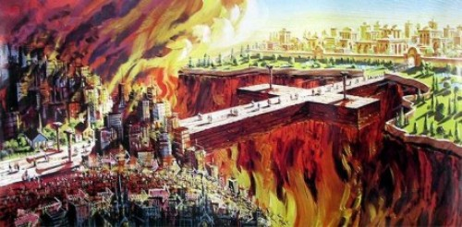
CONCLUSION #1: If God Wants All Man To Be Saved, Then It Will Be Man’s Fault If He Is Lost

Slide 6
CONCLUSION #2: God’s Plan For Man’s Salvation Can Only Be Found In The New Testament.
“God, after He spoke long ago to the fathers in the prophets in many portions and in many ways, in these last days has spoken to us in His Son, whom He appointed heir of all things, through whom also He made the world.” (Hebrews 1:1-2)

Slide 7
CONCLUSION #3: Christ Is The Center Of New Testament Faith
“Come to Me, all who are weary and heavy-laden, and I will give you rest. Take My yoke upon you and learn from Me, for I am gentle and humble in heart, and you will find rest for your souls. For My yoke is easy and My burden is light.” (Matthew 11:28-30)

